Slide 1

Navigating the Credential Maze: Unlocking Career Opportunities with Industry-Recognized Credentials
Notes:
Start Recording
Welcome to today’s webinar, around the updates coming to the CCMA Exam and study materials! Today’s session is being recorded. NHA will send out the recording to anyone who registered for today, we will also post the recording on our website in the NHA Events webpage. We are hoping to have time for open Q&A at the end, so please stick around with us 0 survey = 50$ amazon gift card

Slide 2

Slides sent to you? Click here…

Slide 3
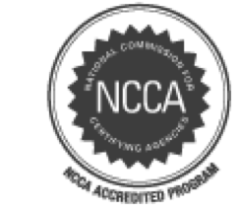







Solutions For Every Step of the Way
Learning &
Assessment
Certification
Preparation Tools
Certification Exam
Continuing Education
& Recertification
Professional Development
CERTIFICATIONS & PROFESSIONS WE SERVE
Medical
Assistant
Phlebotomy
Technician
Pharmacy Technician
Medical Admin.
Assistant
Patient Care Technician
Billing & Coding
EKG
Technician
Electronic Health Records
TRAINING SOLUTIONS
PharmaSeerTM PharmaSeer MathTM
PersonAbilityTM
NHA P360
VitalsTM
TEAM Based
CareTM
Principles of
Health CoachingTM
Medical
Terminology
Anatomy &
Physiology
MA SkillsBuilderTM:
Clinical
MA SkillsBuilderTM:
Admin
MA SkillsBuilderTM:
Complete
Notes:
For those of you who have never heard of NHA or know what we do I thought I would give you a brief overview.
Since 1989, NHA has prepared and awarded more than 1.25M certifications to healthcare students and professionals.
Our Goal is to improve patient care – and as the industry leader, we are passionate about developing and advancing the frontline healthcare worker.
NHA offers everything from Learning & Assessment, to Certification Preparation Tools, to the Certification Exam, Continuing Education & Recertification, and professional development.
At our core we are a certification organization –we have 8 NCCA accredited industry-based credentials. These are credentials that your students can take into the workplace, get jobs, and start right away. We have 5 clinical based certifications (CCMA, CPT, CET, CPCT/A, and ExCPT) and 3 Administrative certifications (CMAA, CBCS, CEHRS).
NHA certification exams are updated regularly to ensure your students have the most current and job-relevant knowledge and skills.
Additionally, we have began creating foundational resources for our programs and their learners – like med term, A+P, personabilty – a soft skills tool, and more.

Slide 4
Healthcare Workforce
College & Career Readiness
Topics
Choose a Credential
Get Started + Resources
Discussion + Questions
Notes:
Ok, let's go ahead and get started..
Hi everyone, my name is Beth Pintner and I am the Account Executive for NHA. I'm pleased to be here with you all today and looking forward to our discussion! I have the pleasure of working with schools to help them implement certifications into their program.
Today we are going to cover these important topics. We will talk though the healthcare industry and their workforce needs, go over how CTE programs are helping to solve these needs. Then we will dig in on Industry Certifications and what you need to know to choose a quality partner + build a program that changes lives.
How does that sound?
If you think of anything that you would like me to cover or have questions while I am presenting, please feel free to raise your hand or write it down as I will have time for questions at the end.

Slide 5





  88M
  1.8 Million
  NEW JOBS
  Healthcare jobs will be among the fastest growing in the United States through 2026.
  Source: US Bureau of Labor Statistics
  170 Million
  People will likely suffer
  a chronic illness by 2030. An increase of 37% from today.
  Source: National Library of Medicine
  48M
  2050
  2021
By 2050, America’s senior population will swell to 88 million, up from 48 million in 2021.
Source: National Institute of Health
  Healthcare occupations and those associated with healthcare account
  for 13 of the 30 fastest growing occupations from 2019 to 2029.
  Source: US Bureau of Labor Statistics
  Registered Nurses and Doctors are
  Only 33% of the Healthcare Workforce.
  Source: US Bureau of Labor Statistics
Notes:
We often hear about the serious need for more workers in healthcare. Here are some reasons why… by 2050 America’s senior population will almost double from what it is today and more than 150 million individuals will be managing chronic illnesses – like diabetes, heart disease, and COPD. Leading to the need for more providers. But note: only 33% of healthcare careers are made up of Doctors and nurses. All the rest of these needed roles include allied health professions.
So, let’s talk about some of the critical front-line roles needed to ensure quality patient care…

Slide 6
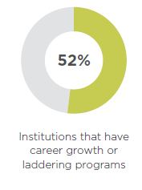

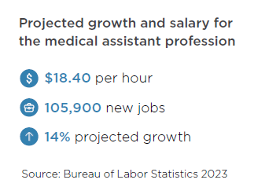
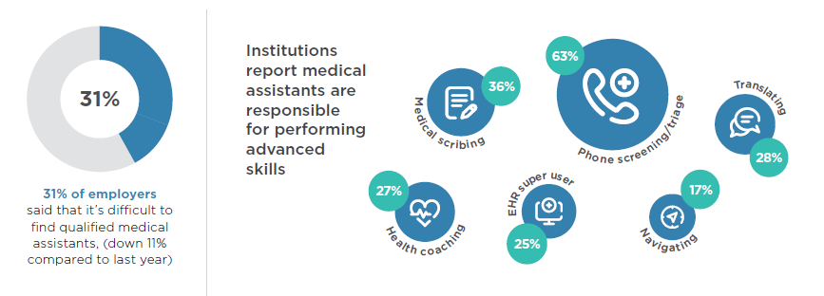
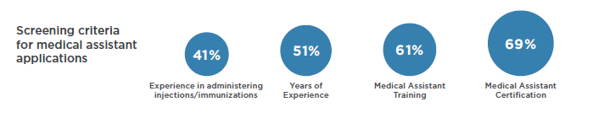

Notes:
Medical Assisting is one of the fast-growing allied health careers.
Medical Assistants are health care professionals who assist doctors in clinics and medical offices. They may show you to the exam room, take your vital signs, check your height and weight, ask you about your symptoms, and health concerns and pass that information on to your doctor.
This profession is growing at a rate of 19.2%, compared to the average market which is growing around 3%, you can see the median salary range across the US is just over 37K.
https://datausa.io/profile/soc/medical-assistants#growth

Slide 7
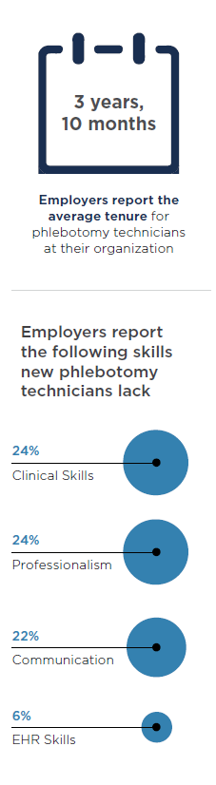

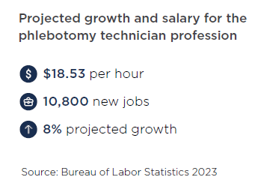
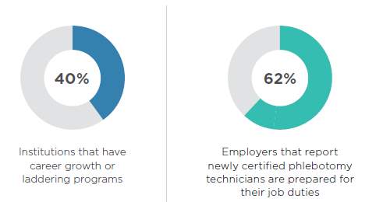
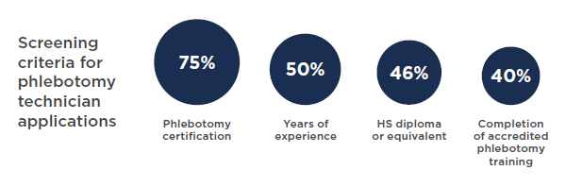
Notes:
The 2nd is Phlebotomy Technician. Phlebotomy Technician is really interesting because this is something every health profession needs to know how to do (except of course the administrative side). They need to know how to take a stick or draw blood. This is a great frontline opportunity for students. It is growing at a rate of 17.3%, the average salary here is $33K almost $34.
80% of employers report that their phlebotomy technicians are certified.

Slide 8
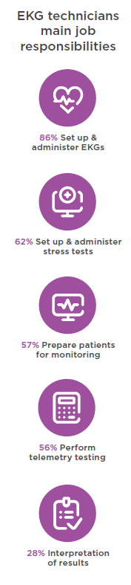
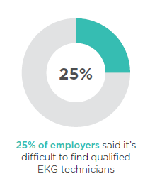

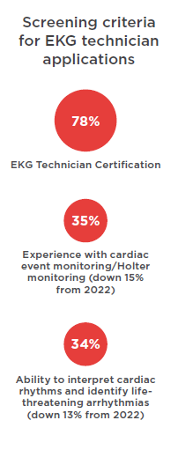
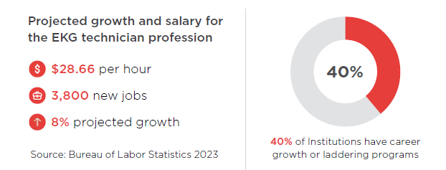
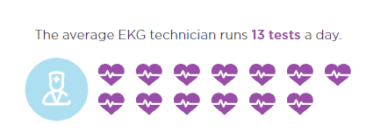
Notes:
The 2nd is EKG Technician. EKG technician is someone that sets up and administers EKGs. This is a great frontline opportunity for students. The average salary here is $56K almost $57K.
79% of employers report that their EKG techs are certified and 75% of employers report that newly certified EKG technicians are prepared to do their job duties. So they really believe in certification.
I love this stat that an average EKG technician performs around 13 tests a day.

Slide 9
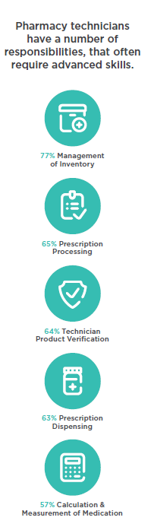

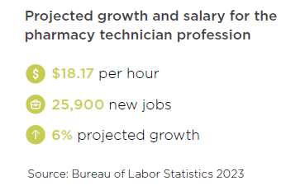
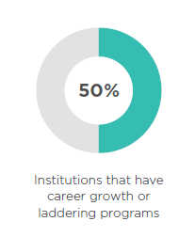
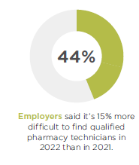
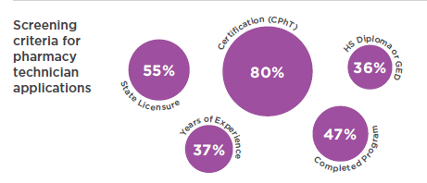
Notes:
And the 3rd profession I wanted to highlight was Pharmacy Technician …. This is another field that is growing quickly.
I love this role because for the students that want to go on and become a Pediatric Neurosurgeon is really going to benefit from earning a Pharmacy Technician certification. They have to know all the Drugs and all the formulas and can really help them get a leg up in medical school or getting access to a competitive program and we need more Pharmacy Technicians.
These are just a few examples of fast growing professions we serve.

Slide 10
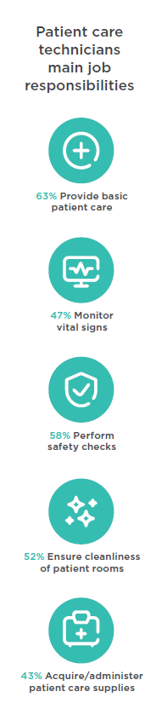

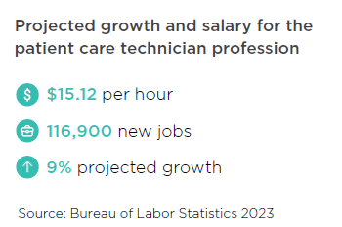
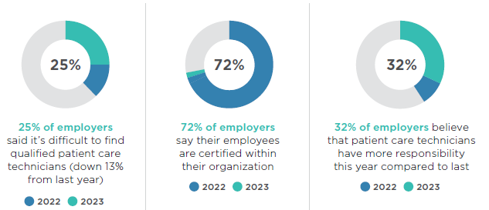
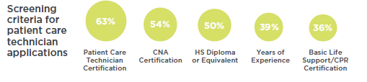
Notes:
The 4th role I want to highlight is Patient Care tech, 78% of employers require or encourage certification for patient care technicians. (Source: 2020 Industry Outlook). Healthcare is evolving, and patient care technicians are in higher demand than ever before. Patient care technicians are also facing increasing responsibilities in their role due to a shortage of LPNs in hospitals combined with the increasing patient hospitalizations. Patient care technicians who are NHA certified (CPCT/A) are better prepared to tackle these responsibilities than CNAs or PCTs who are not certified
Other job titles with scopes that a CPCT/A can fulfill or exceed include:
•Certified Patient Care Assistant
•Home Health Aid
•Certified Nursing Assistant
•Patient Care Associate
•Patient Care Assistant
•Home Health Assistant
Doctors, nurses and other healthcare professionals rely on patient care technicians to assist with the critical day-to-day care some patients require. They provide hands-on assistance to serve patients' basic needs, which greatly impacts the lives of their patients and their patients' families. As a patient care tech, you may be able to perform some or all of the following tasks:
•Provide basic patient care — bathing, feeding, catheter care, etc.
•Acquire, distribute and administer patient care supplies
•Perform safety checks and ensure cleanliness in patient rooms
•Accommodate any additional patient needs
•Obtain EKG readings and monitor vital signs
•Perform phlebotomy procedures
•Provide emotional support to patients and families,
particularly coping with grief and death

Slide 11
Healthcare
Workforce
Notes:
Before I get started, I would love to learn more about you and what your role is. By Show of hands, how many in this room are District leaders? Classroom teachers/Coordinators? Any other roles that I am missing?
[this will help you understand what your audience make up is. If heavier in teachers – you might lean more into product details. If leaders = outcomes.]
Okay awesome, Welcome! I am excited to learn from each of you as well as share with you some content.
Since some of you are health science instructors you are probably aware of what is going on within the healthcare space. As CTE directors you may or may not have a background in health science, so I am going to share with you a little bit what is happening in the health care space.

Slide 12


Coming in 2024/25
NEW Patient Care Technician Competition

Slide 13
Education
  NHA has certified over 250,000 CTE students in allied health professions.
29%
54%
30%
In 2024, healthcare training programs are projecting over 29% enrollment growth year over year compared to 2020.
  54.3% of healthcare occupations require less than a bachelor's degree as a hiring prerequisite.
  Over 30% of healthcare occupations require only
  a license, training, or
  non-degree award.
Notes:
Healthcare training and Education is needed now more than ever! Many front line professions do not require a bachelors degree and 30% of them require only training and a license or industry certification

Slide 14


Certification: Industry Credentials
  Credentialing serves as a nationally recognized standard for
  competency in quality of care.
According to an annual industry study performed
by NHA, 74% of employers surveyed encourage
or require certification upon hire.
  63% of organizations increase pay when an employee earns professional certification.
Notes:
Where these entry level healthcare professions are non-degree level professions, employers still must maintain quality patient care and for this, they lean on credentialing.
Credentialing serves as a nationally recognized standard for competency in quality care.
According to an annual industry study performed by NHA, 74% of employers surveyed encourage or require certification upon hire.
And 63% increase pay when the employee earns professional certification.

Slide 15
College + Career Readiness
Notes:
So that is a little bit about the healthcare landscape. Now, how do we help students become career and college ready.
Employers are looking to secondary educators to help them bridge the workforce gap. They are seeing the value in partnering with school districts and CTE programs to add to their candidate pool.
Working as partners helps remove barriers, like age requirements to help facilitate externships and hands-on learning opportunities.

Slide 16
Most popular industry-recognized professional credential exams offered in CTE healthcare programs
33%
Pharmacy Technicians
33%
Phlebotomy
56%
58%
Medical Assistant
33%
Patient Care Technician
49%
Nursing Assistant
33%
EKG Technicians
Of the students who complete a CTE Health Science Pathway: 56% work in healthcare.
Most students go straight into the workforce after high school
24% Work
35% Post-secondary Education
32% Work + Post-sec Education
5%
5%
Military
Other
Source: NHA access article: https://info.nhanow.com/learning-leading-blog/pathways-through-cte-across-america
Notes:
This slide is a summary of a survey we did with some of our CTE partners.
This shows us some of the outcomes of the programs we work with. In a survey summarized here, 56% of CTE students work in the Healthcare profession after high school, either full time or while perusing their post-secondary pathway. For employers, this means they can grow their own leadership and develop an individual throughout their HC career.

Slide 17







Since 2013 NHA has certified over 180,000 CTE Candidates
Average of 30,000 per Academic Year (AY)
34,000 Certified Medical Assistants (CCMA)
AY: 8,500
33,000 Certified Medical Administrative Assistants (CMAA)
AY: 3,000
34,000 Certified EKG Technicians (CET)
AY: 5,100
29,000 Certified Phlebotomy Technicians (CPT)
AY: 5,200
20,000 Certified Patient Care Technicians (CPCT/A)
AY: 5,300
6,000 Certified Pharmacy Technicians (CPhT)
AY: 1,618
3,500 Certified Billing & Coding Specialists (CBCS)
AY: 300

Slide 18

NHA + Texas educators solving for workforce needs
NHA + Texas CTE
Approved Industry Credentials
Medical Assisting (CCMA)
Pharmacy Technician (ExCPT)
Patient Care Technician (CPCT/A)
EKG Technician (CET)
Phlebotomy Technician (CPT)
Billing and Coding Specialist (CBCS )
71,000
The number of CTE students we have certified Together!
80,000 National Employers Recognize NHA credentials when hiring.
HCA Healthcare
Labcorp
Walgreens, CVS
UnitedHealthgroup
700
Texas CTE Schools Partner with NHA
Notes:
Read slide -
Your students are the future of healthcare. Providing your health science students access to an California approved industry-recognized credential gives them access to hands-on experience, increased postsecondary attainment opportunities, and can empower them to enter a high-wage, high-demand profession.

Slide 19

NHA + CTE
38 State Departments of Education formally recognize NHA Credentials
NHA + CTE
Medical Assisting (CCMA)
Pharmacy Technician (CpHT)
Patient Care Technician (CPCT)
Phlebotomy Technician (CPT)
EKG Technician (CET)
Billing + Coding (CBCS)
Electronic Health Records Specialist (CEHRS)
Medical Administrative (CMAA)
249,320
The number of CTE students we have certified Together!
3,037
CTE Schools Partner with NHA
80,000 National Employers Recognize NHA credentials when hiring.
Ascension
Banner Health
CVS
Walmart

Slide 20


Top 3 skills and experiences that students report gaining in their CTE classes are:
1
Skills to help them
get jobs in the future
2
Real-world experiences
3
The chance to work as part of a team
R
Notes:
Not only do students earn their Industry based credentials but they also report having the opportunity to gain real work experiences, learn how to be on a team, and skill up for jobs they can access right now. On top of them earning the wages aligned to their professional certification, they also often gain access to benefits and employers tuition assistance or scholarships.

Slide 21
Health Science Credentials
Notes:
The first step to building these quality experiences for your students is to start involving the employers in your market in your program. This can take on many different levels of relationships and interactions.

Slide 22
Choosing Credentials
Steps to Implementing Credentials
Align with Workforce
Get Started
Resources
Celebrate!
Notes:
In this section we will talk through the steps to take in your program to provide access to certification for your learners including how to choose a certification provider, align with the work force, and how to get started…

Slide 23
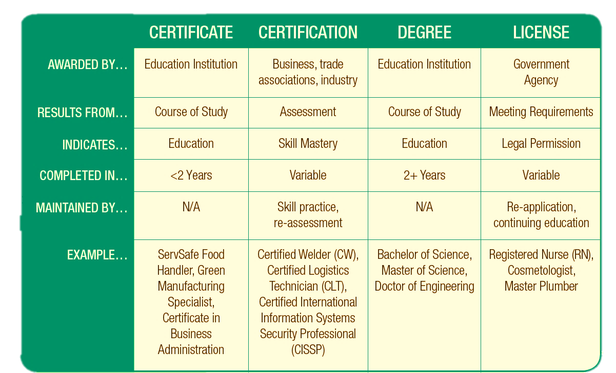
Source: ACTE “what is a credential?”
Notes:
https://www.acteonline.org/wp-content/uploads/2018/02/What_is_a_Credential_71417.pdf
As you start this journey, please note there are many terms and non-degree options available to schools and students.
I often get asked what is the difference between a certificate and a certification. A Certificate is something you earn after you complete a course. Earning your certification is more than just completing a course. Certification, or sometimes called an industry certification is an assessment, that validates a skill or set of knowledge that has been obtained by a learner as aligned to a specific profession. Certifications have a set time in which they expire and need to be maintained through continuing education to continue to be active.

Slide 24
Choose a Credential Provider
Industry Recognition
Accreditation
Accessibility
Educator
Support +
tool kits
Supporting
Resources + Tools
Pre–exam and post-exam Reporting Tools
Continuing Education & Stackable Credentials
Notes:
Some important things to consider when evaluating a certification provider…
Accreditation
Offers NCCA-accredited certifications
Certification exams meet or exceed accrediting association regulations
Offers multiple certifications for stacking & career advancement
Industry Advocacy
Actively pursues certification and accreditation standards in every state
Partners with employers to promote hiring credentialed candidates
Provides access to job boards, and other career-building resources
Accessibility
Offers multiple pathways to eligibility to sit for an exam
Offers on-site testing
Posts immediate exam results ,allowing job seekers a faster path to earning credentials
Customer Service
Access to experts with online, chat, social media and phone services
Actively communicates important dates for exams, renewal, and continuing education
A dedicated account manager to guide you through the certification process
Supporting Resources
Provides online study guides and multiple practice tests
Free test plans for each certification
Provides self -paced learning, dynamic study drills, critical thinking exercises, remediation tools, and examples of real world application of concepts
Analytic Support
Provides analytics for individuals, classes and cohorts
Provides year-over-year data to measure overall program performance
Provides personal remediation tools directing students back to concepts they still need to master
Additional Credentialing Opportunities
Offers multiple NCCA-accredited certifications
Keeps you up-to-date on renewals and continuing education
Makes it easy to keep track of all your certifications under one roof

Slide 25

Career Technical Education and credentials
create a viable healthcare workforce.
Provisional Certification
A candidate who is scheduled to graduate from an accredited high school may take the certification exam and receive a Provisional Certification up to twelve (12) months before graduation as long as all certification eligibility requirements are met.
Provisional certification is a placeholder and is intended to allow candidates to take certification exams as near to the time they complete their training even though they have not yet met the eligibility requirement of holding a high school diploma or its equivalency needed to receive a standard (full) certification.
*Pharmacy Technician does not qualify for the Provisional Pathway
Notes:
In the high school space we have a special status that allows students to sit for their certification prior to the completion of their program.
What this means is a candidate who is scheduled to graduate from an accredited high school or GED program may take the certification exam and receive Provisional Certification up to 12 months before graduation.
***This is the same certification that a student would obtain at the post secondary level or through their employer.
Please note – our eligibility requirements do not have an age requirement
What questions do you have around provisional certification?

Slide 26
Career Technical Education and credentials create a viable healthcare workforce.
Provisional Certification
A candidate who is scheduled to graduate from an accredited high school may take the certification exam and receive a Provisional Certification up to twelve (12) months before graduation as long as all certification eligibility requirements are met.
Provisional certification is a placeholder and is intended to allow candidates to take certification exams as near to the time they complete their training even though they have not yet met the eligibility requirement of holding a high school diploma or its equivalency needed to receive a standard (full) certification.
Notes:
IN the high school space we have a special status that allows students to sit for their certification prior to the completion of their program.
What this means is a candidate who is scheduled to graduate from an accredited high school or GED program may take the certification exam and receive Provisional Certification up to 12 months before graduation.
***This is the same certification that a student would obtain at the post secondary level.

Slide 27



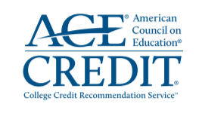
College + Career Readiness
5 NHA Certifications Now Qualify for Post-secondary College Credits
It allows individuals who have passed an ACE approved NHA certification exam to earn college credit for that work.
That work will be captured in the form of an ACE transcript that works in the same way as a traditional college/university transcript.
These credits can be used to meet continuing education (not for NHA recertification) or career development requirements (for employers) or could potentially be transferred to an institution of higher learning and count towards completion of an associated degree.
Medical
Assistant
Phlebotomy
Technician
Patient Care Technician
EKG
Technician
Electronic Health Records
Notes:
5 NHA Certifications now qualify for Post-Secondary College Credits through ACE Credit.
CCMA: 5 credits Lower division baccalaureate/associate degree
CET 2 credits
CPT: 2 credits Lower division baccalaureate/associate degree
CPCT/A: 1 credit
CEHRS – 2 credits
ExCPT: 2 Credits – Vocational

Slide 28
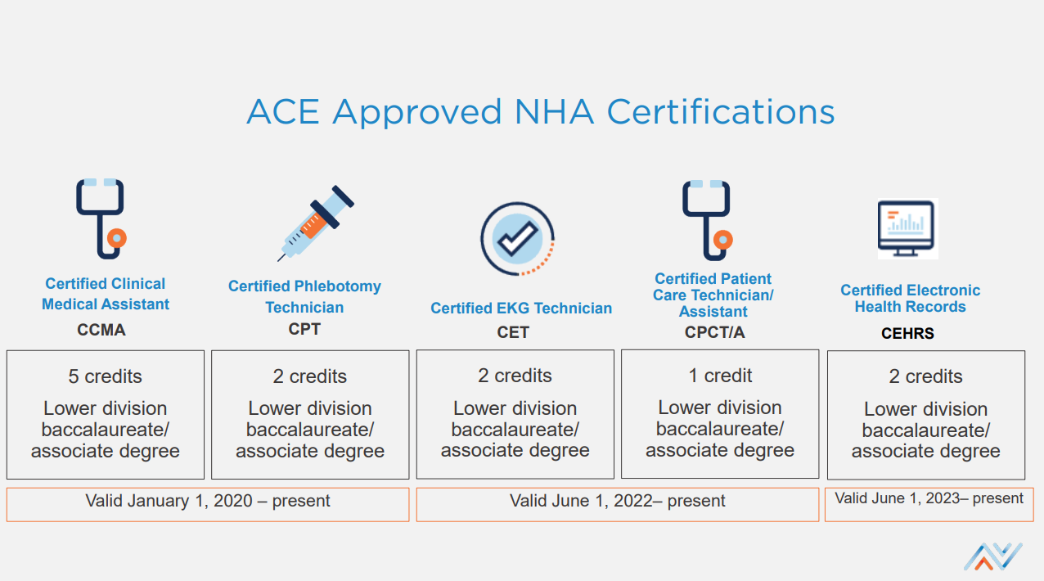
College + Career Readiness
For more information, visit
https://www.nhanow.com/certification/Before-After-Certification/ace-credit

Slide 29
ALIGN WITH WORKFORCE
Notes:
So now that you have taken the time to review what qualities you want in a certification provider the next step is to see which certifications align best in your program.
Preconceived [teacher assuming no] ideas about teenagers (stereotypes) and their training are the biggest barrier combined with Age requirements: 18 (Insurance rules), HIPPA – students interacting with families of peers, Vaccinations (TB, standard vacs)

Slide 30
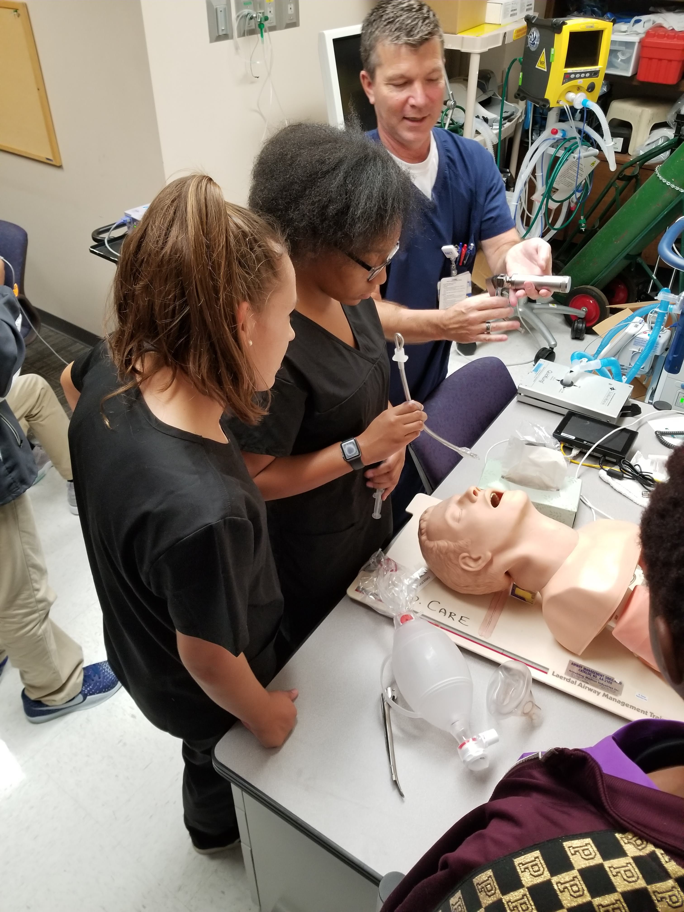
Local Workforce Needs
Employers
Clinical support help?
  Medical Asst vs Patient Care Tech
Administrative Support
  Administrative Assistant vs Billing + Coding
Employer Recognition of credential
Skill set alignment
Engage Certification organization
Program Support
Notes:
Check job demand in your area – build partnerships for externship or provide opportunities for students to get hired right away.
What is the need for Medical Assistants vs Patient Care Technicians? Administrative Assistant vs Billing and Coding.
Set standards and expectations within the team to align to the level of student. Encourage trainers to engage the students and give them learning opportunities.

Slide 31

Utilize Networks
Who do you already know?
  Current and former employers
  Colleagues – peers
  Other educators
Who can you get to know?
  Chambers of Commerce
  Workforce organizations
  non-profit or advocacy groups
  Where are the jobs?
Don't forget your school administrators!
Notes:
Start with what you already know!
As an individual you have a vast network of contacts – this is a great time to put them to work!
From your large health systems, to your mom and pop Pharmacies, getting to know these organizations and their need for quality employees is important. But do not fear, we are not suggesting diving into car sales mentality and dialing up every one you know. A great first step is scheduling coffee or a call to talk about the challenge of helping your students gain access to more extensive learning.

Slide 32

Location Types
Ambulatory Care
Simulation Training Centers
Acute
Care
Long-term Care
Labs
Notes:
Job titles: HR Coordinator, Nurse Educator, learning and development leaders, volunteer coordinators
Where can your students get hands on experience/externships? Outside your normal hospital settings they can go to
Long term care
Hospitals
Clinics – Dr offices
Labs
Simulation training centers at health systems.

Slide 33


Access creates outcomes
“The programs and certifications I earned at Davies Career and Technical High School certainly paved the way for my success thus far in the medical/healthcare field! Becoming a CNA during High School prepared me by giving me the knowledge and skills to perform duties as a Hospital Corpsman, which has been a stepping stone in my career pathway towards Epidemiology and Neuropathology. Between the terminology and pharmaceutical courses in the Davies Health Careers curriculum, they laid the groundwork for my cross training in various clinical settings that I’ve had the opportunities to work in. I’m grateful that I had the resources and training early on in order to not only apply them, but master the tools I was provided.”
— Jasmine Monteiro
Notes:
I always like to share a Student Success Story – Jasmine earned her CNA license and then went on to earn her Patient Care Technician Certification from a CTE school.
When we called to talk to her about doing a webinar for us she was helping the military get their covid vaccines.

Slide 34
GET STARTED
Notes:
What questions do you have about professions?
We get questions like my students aren’t 18 yet so how can they earn a certification or get hands on training?
What are the requirements for Phlebotomy or EKG?
Let’s talk about how to get started!

Slide 35
NATIONAL THERAPEUTIC SERVICES PATHWAY
FRESHMAN
ENGLISH I
JUNIOR
ALGEBRA 1
BIOLOGY 1
STATE HISTORY
SOPHMORE
ENGLISH II
CHEMISTRY
US HISTROY
GEOMETRY
ENGLISH III
ALGEBRA II
PHYSICS
WORLD HISTORY
SENIOR
ENGLISH IV
PRE-CALCULUS
ANATOMY + PHYSOLOGY
PSYCHOLOGY
HEALTH SCIENCE I: INTRODUCTION
SAMPLE PROFESSIONS
Anesthesiologist Assistant
Certified Nurse assistant
Clinical Medical Assistant
Data entry coordinator
Dental Assistant
EMT/Paramedic
Home Health Aide
Licensed Practical Nurse
Message Therapist
Pharmacy Technician
Surgical Technician
INFORMATION TECHNOLOGY APPLICATIONS
HEALTH SCIENCE II: HEALTH, SAFETY + ETHICS
HEALTH SCIENCE III: OCCUPATIONS
HEALTH SCIENCE IV: CAPSTONE

Slide 36
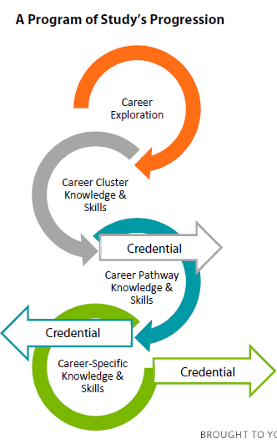
Programs of Study
Consist of an intentional sequence of specialized courses
Link secondary and postsecondary education
Integrate challenging academic and technical instruction
Include dual credit opportunities
Lead to an industry-recognized credential, certificate or degree
Source: https://careertech.org/programs-study

Slide 37
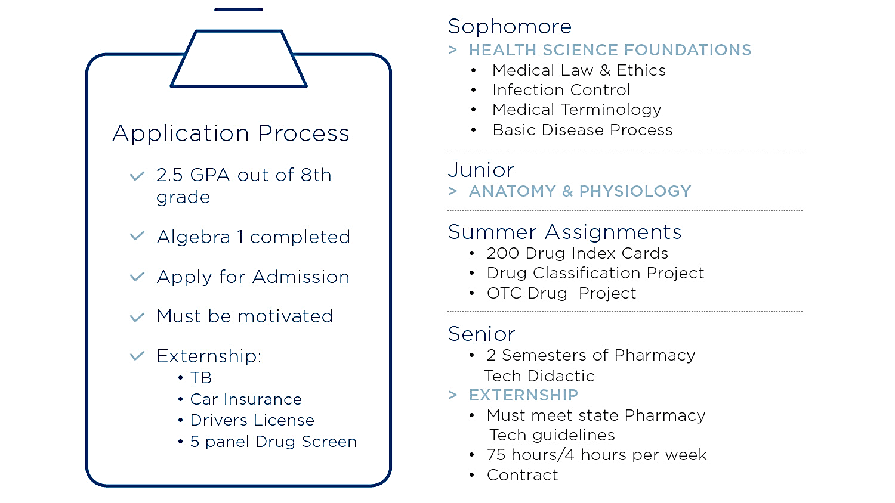
SAMPLE

Slide 38
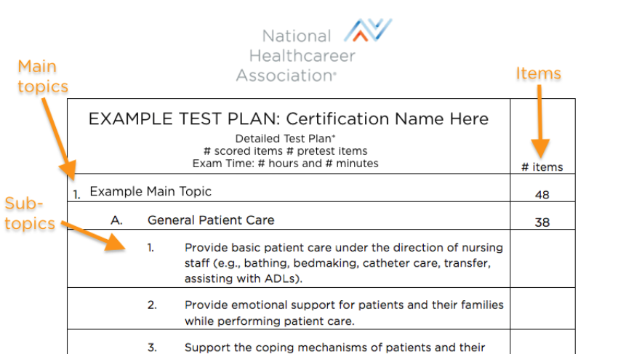
Step 1: Crosswalk the Test Plan
Notes:
The 1st step is to do a crosswalk to the test plan. You can find all 8 of our NCCA accredited industry-based credentials test plans on our website at nhanow.com or schedule a time to meet with me and I would be happy to go over them with you in more detail.

Slide 39
Flexible Pathways
Core Competencies for Medical Assistants
Exploring
Health
Professions
Foundational Knowledge & Basic Science 10%
Anatomy & Physiology 8%
Clinical Patient Care 54%
General Patient Care (31%)
Infection Control (8%)
Testing & Laboratory Procedures (5%)
Phlebotomy (5%)
EKG & Cardiovascular Testing (5%)
Patient Care Coordination & Education 5%
Administrative Assisting 13%
Communication & Customer Service 5%
Medical Law & Ethics 5%
Anatomy &
Physiology
Foundations
of Medicine 1
Foundations
of Medicine 2
Medical Assisting
Notes:
Here is an example of a pathway some of our schools use for Medical Assisting.
Over to the right you can see the main sections of our CCMA Testing Plan, and how this school has built out their pathway to align with the skills and competencies of our test plan. Most schools will create their own curriculum from our test plan and/or use NHA’s training resources, such as Med Term, A&P, MA Skillsbuilder Clinical and Admin.

Slide 40
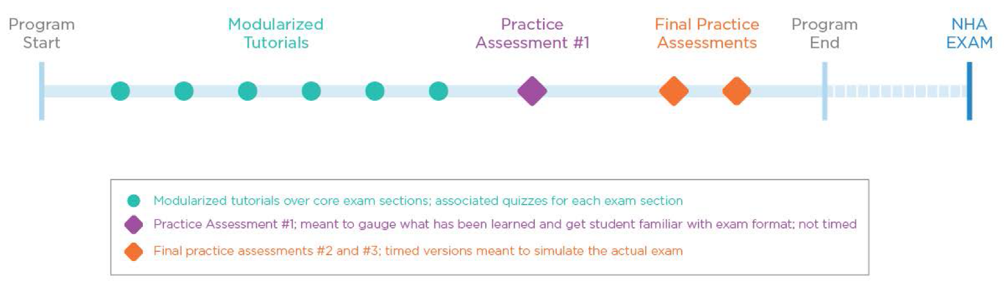
Step 2: Set timelines
Set preferred Exam date
Use tutorials to support curriculum
First Practice Assessment
  Use reporting data
Final Practice Assessments
  Additional reporting
Exam
Notes:
Step 2 is to Set timelines - Start with the end in mind – When will you offer the exam? Senioritis is a real thing.
And then work backwards -
NHA has implementation guides for all 8 of our certifications which come with best practice recommendations and can help with pacing and of course you will have me to help guide and train you along the way as well.

Slide 41


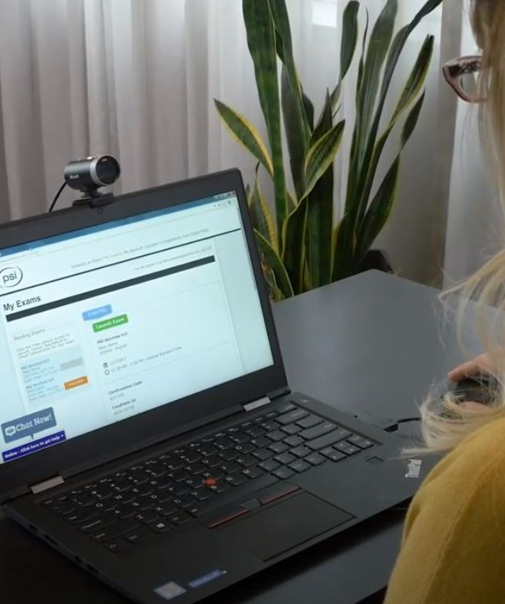
NHA’s Testing Options
On-Site
PSI Locations
LRP
Not applicable for Remote Testing
Not available for ExCPT
Local testing centers
Proctored by PSI Trained Personnel only
Notes:
NHA has always worked to provide flexible testing options.
You can test your candidates on-site, following the appropriate testing guidelines and proctor requirements. If you haven’t already, your institution can complete the Testing Center Attestation and offer the exam onsite. Proctors go through NHA’s proctor training and must follow the compliance guidelines for conflict of interest. This option provides a great resource for testing. I always suggest onsite testing as it is less things for your students to worry about on exam day.
We have been partnered with PSI testing for secure off-site testing for several years. For locations or exams that need to use third-party testing, PSI has always been an excellent option. PSI locations follow strict protocols and requirements, and also have locations around the country.
Our 3rd option is Live Remote Proctoring through PSI. Just like with their on-site testing, LRP will be leveraged entirely through the PSI process and proctors. With Live Remote Proctoring, you can provide your candidates a socially distanced testing option, relieving your institution of the burden of proctoring.

Slide 42
RESOURCES
Notes:
Now let’s talk resources.

Slide 43
Ensuring Success Before, During & After Credentialing
Learning &
Assessment
Certification Exam
Professional Development
Flexible, interactive & assessment-rich solutions​
Facilitator tools & performance reporting
Eight nationally accredited, industry-leading certifications ​
An accessible platform ​
for real-time results​
Resources beyond certification ​
Inspiring new skill development
& fueling career growth​
Certification
Preparation Tools
Continuing Education
& Recertification
Engaging online study and practice assessment tools​
Focused remediation and
robust reporting for administrators & students​
CE that allows certification holders to stay relevant in their jobs & industry​
Expanding skills & keeping
credentials current​
Notes:
As I mentioned earlier, NHA offers everything from Learning & Assessment, to Certification Preparation Tools, to the Certification Exam, Continuing Education & Recertification, and professional development.

Slide 44

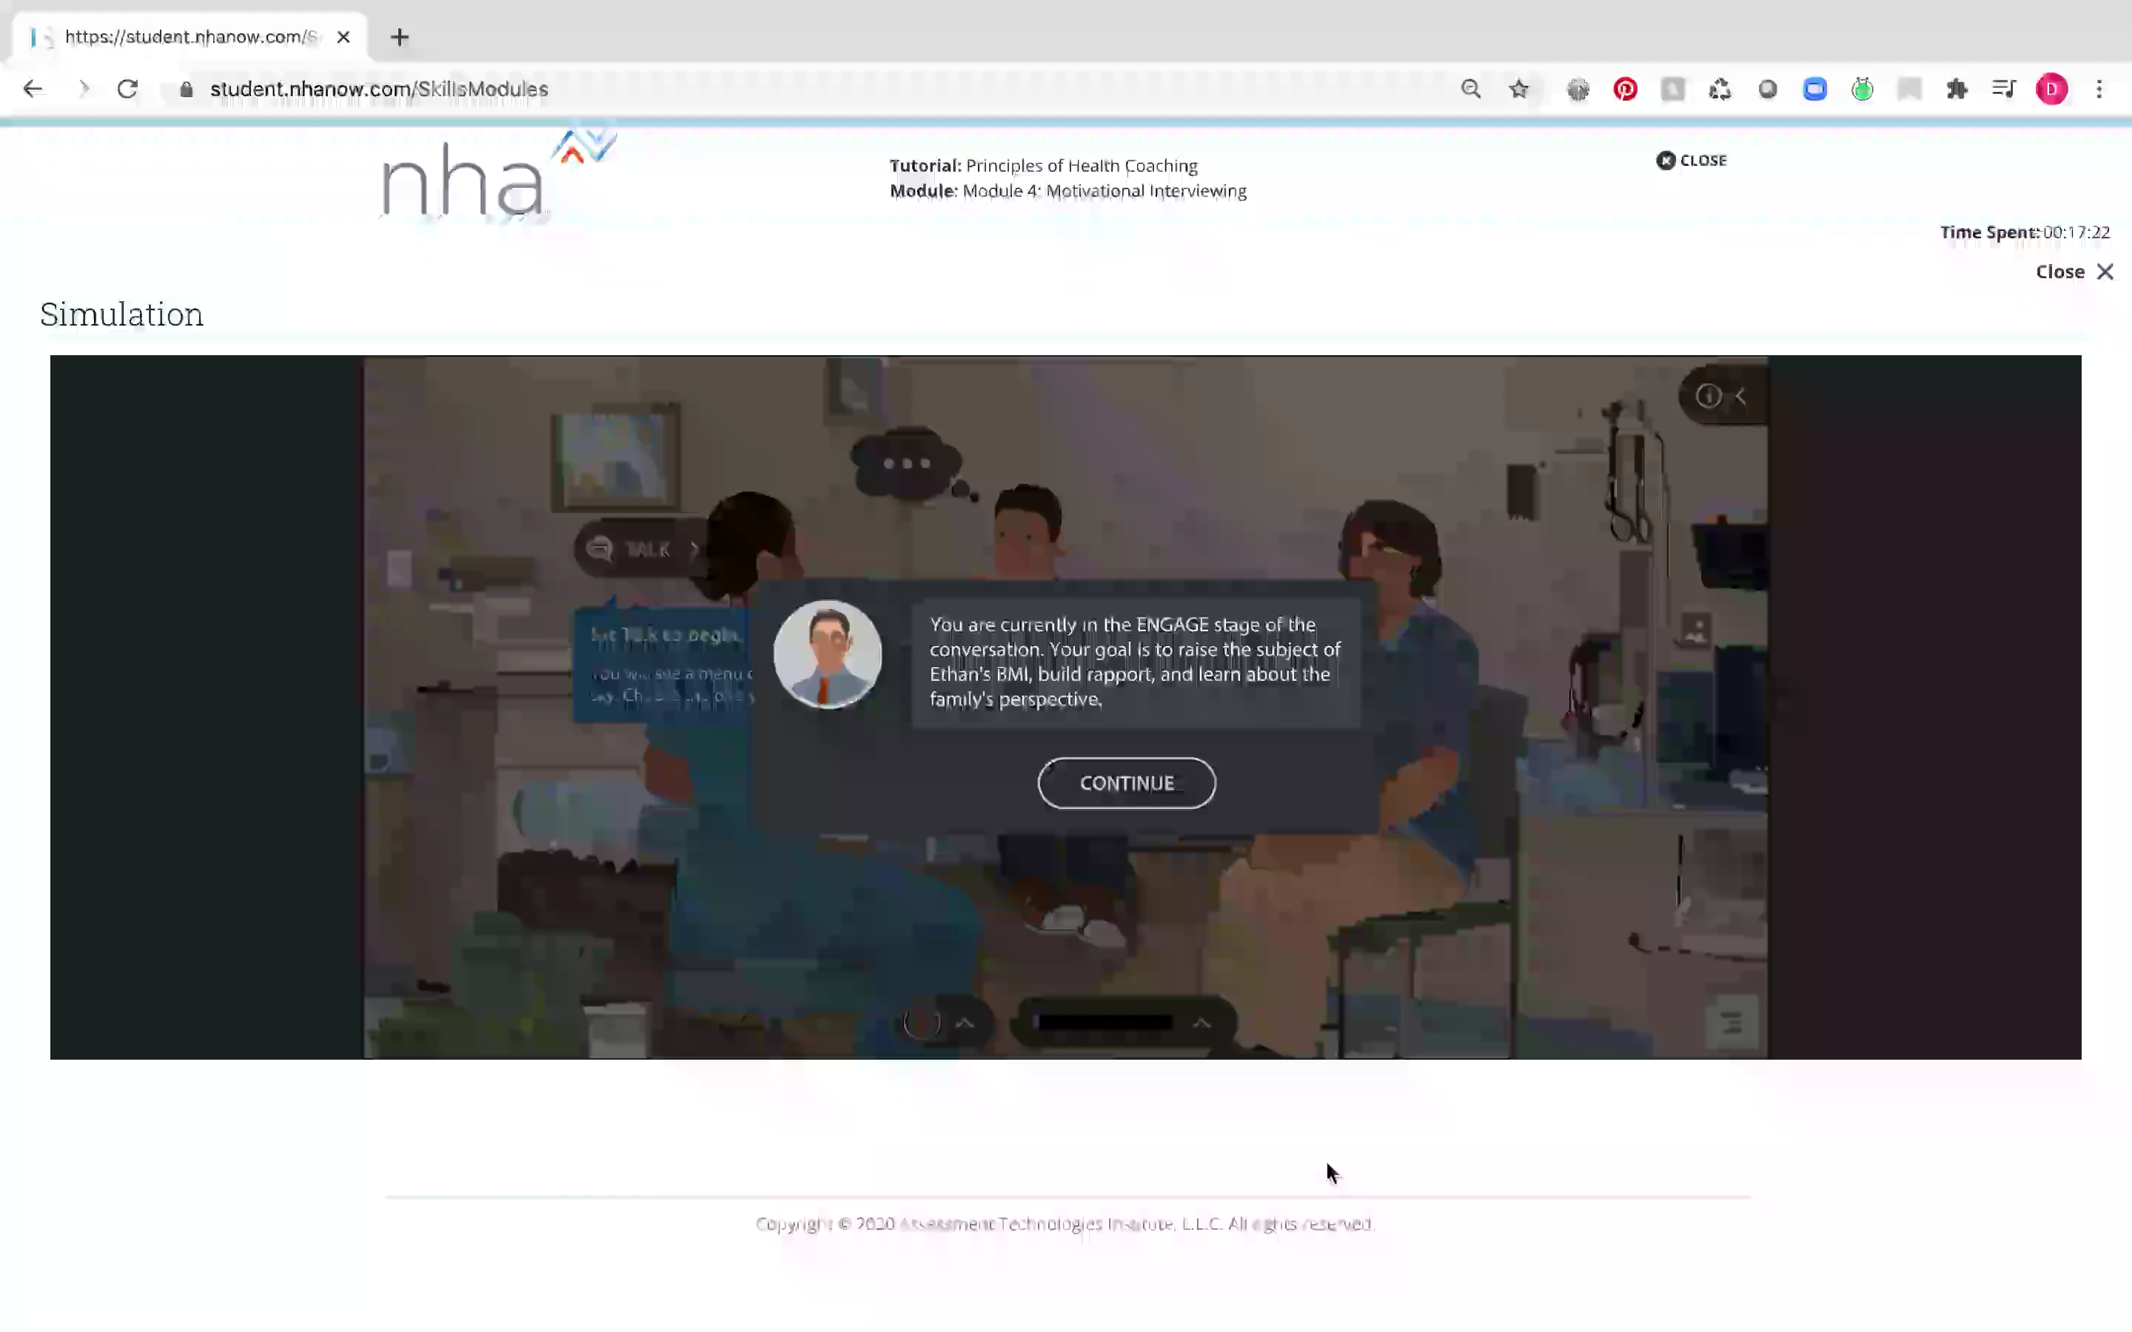

Accessible Online, Engaging &
Interactive Tools for Distance Learning
Secure live remote proctoring | Safe, self-paced practice | Applied learning assessments
Study guide and practice tests | Interactive gaming, flashcards and simulation
Notes:
We have Exam readiness prep materials that are mapped to our test plans.
Our platform encourages safe practice through online prep and practice tests to measure improvement through applied learning assessments delivered in a variety of methods including, quizzing, gaming, flashcards and simulation
Mobile app – we also have a mobile app where students can access flashcards on the go.
Secure Live Remote Proctoring | Safe, self-paced practice | Applied learning assessments |
Online Study guide and practice tests | Interactive gaming, flashcards, simulation

Slide 45
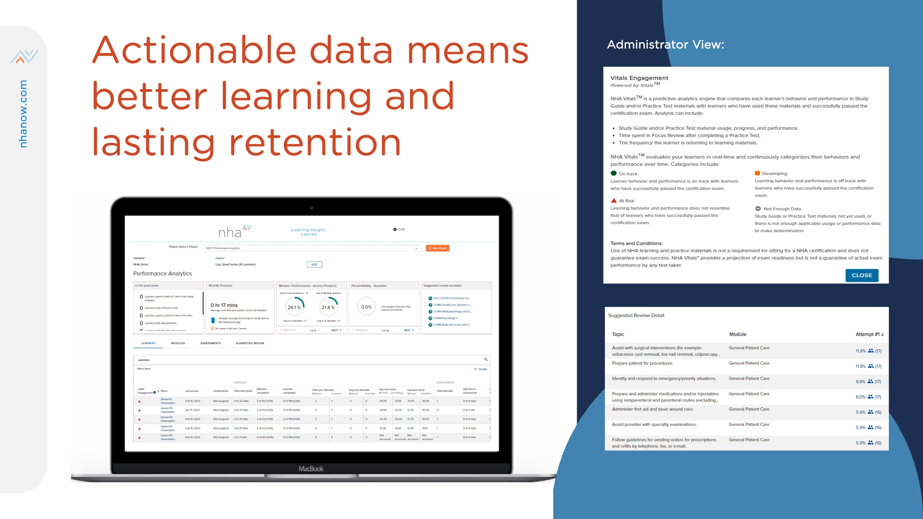
45
Notes:
Because we strongly believe information leads to positive change, we power our solutions with action-oriented data analytics and reporting. We make it easy for you to identify areas of weakness in your program and for your individual learners so you can help coach them to achieve success.

Slide 46
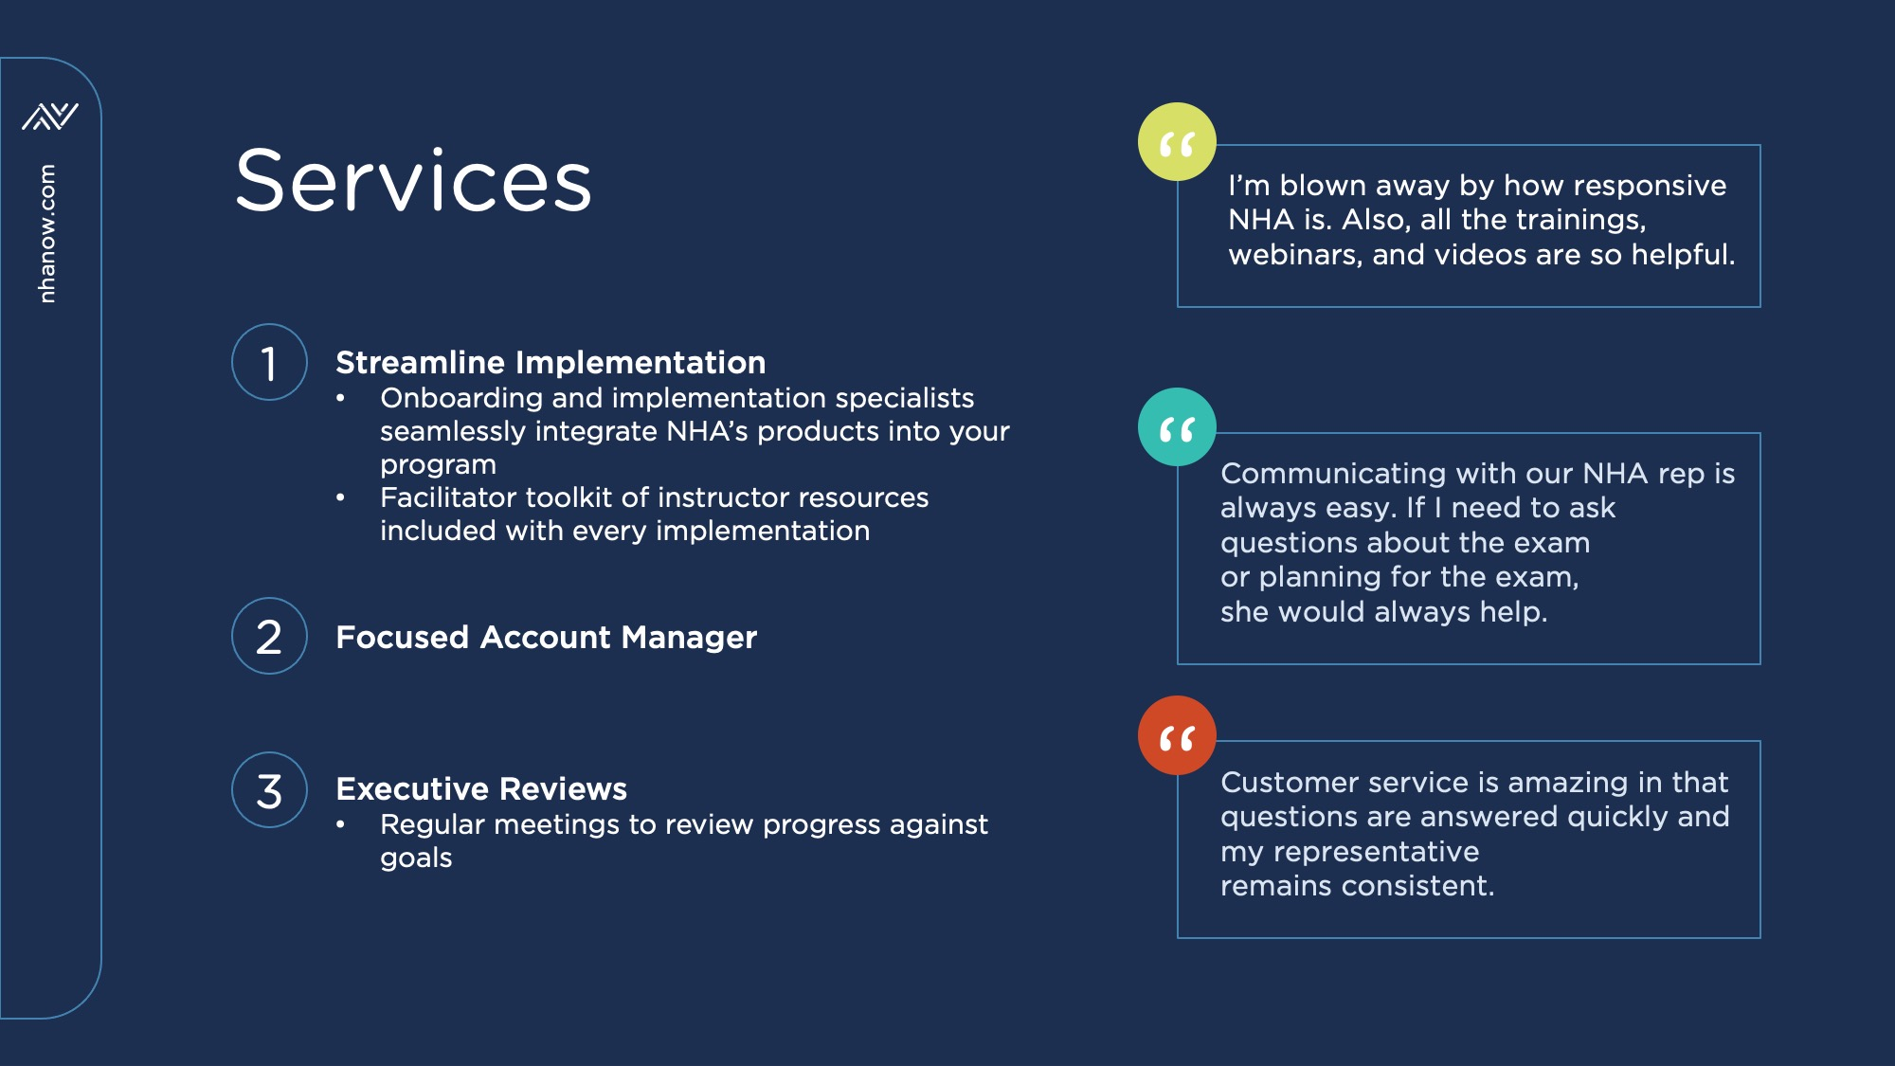
46

Slide 47
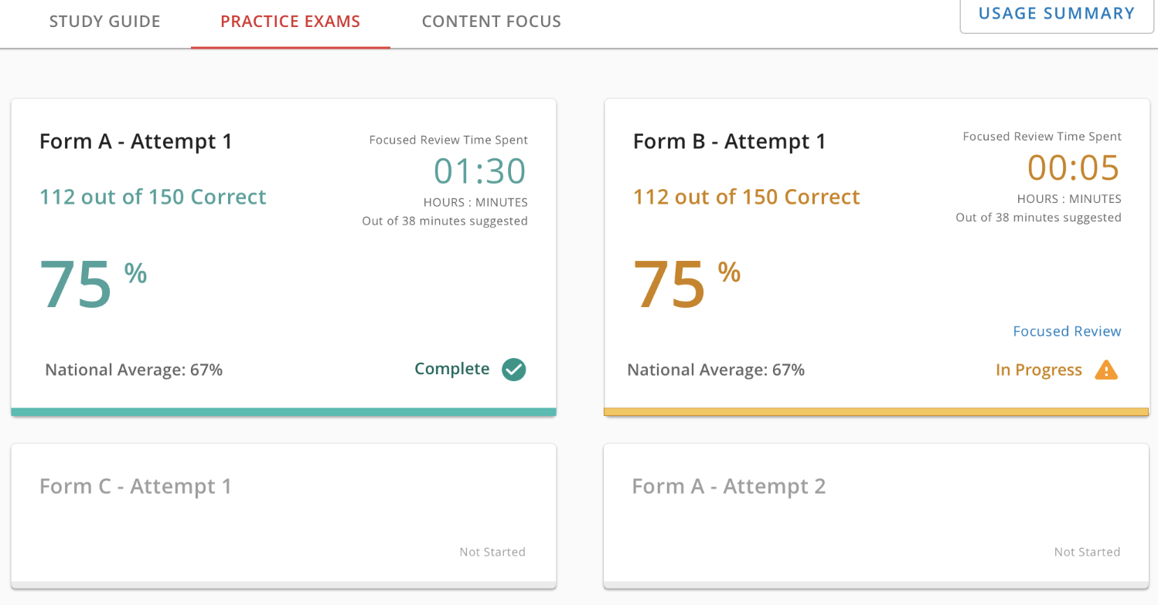

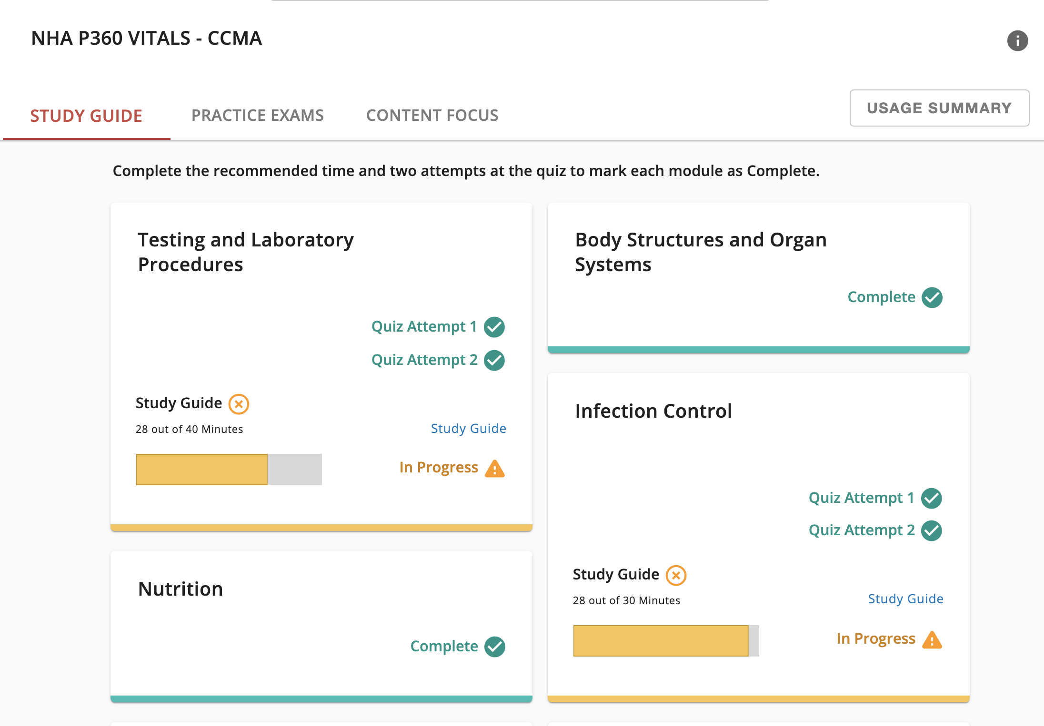
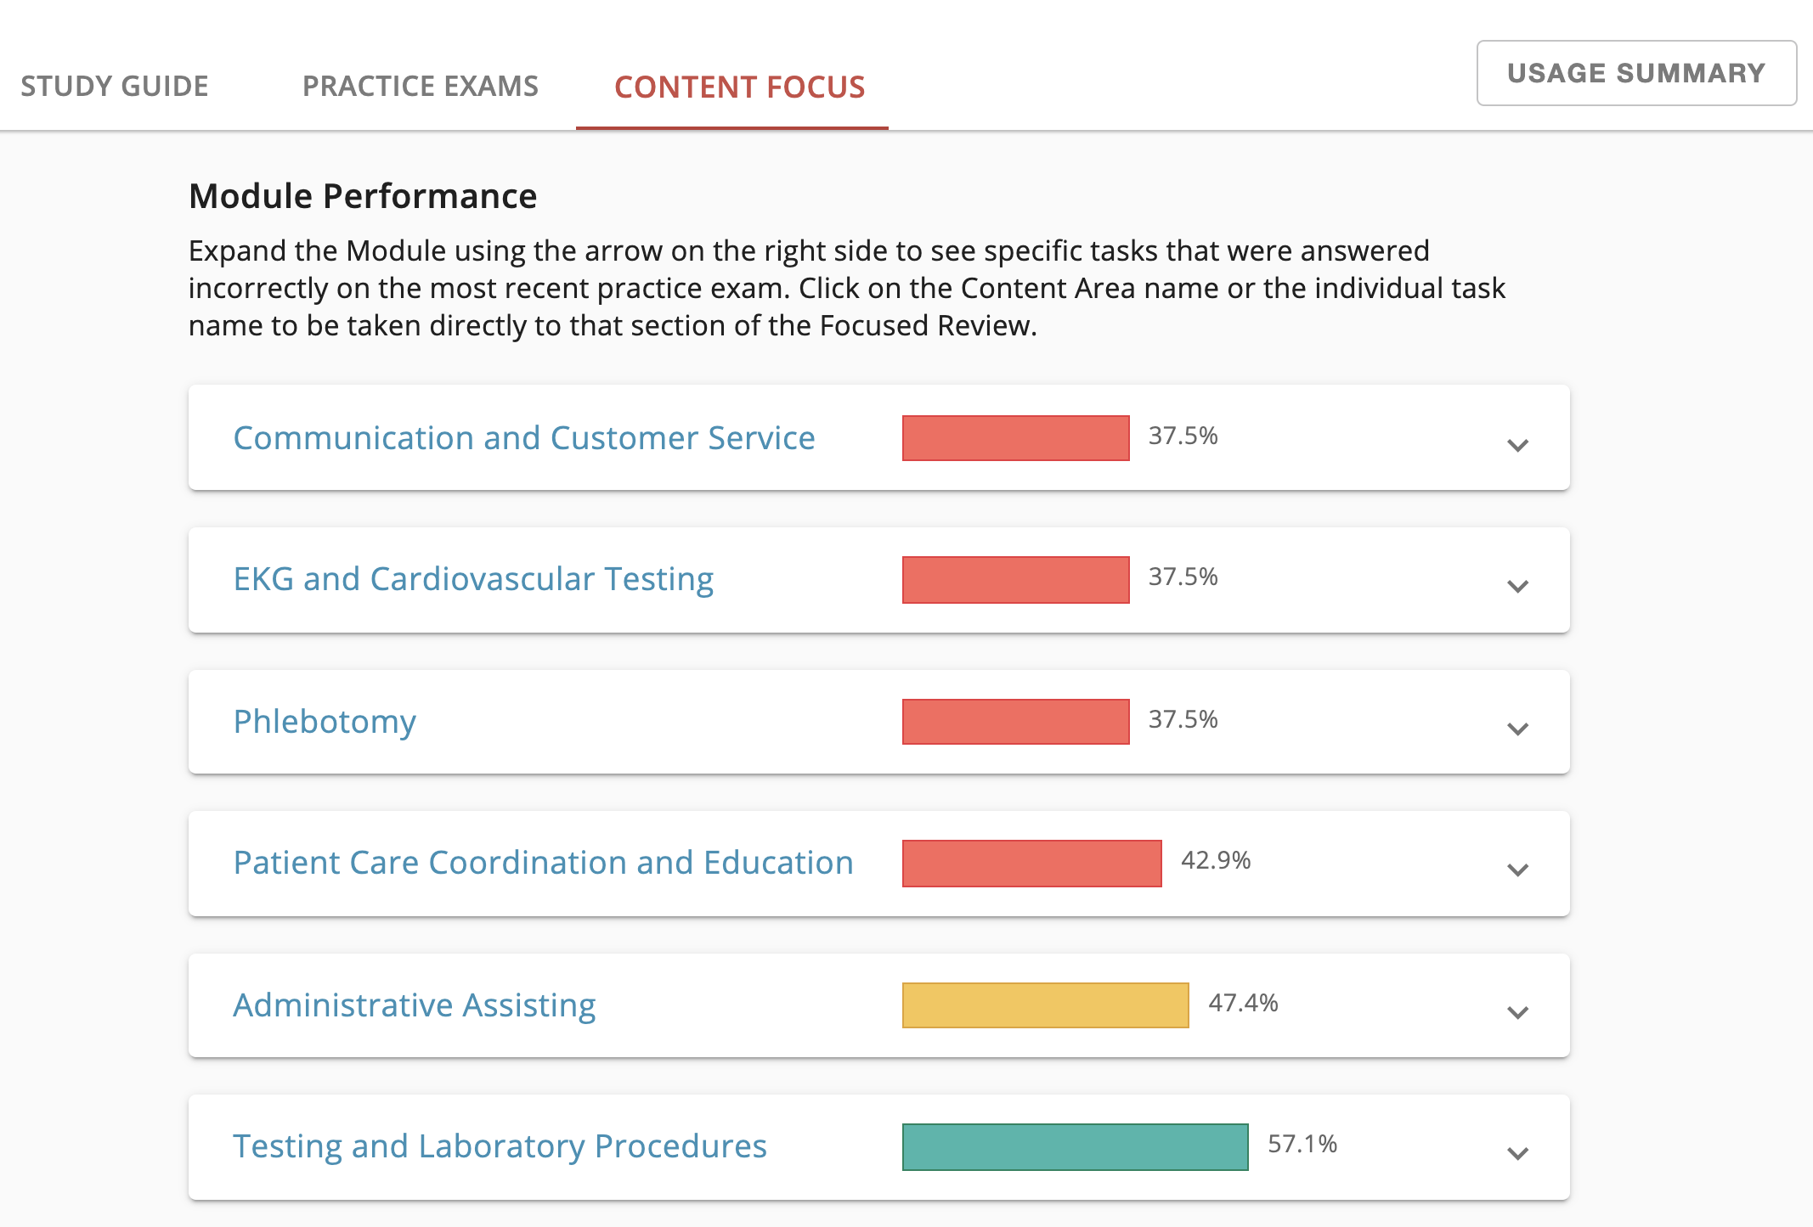
Powered by Reporting and Actionable Data
Notes:
Because we strongly believe information leads to positive change, we power our solutions with action-oriented data analytics and reporting. We make it easy for you to identify areas of weakness in your program and for your individual learners so you can help coach them to achieve success.

Slide 48
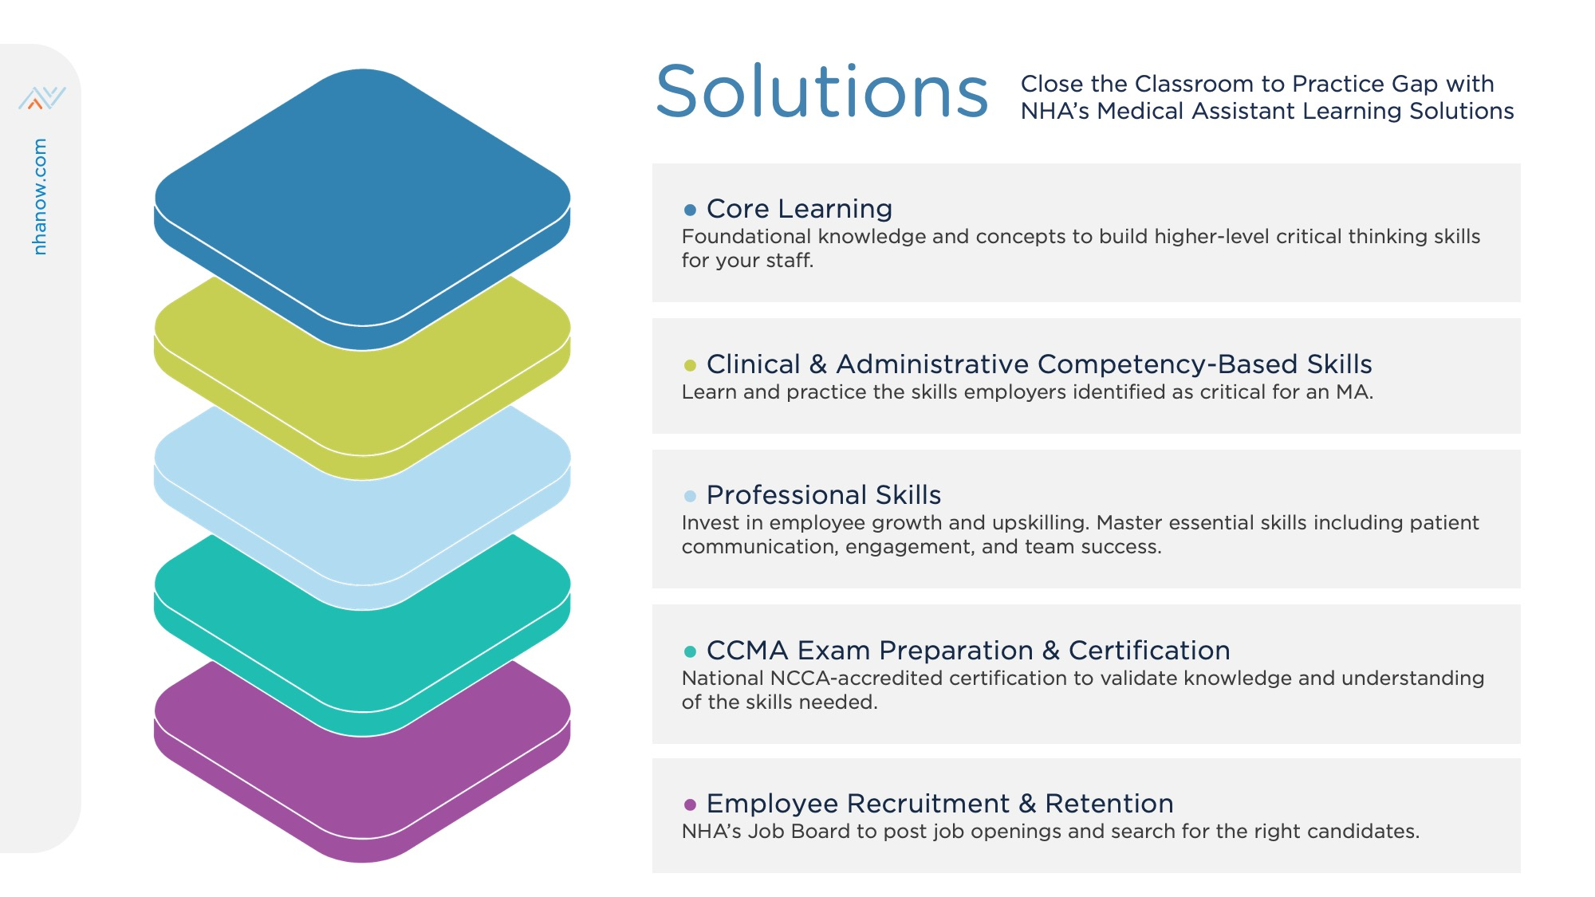
48
Notes:
As I mentioned earlier, NHA offers everything from Learning & Assessment, to Certification Preparation Tools, to the Certification Exam, Continuing Education & Recertification, and professional development.

Slide 49
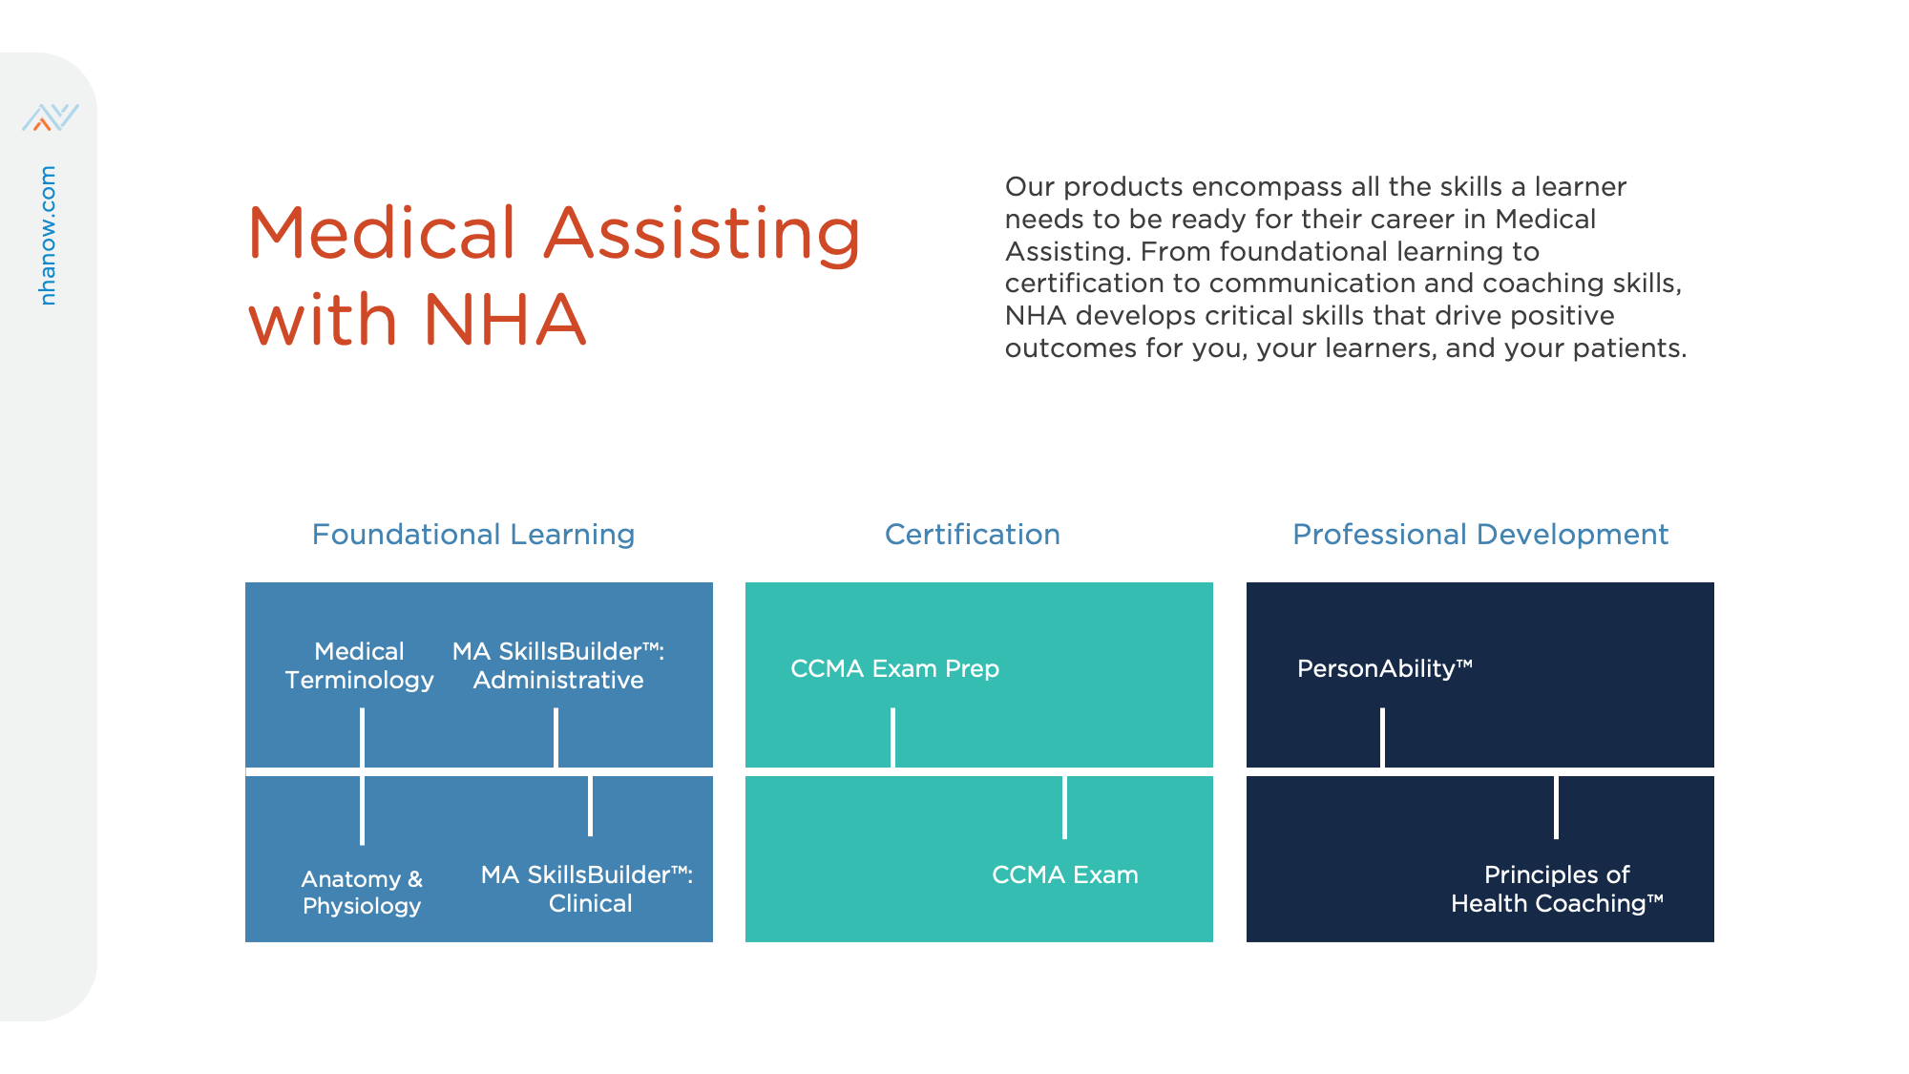
49

Slide 50
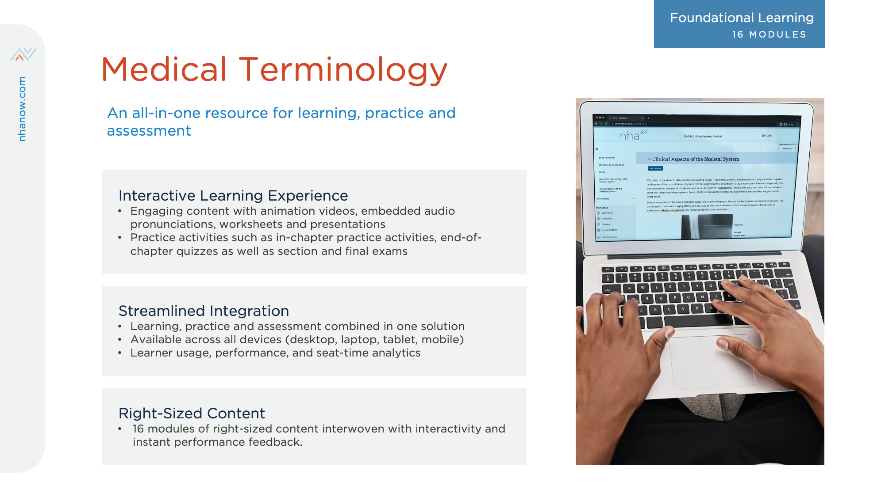
50

Slide 51

51

Slide 52
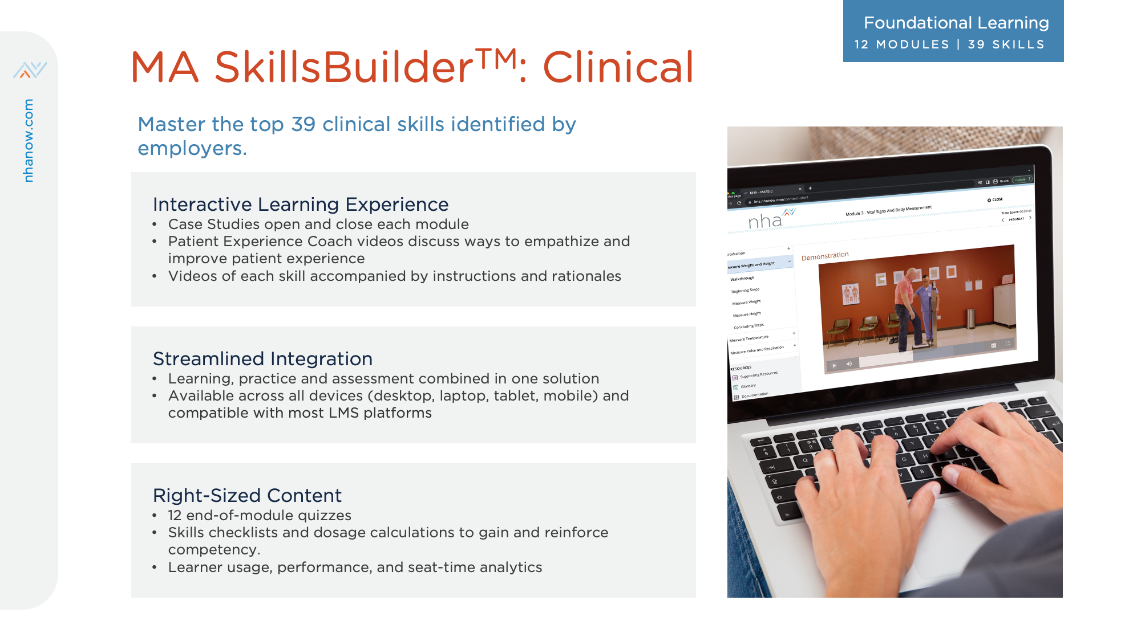
52

Slide 53
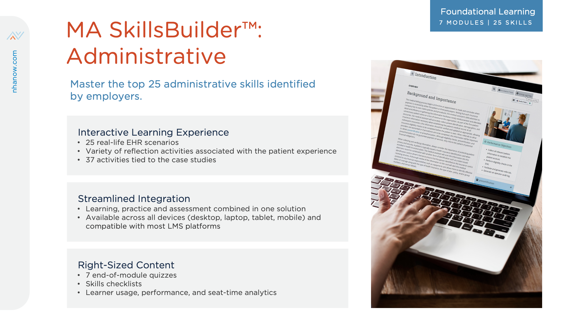
53

Slide 54
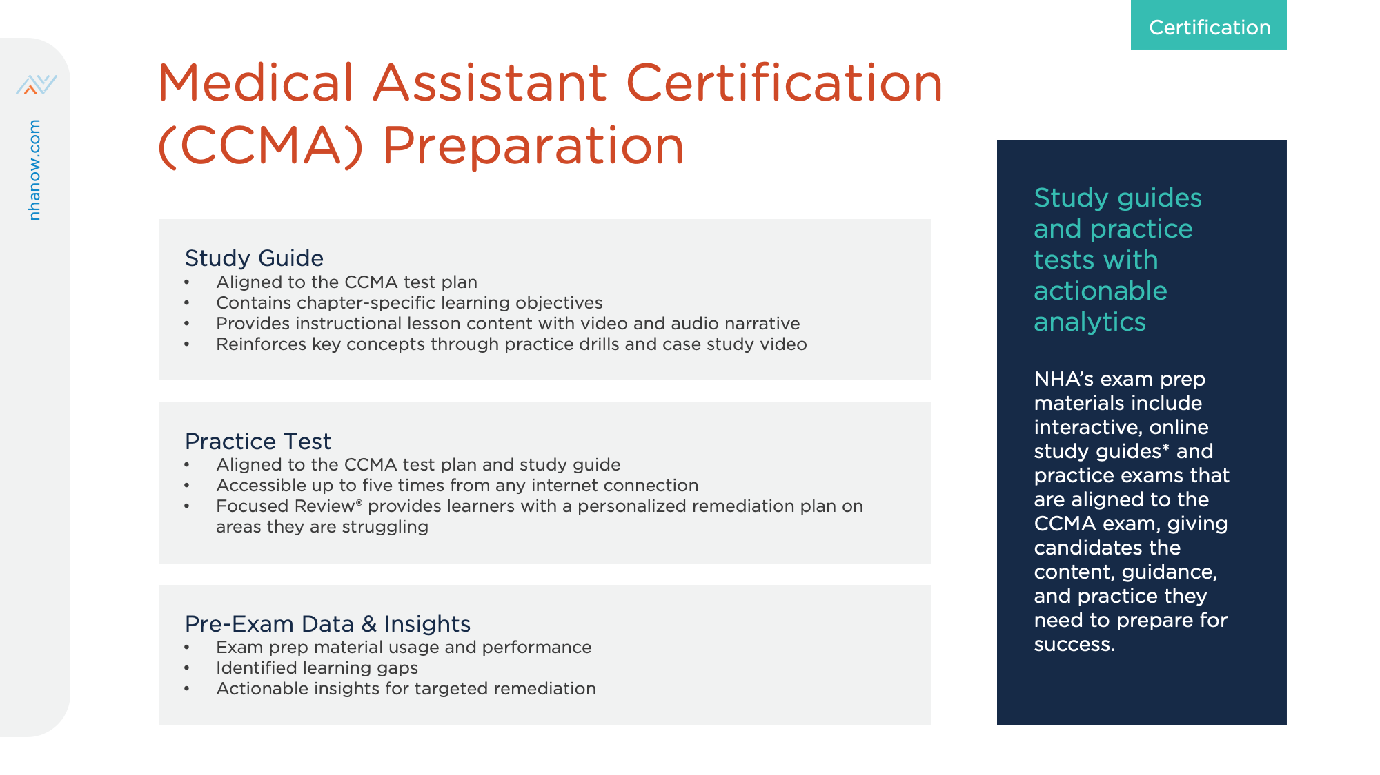
54

Slide 55
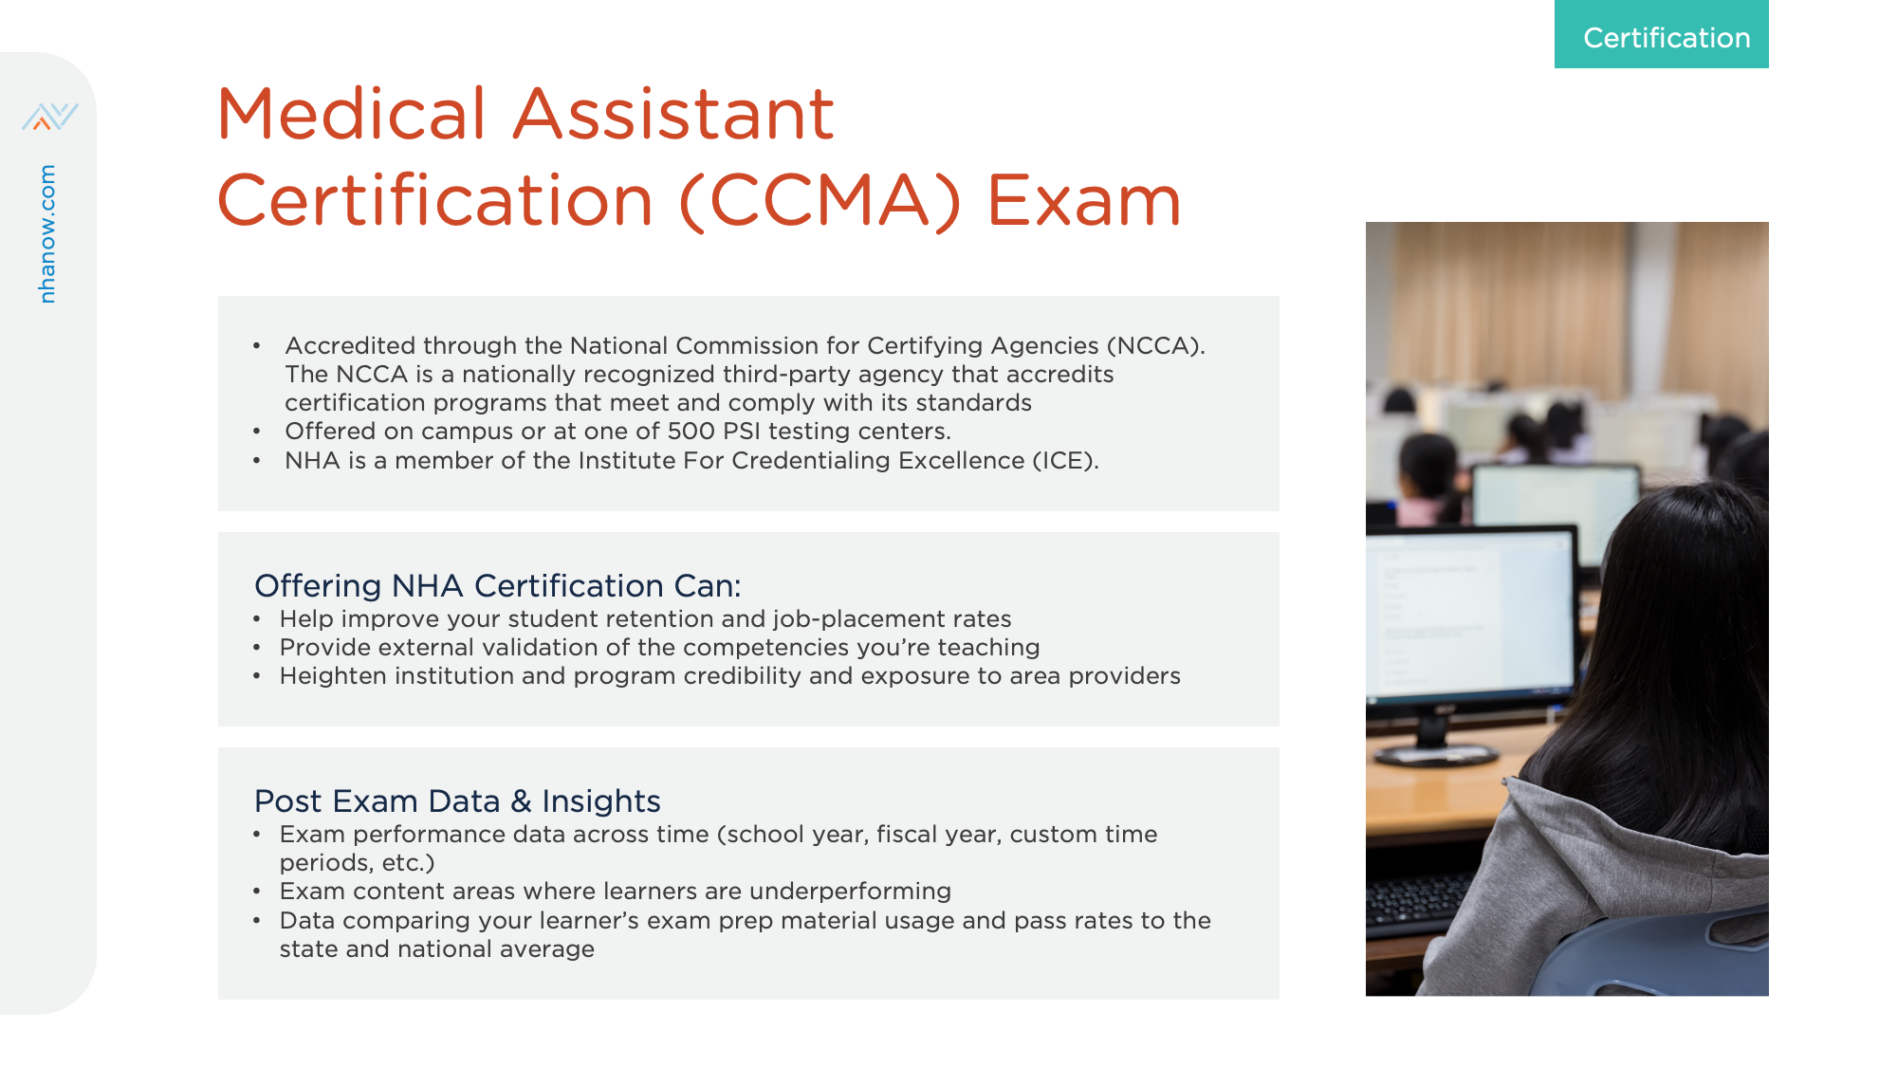
55

Slide 56
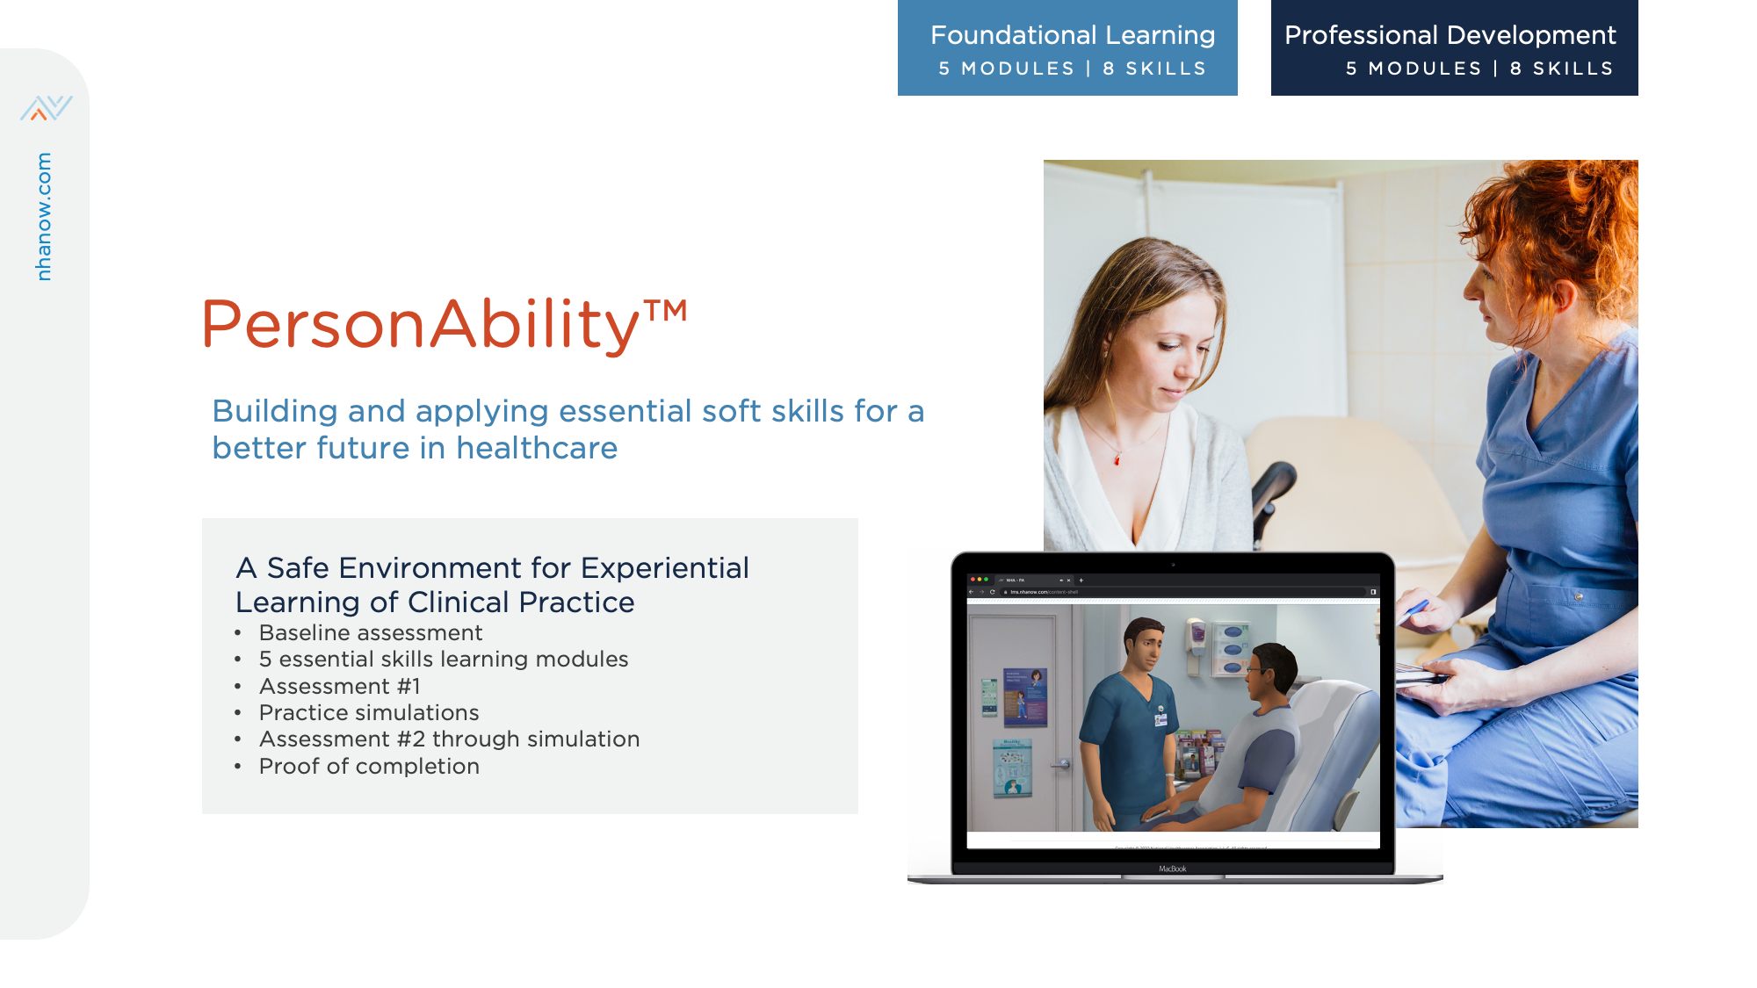
56

Slide 57
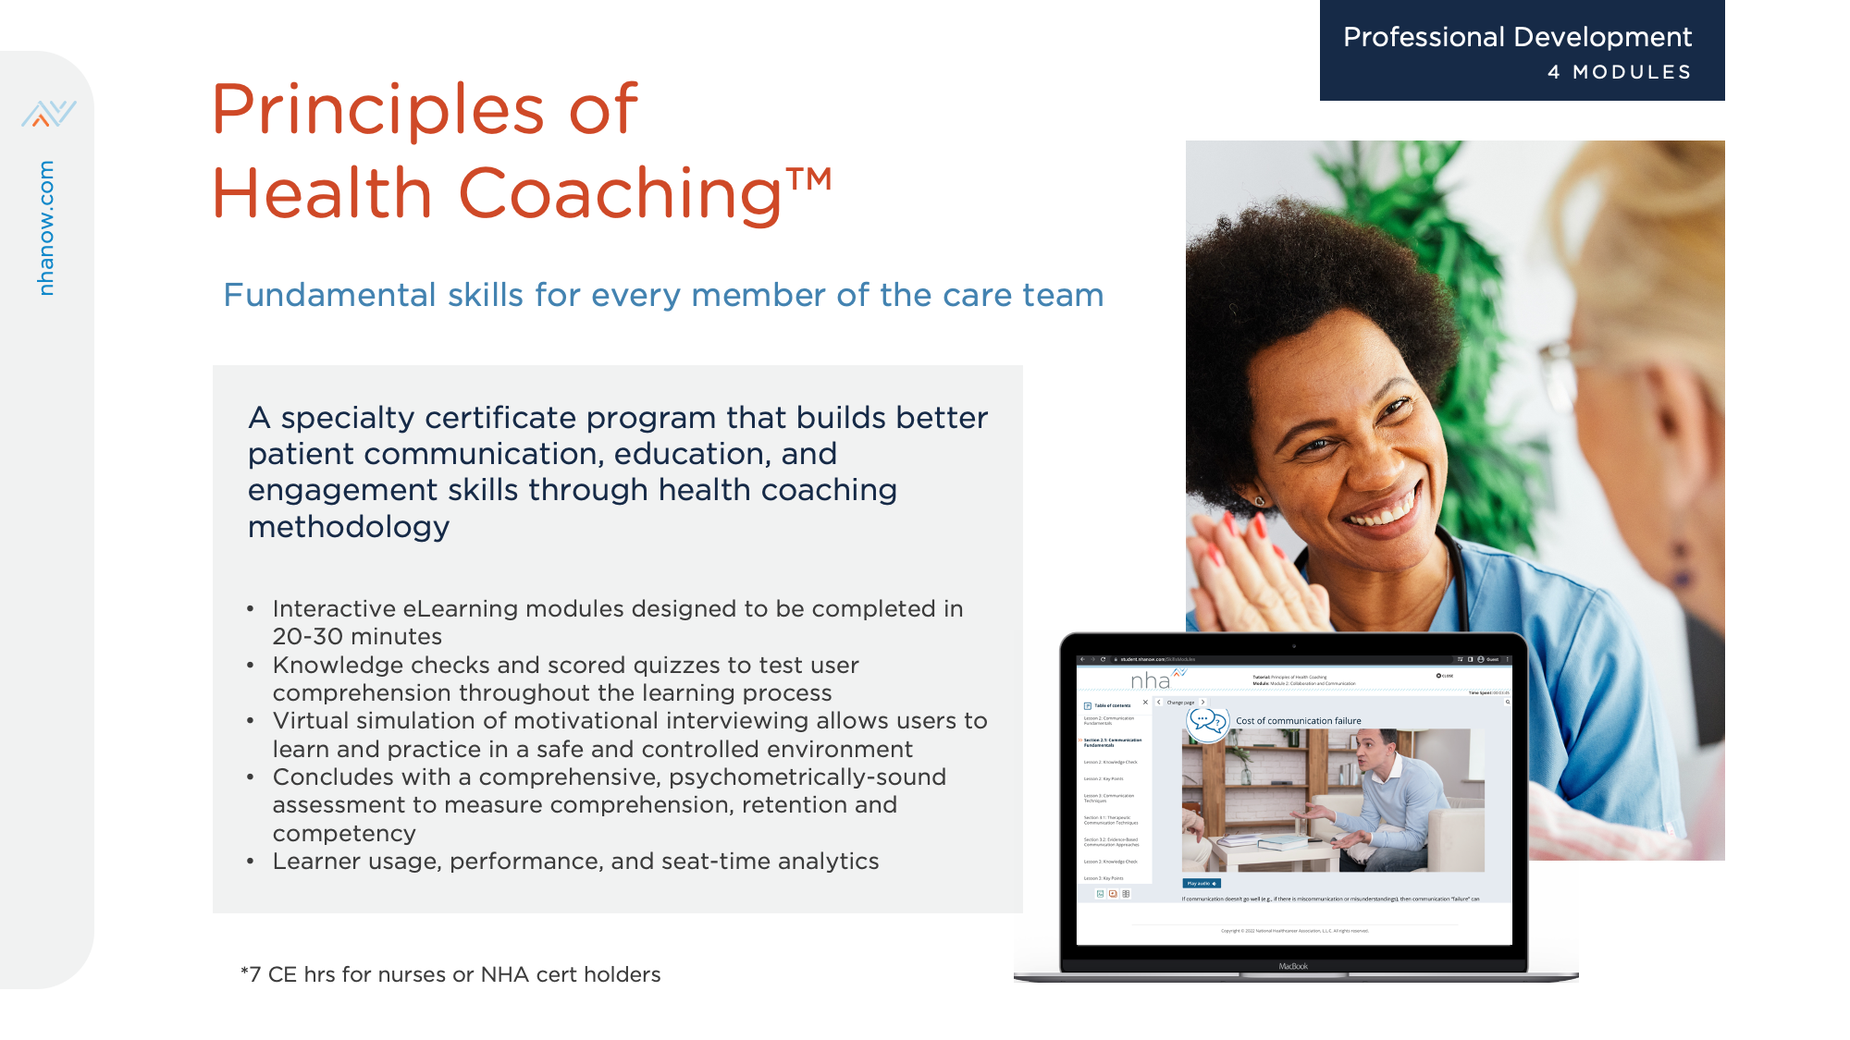
57

Slide 58
One partner for pharmacy technicians at every step of the way
Notes:
Just like we’re with you every step of the way, NHA continues to build their pharmacy technician offering so that we can be with your technicians throughout their career journey.
PharmaSeer is now stop number 1, followed by
ExCPT prep
Updated ExCPT exam
Data and insights (P360 Vitals)
Pharmacy technician advocacy and regulatory efforts (ongoing, continuous support)
Future:
PharmaSeer Math
Other opportunities for technician advancement and continuing education

Slide 59

Introducing NHA's Pharmacy Suite
Combining products to serve pharmacy technician programs
Three options for a solution that aligns with your needs
Better value for the both the student and the institution
Streamlined purchasing to simplify implementation
Free exam retake, available with the purchase of a pharmacy technician Classroom or Career bundle
Notes:
NHA is routed in assessment and has been the leading provider of allied health certifications for a long time but many people don’t realize that NHA is so much more. We apply the expertise we have in assessment to build foundational learning tools and certification preparation. We provide robust performance reporting and analytics. We also offer a number of opportunities for our partners to collaborate and network through our various advisory boards and advocacy groups.

Slide 60

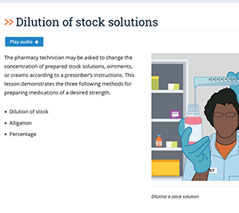
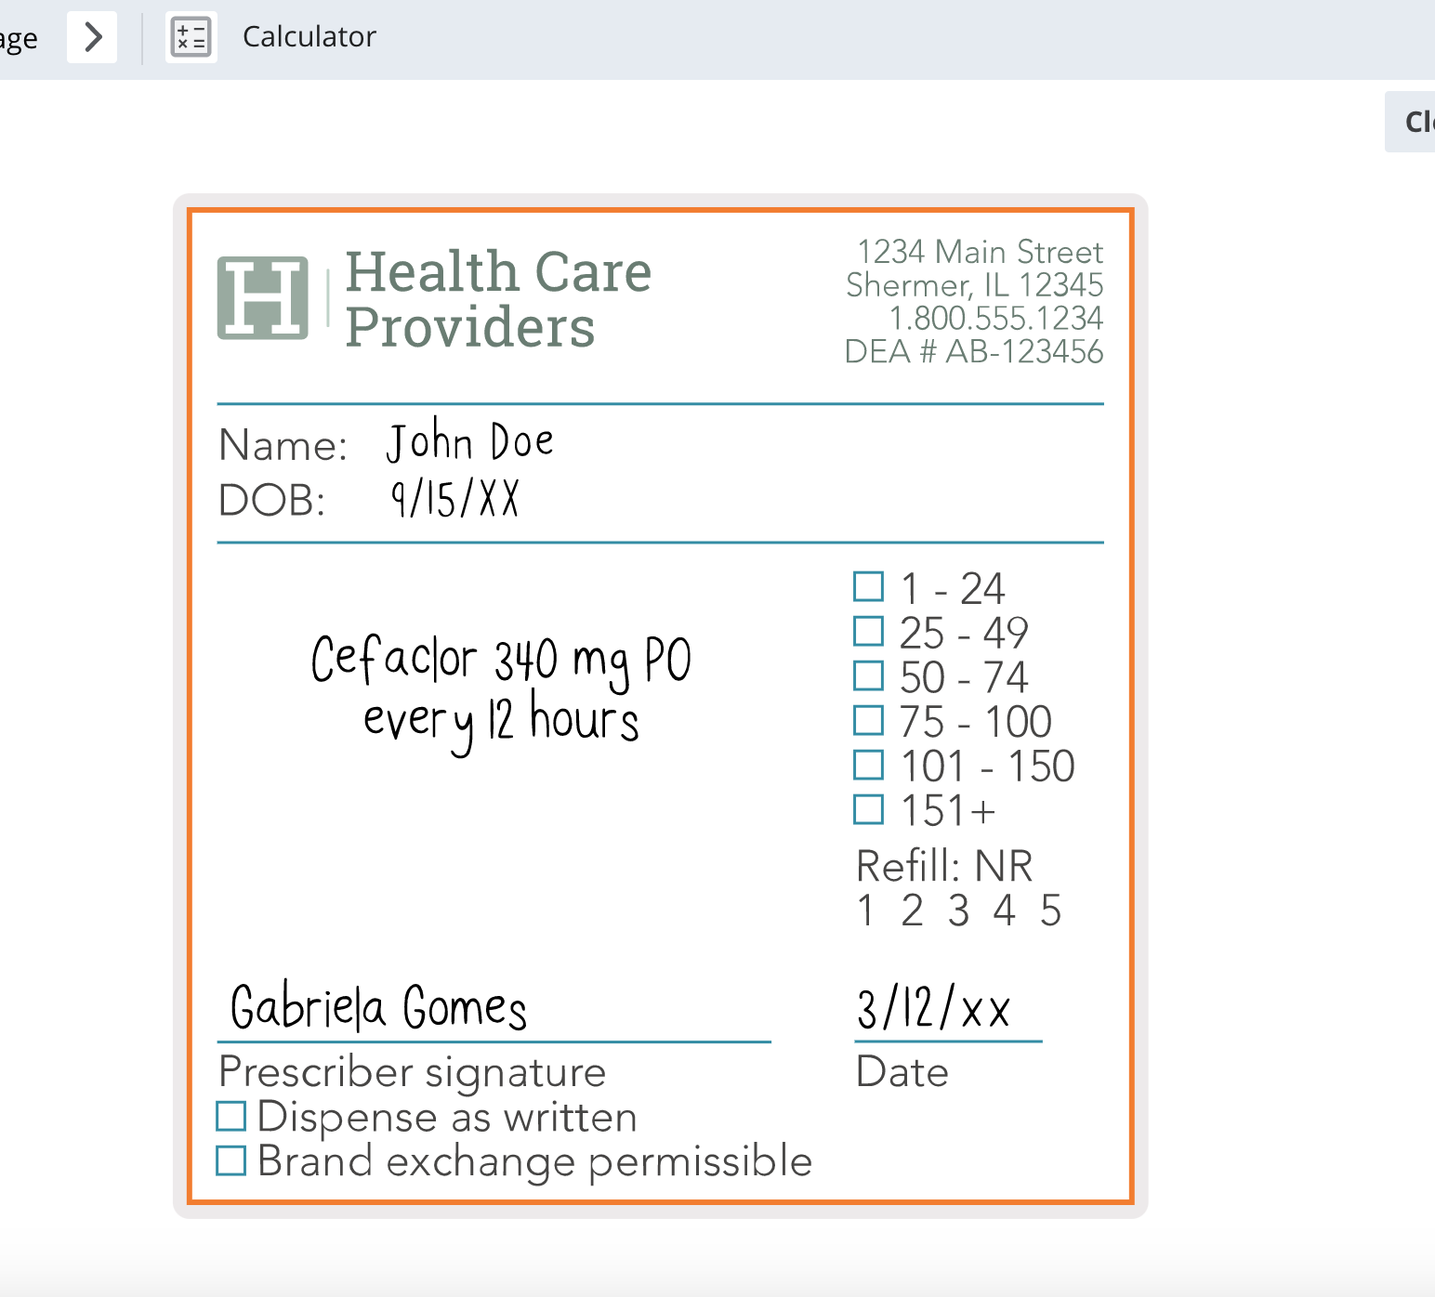
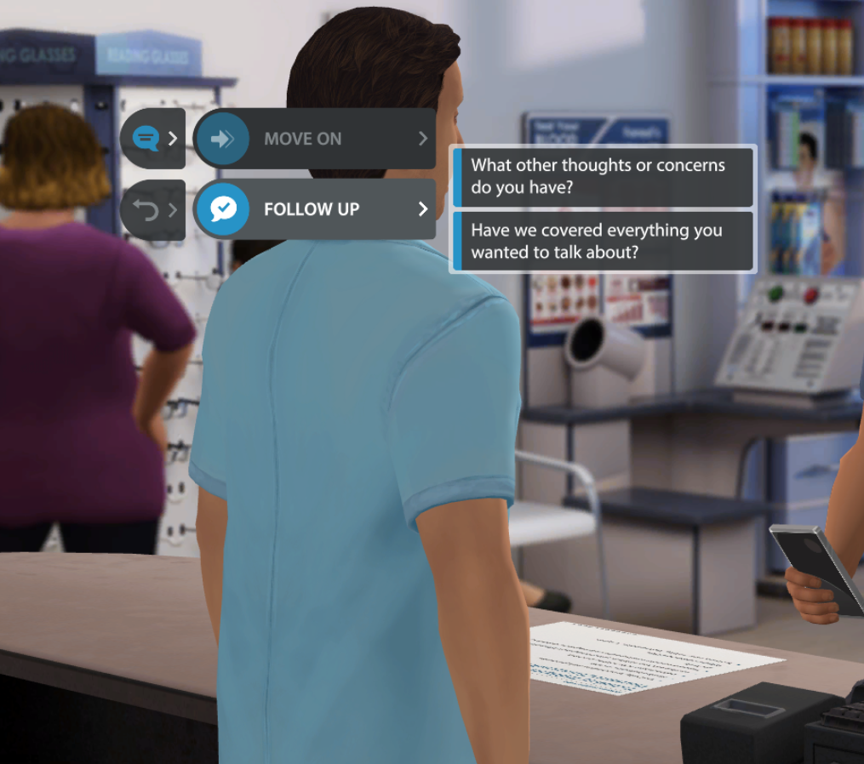
A strong foundation
Entry-level training establishes a strong foundation for a pharmacy technician’s career journey
PharmaSeer™
An entry-level training tool to confidently prepare pharmacy technicians
PharmaSeer Math™
A digital learning resource to master calculations used in pharmacy practice
PersonAbility™
An interactive tool designed to build essential soft skills for a better future in healthcare

Slide 61
TIME FOR QUESTIONS
Nigora McGill
Account Manager
913-904-7824 | Nigora.McGill@nhanow.com

Slide 62

Appendix
Notes:
National resources

Slide 63




Perkins V Act
$1.4 Billion
  4.7 Million
  CTE STUDENTS
  Engaged in Career Technical Education courses in the 2020/21 School year.
CTE is delivered at comprehensive and CTE high schools, magnet schools, area technical centers, and some community colleges.
annually for CTE education
In 2020/21 almost 1M students were enrolled in Health Science programs and is the largest career cluster.
15 Career Clusters
Source: https://www.acteonline.org/
Notes:
We often hear about the serious need for more workers in healthcare. Here are some reasons why… by 2050 America’s senior population will almost double from what it is today and more than 150 million individuals will be managing chronic illnesses – like diabetes, heart disease, and COPD. Leading to the need for more providers. But note: only 33% of healthcare careers are made up of Doctors and nurses. All the rest of these needed roles include allied health professions.
So, let’s talk about some of the critical front-line roles needed to ensure quality patient care…

Slide 64
State Shapes
ME
WA
VT
MT
ND
NH
MA
OR
MN
NY
ID
SD
WI
MI
RI
WY
PA
MD
NJ
CT
IA
OH
DE
NE
IL
IN
WV
Washington D.C.
NV
VA
CA
UT
CO
KY
KS
MO
NC
TN
SC
AZ
NM
OK
AR
AL
GA
MS
AK
TX
LA
FL
HI
Notes:
64

Slide 65

Directions for creating state slide
Go to tableau > Performance 360 >
Use state DOE website to show our certs alignment
To get count of partners = P360 > passrate by year > download to CSV >

Slide 66

66
Notes:
For those of you who have never heard of NHA or know what we do I thought I would give you a brief overview.
Since 1989, NHA has prepared and awarded more than 1M certifications to healthcare students and professionals.
Our Goal is to improve patient care – and as the industry leader, we are passionate about developing and advancing the frontline healthcare worker.
NHA offers everything from Learning & Assessment, to Certification Preparation Tools, to the Certification Exam, Continuing Education & Recertification, and professional development.
At our core we are a certification organization –we have 8 NCCA accredited industry-based credentials. These are credentials that your students can take into the workplace, get jobs, and start right away. We have 5 clinical based certifications (CCMA, CPT, CET, CPCT/A, and ExCPT) and 3 Administrative certifications (CMAA, CBCS, CEHRS).
NHA certification exams are updated regularly to ensure your students have the most current and job-relevant knowledge and skills.
Additionally, we have began creating foundational resources for our programs and their learners – like med term, A+P, personabilty – a soft skills tool, and more.

Slide 67






College + Career Readiness
5 NHA certifications now
Qualify for Post-secondary College credits
Medical
Assistant (CCMA)
Phlebotomy
Technician
(CPT)
EKG
Technician
(CET)
Patient Care Technician (CPCT)
Electronic Health Records
(CEHRS)

