Slide 1
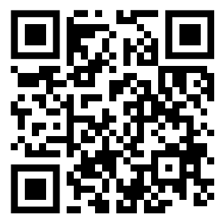
Welcome
START!
Linda Stanhope
Kim Turnbull

Slide 2
Medical Lingo: Get out of Limbo
THOA PDC 24
Activities
Labs
Scenarios
Drills
Research

Slide 3
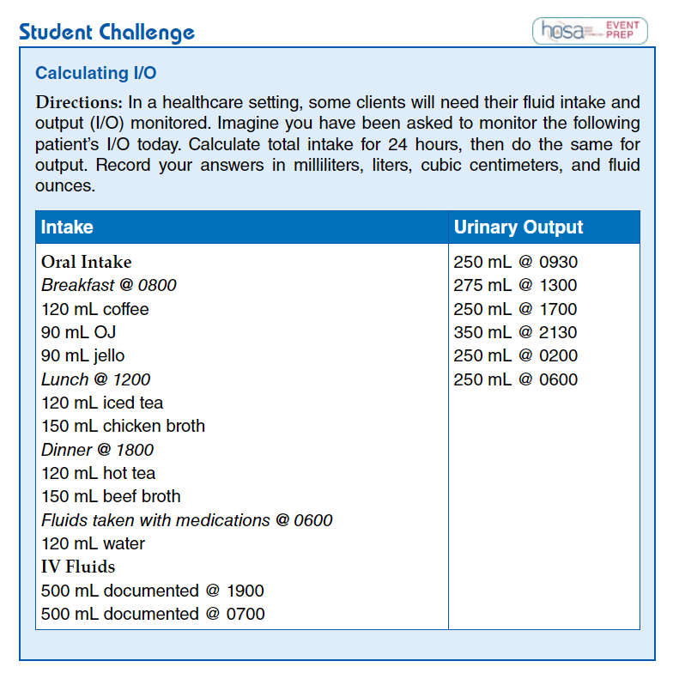
Bell Ringer
II/O Practice

Slide 4
Real Life
In this chapter, you will learn medical word parts and terms related to basic anatomy and physiology. Before you begin this chapter, read the scenario that follows.
Medical Term Scavenger Hunt - Chapter Opener
Norah Le, a 16 y/o Asian female, comes to the ER c c/o pain in the RLQ of the abdominal area. The nurse places her in lateral position until the doctor comes in, @ which time pt. is placed in a supine position. Upon PE, while palpating in the Rt iliac region, the pain becomes more intense. Dr. Jutte orders a STAT CBC, UA, HCG, and ultrasound of the abdomen to r/o appendicitis.
For each highlighted medical term or abbreviation, search through this chapter to find the meaning. Some of these terms and abbreviations were introduced in the previous chapter.

Slide 5
Real Life
•
Medical Record Practice

Slide 6
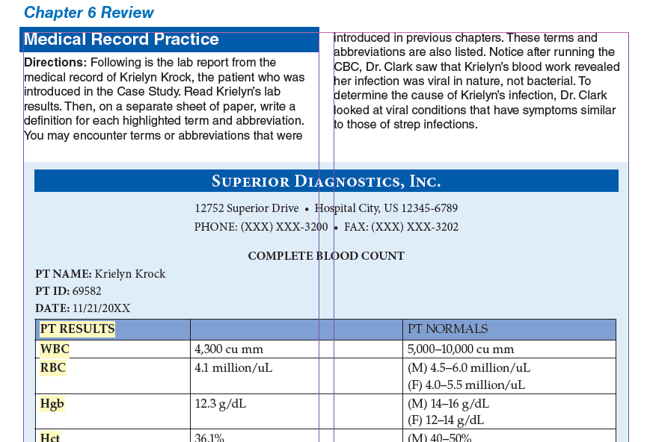
Labs
X-ray Reports
Consultations
H & P
Nurses Notes
MEDICAL RECORD
Notes:
Use students and create a story about why one may need more than another.

Slide 7
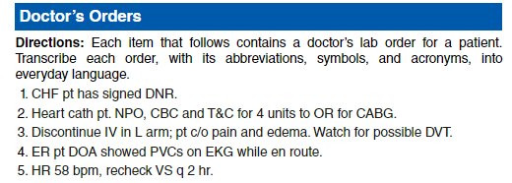
Labs
X-ray Reports
Consultations
H & P
Nurses Notes
Doctor’s Orders
Transcription Practice
Notes:
Use students and create a story about why one may need more than another.

Slide 8
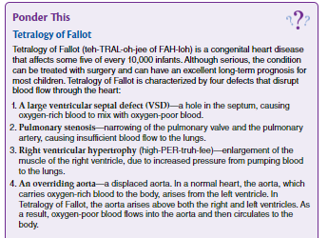
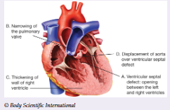
NEXT!
Ponder This

Slide 9
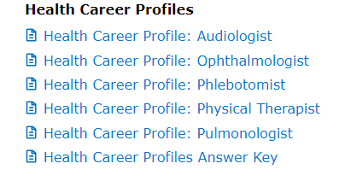
Career Spotlight
A Day in the Life
CREDITS
Career List
Phlebotomist

Slide 10
Career Spotlight
CREDITS
Phlebotomist

Slide 11
Official Event Resource

Slide 12
Official Event Resource
Teamwork Events

Slide 13
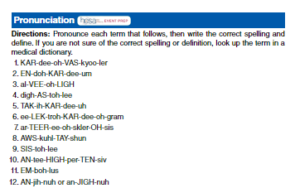
Event Prep
Table of Contents
Sports Medicine
Career Health
Display
Biomedical Debate
Medical Spelling
Epidemiology
Notes:
Use students and create a story about why one may need more than another.

Slide 14
New Labs in Intro to Medical Terminology, 2nd Ed
Inquiring Minds
Labeling the Body
Skin Function
Fingerprints
Understanding Calcium - chicken bones
Rigor Mortis
Blood Type & Cross
Pulse points
Arrhythmias
Rhinovirus - research lab
Virus mutations - research COVID mutations
Digestion in Oral Cavity
Diarrheal Diseases - top 5
Diarrheal Diseases - top 5
Developmental Disabilities - research
Neuro VS
Supertasters
Taste and Smell
Type I & Type II DM - research
Hydration - group lab
Prostate Cancer Tx - research
Types of Birth Control - small group research
PMS - research
DNA Testing
Notes:
Have students act out/be visuals for the organs!

Slide 15
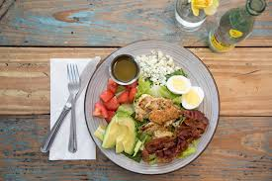
Inquiring Minds
Therapeutic Diet:
Any special diet
Enterally: Through a Feeding Tube
Parenteral: nutrition given
through an IV due to a non
functioning GI tract
Registered Dietitian: assesses nutritional status and plans diets according to needs of the patient.

Slide 16
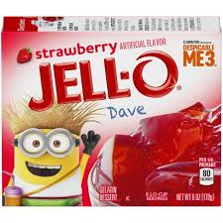
Specialized Diets for Patients
Inquiring Minds
Clear Liquid: Clear broth and juice, ginger ale, gelatin, popsicles, clear coffee, tea.
Requires minimal digestion - common after surgery
Full Liquid: Strained soups/cereals, coffee, fruit and veggie juice, ice cream, pudding + all clear liquids.
If unable to chew or swallow solid food (transition diet b/w clear liquid and solid food).
Soft and Bland
When a patient cannot swallow hard or coarse food.
Mechanical Soft: Soft diet except food is ground or strained.

Slide 17
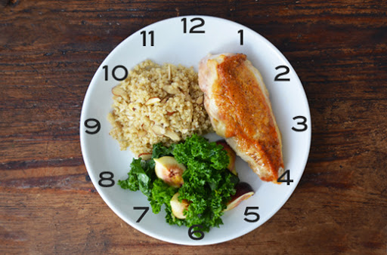
Student Challenge
If the patient is unable to see and would like to feed himself, describe the position of the food on the tray.
Ie - cold liquids in the left corner, hot liquids in the right corner.
Describe the food on the plate in terms of a clock face.

Slide 18
Arrhythmias
Inquiring MInds
Using your arrhythmia strip and teammates
Identify your rhythm
Research signs & symptoms of your arrhythmia

Slide 19
Arrhythmias
Inquiring MInds
Answers!
Name
S/S

Slide 20
Arrhythmias
Inquiring MInds
Answers!
Name
S/S

Slide 21
Arrhythmias
Inquiring MInds
Answers!
Name
S/S

Slide 22
Dipstick Lab
Workplace Lab
HOSA Competition
Real world application
Springboard discussion over hydration, infection, diabetes/disease conditions

Slide 23
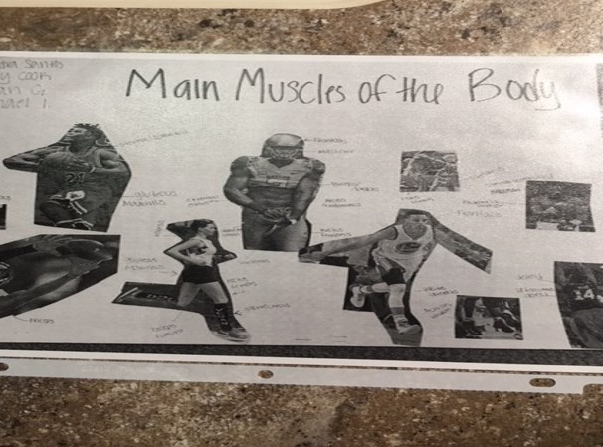
Collage ideas!
Notes:
Bland

Slide 24
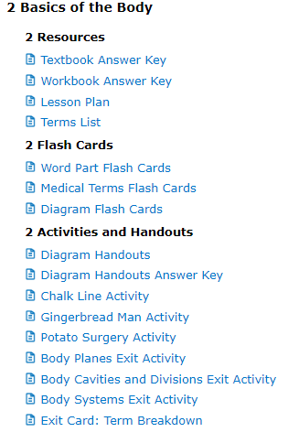
Menu
Lesson Plans
Scope & Sequence
Games
Teaching Strategies
Chapter Reviews
Cumulative Reviews
!
Additional Labs/Activities found in Teacher Resources
Textbook LABS

Slide 25
Walk in the patient’s shoes -
Literally
Help teach students empathy for their patients through simulations of disabilities
Breathing problems- have students' breath through straws and compression binders
Aging- have students wear braces and use canes and walkers
Hemiparesis/stroke – tie down limbs with braces or torn rags to restrict movement
Notes:
Have students act out/be visuals for the organs!

Slide 26
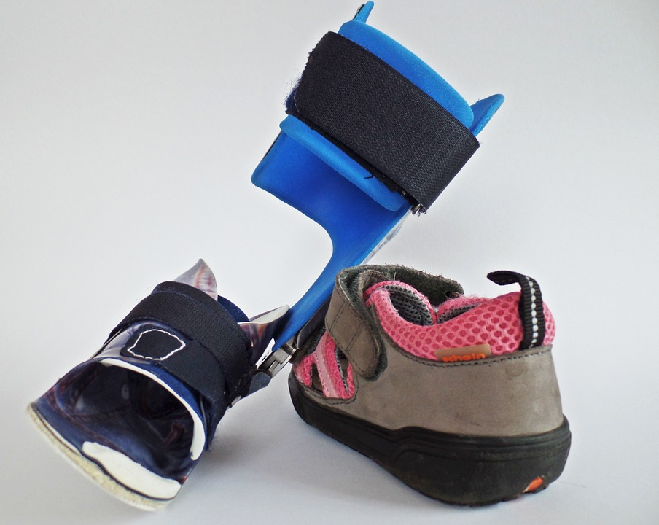
Walk in the patient’s shoes -
Literally
Help teach students empathy for their patients through simulations of disabilities
Vision- cheap readers, Vaseline, sleep mask
Arthritis- tape fingers/toes, rice or popcorn kernels in disposable gloves and socks, sticks
Sensory perception- thin or thick gloves and blindfolds
Hearing-earplugs and noise canceling headphones
Notes:
Have students act out/be visuals for the organs!

Slide 27
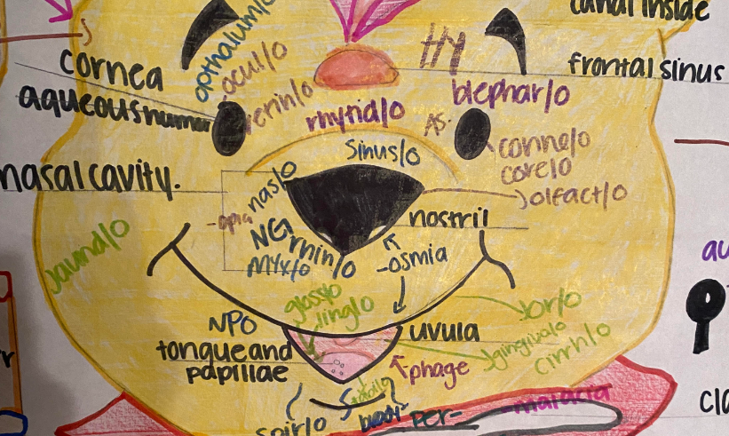
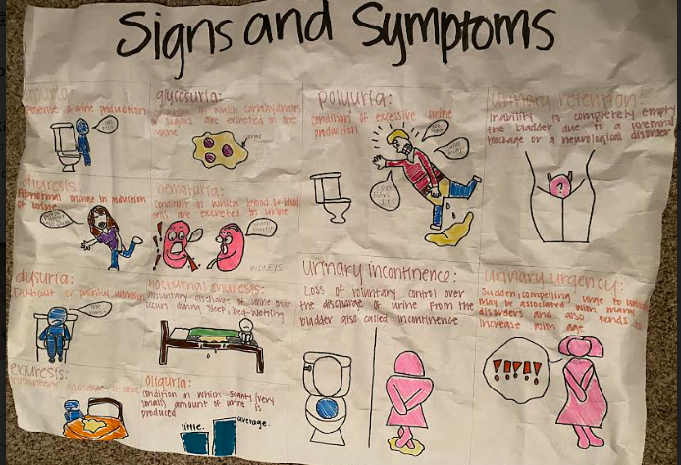
Labeling Practice & Drawing Terms
Practice
Word Parts
Terms
Practice!!

Slide 28
Direction found in Lesson Plans
Foldables
Bell ringers
Exit Tickets
Labs
Flash
cards
Games
White Boards
Review Activities/Diagram Drills
Models
Table Groups
Small group Races
Diagram cards
Word Surgery
Word Construction
Diagram Drills
Bingo
Flyswatter
Kahoot
Gimlet
Quizlet

Slide 29
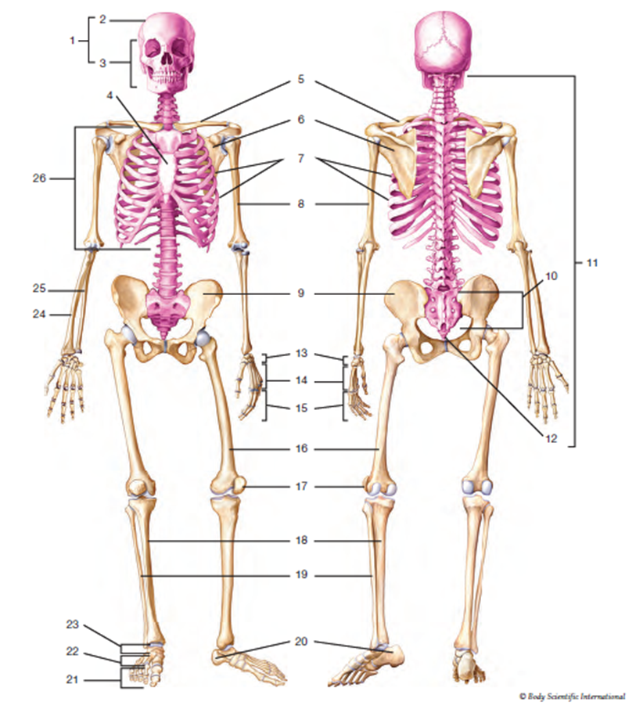
Diagram Drill
Diagram Drill
Notes:
Have students act out/be visuals for the organs!

Slide 30
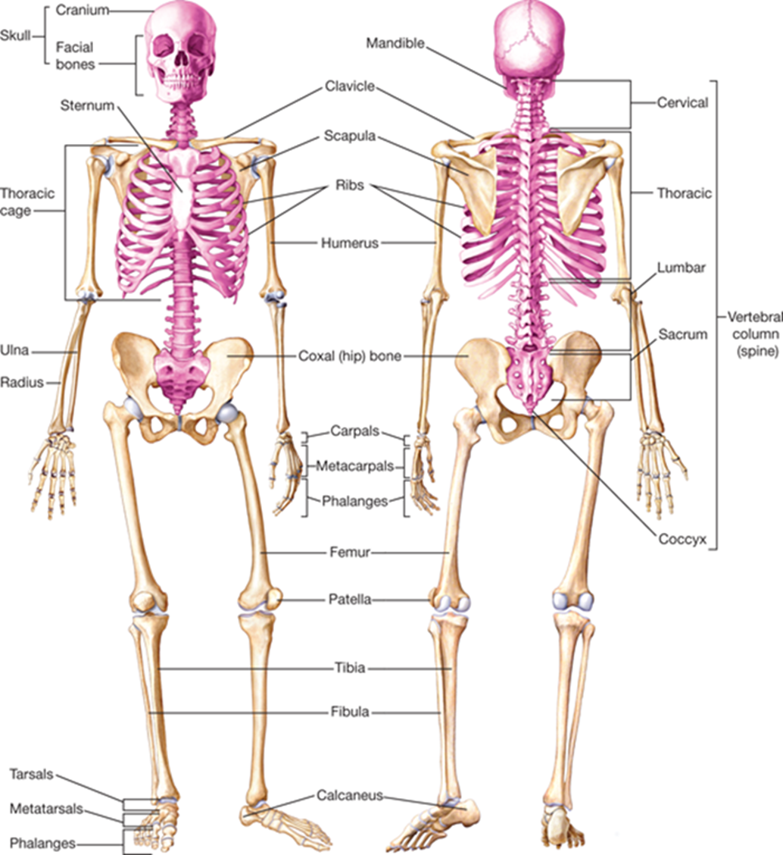
Diagram Drill
Diagram Drill
Notes:
Have students act out/be visuals for the organs!

Slide 31
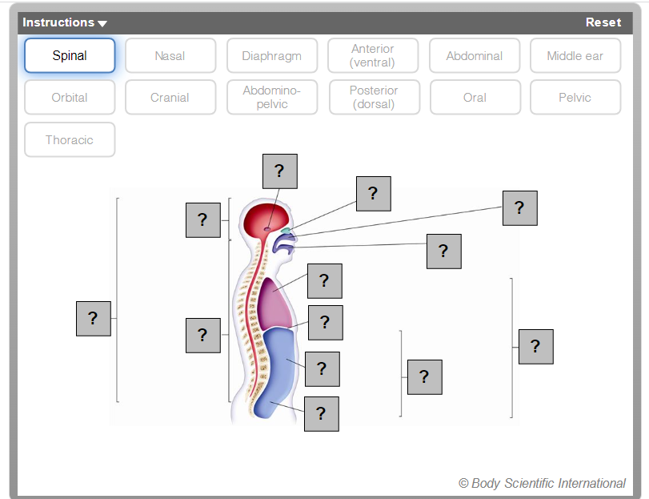
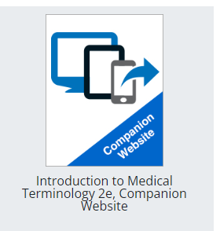
Companion Website
Notes:
Have students act out/be visuals for the organs!

Slide 32
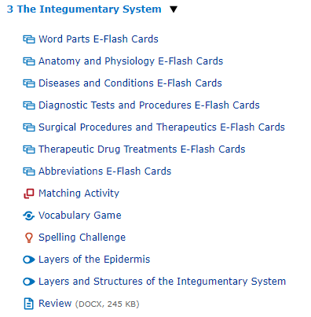
Companion Website
Notes:
Have students act out/be visuals for the organs!

Slide 33
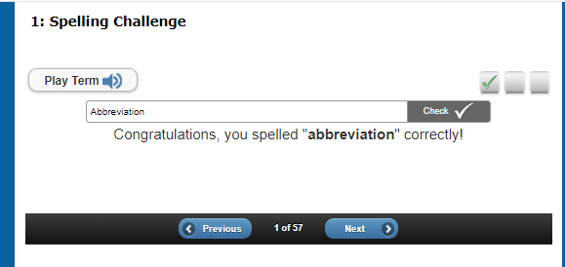
Companion Website
Notes:
Have students act out/be visuals for the organs!

Slide 34
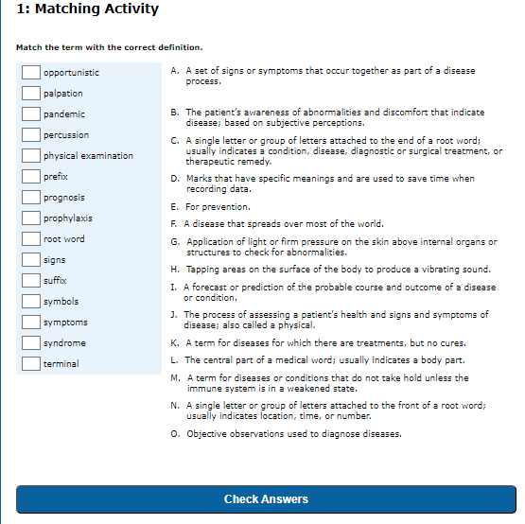
Companion Website
Notes:
Have students act out/be visuals for the organs!

Slide 35
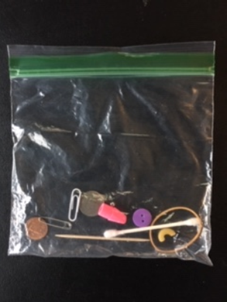
Student Challenge - oldy, but goody
What is
neuropathy?
In this activity students will work in pairs to perform a modified version of the
Some
materials
required
“Stereognosis Exam”

Slide 36
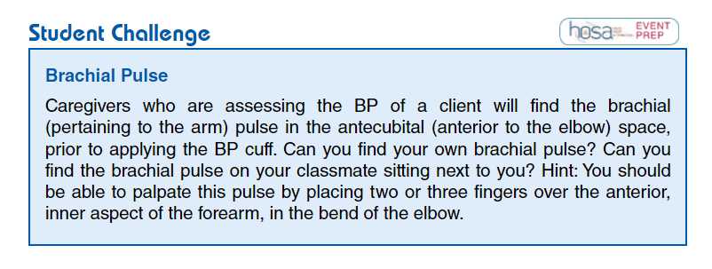
Student Challenge
:
Directions

Slide 37
Start with
terms students understand
Range of Motion
Snow Angel Arms
1
2
3
Brush your Hair
Open the door
Ankle circles
4
5
6
Passive ROM
Students take turns being patient and caregiver
WorkPlace Skill
Work Place Skills
Abduction
And
Adduction
Flexion
And
Extension
Pronation
And
Supination
Inversion
And
Eversion
Circumduction
Rotation
lateral/medial

Slide 38
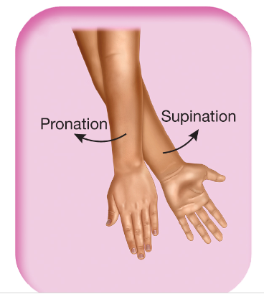
Start with
terms students understand
Range of Motion
Snow Angel Arms
1
2
3
Brush your Hair
Open the door
Ankle circles
4
5
6
Passive ROM
Students take turns being patient and caregiver
WorkPlace Skill
Work Place Skills
Abduction
And
Adduction
Flexion
And
Extension
Pronation
And
Supination
Inversion
And
Eversion
Circumduction
Rotation
lateral/medial

Slide 39
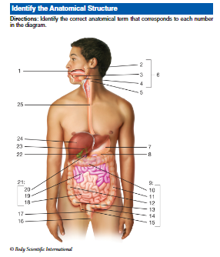
Team Challenge
:
Directions
Alimentary Canal

Slide 40
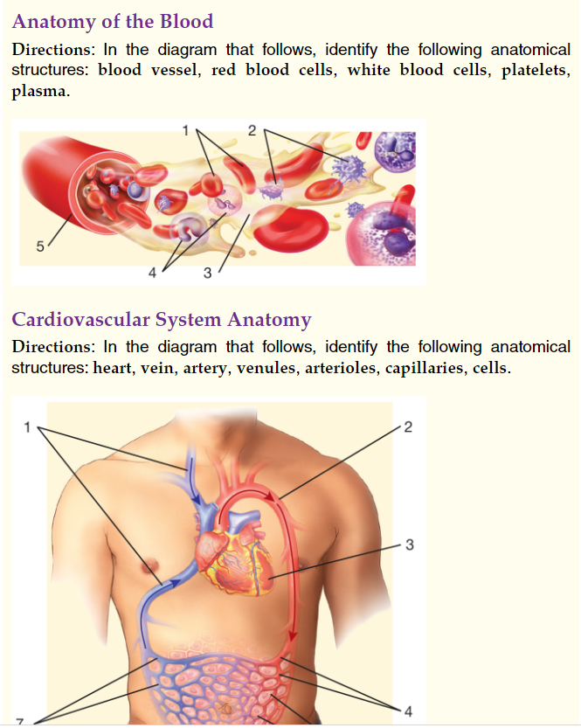
Cumulative Reviews
Notes:
Bland

Slide 41
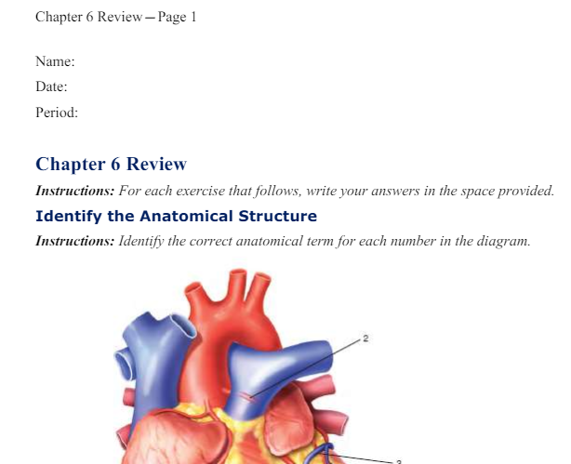
Companion Website has More Reviews!!
https://www.g-wonlinetextbooks.com/introduction-medical-terminology-cws-2023/~~Attachments/index.htm
Notes:
Have students act out/be visuals for the organs!

Slide 42
Word Surgery

Slide 43
bronchoscopy

Slide 44
Visual exam inside the bronchi using a scope

Slide 45
Nephrectomy

Slide 46
Surgical removal of the kidney

Slide 47
Word Construction

Slide 48
Incision into the vein

Slide 49
Phlebotomy

Slide 50
Rupture of the hair

Slide 51
trichorrhexis

Slide 52
Direction found in Lesson Plans
Foldables
Bell ringers
Search the Source
Labs
Flash
cards
Games
White Boards
Review Activities
Models
Table Groups
Small group Races
Diagram cards
Word Surgery
Word Construction
Diagram Drills
Bingo
Flyswatter
Kahoot
Gimlet
Quizlet

Slide 53
Directions: Using reliable and credible online resources, complete the following activities.
1. The Ebola outbreak in 2014 was one of the largest Ebola outbreaks in history, and it was the first Ebola outbreak in West Africa. Visit the Centers for Disease Control and Prevention website and research signs and symptoms of Ebola hemorrhagic fever (EHF). Then study the graph below and answer the questions that follow.
A. What was the number of confirmed cases of Ebola in Guinea during the week of June 8, 2014? - Answer 33 B. What was the number of suspected cases the same week? -- Answer 4
C. Which time frame saw the highest number of confirmed cases of Ebola? Week of March 16, 2014 Week of April 13, 2014 Week of May 25, 2014
Search the Source
Notes:
Have students act out/be visuals for the organs!

Slide 54
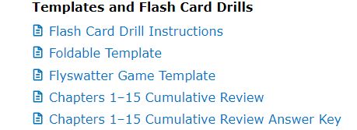
Direction found in Lesson Plans
Foldables
Bell ringers
Exit Tickets
Labs
Flash
cards
Games
White Boards
Review Activities/ Flashcards
Models
Table Groups
Small group Races
Diagram cards
Word Surgery
Word Construction
Diagram Drills
Bingo
Flyswatter
Kahoot
Gimlet
Quizlet

Slide 55
Flashcards- Small group race
Drills
Term
Definition
-otomy
incision
Practice!!

Slide 56
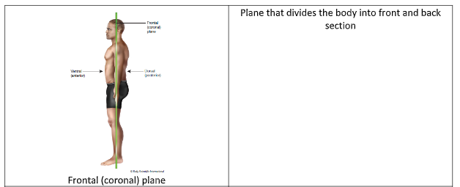
Direction found in Lesson Plans
Foldables
Bell ringers
Exit Tickets
Labs
Flash
cards
Gaes
White Boards
Review Activities/Diagram Cards
Models
Table Groups
Small group Races
Diagram cards
Word Surgery
Word Construction
Diagram Drills
Bingo
Flyswatter
Kahoot
Gimlet
Quizlet

Slide 57
Direction found in Lesson Plans
Foldables
Bell ringers
Exit Tickets
Labs
Flash
cards
Games
White Boards
Review Activities/Flyswatter game
Models
Table Groups
Small group Races
Diagram cards
Word Surgery
Word Construction
Diagram Drills
Bingo
Flyswatter
Kahoot
Gimlet
Quizlet

Slide 58
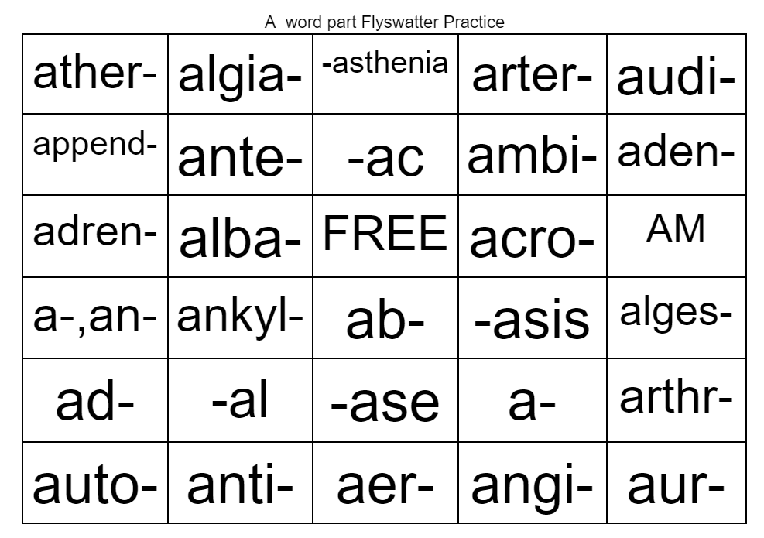
Flyswatter/Bingo

Slide 59
Direction found in Lesson Plans
Foldables
Bell ringers
Exit Tickets
Labs
Flash
cards
Games
White Boards
Review Activities/Models
Models
Table Groups
Small group Races
Diagram cards
Word Surgery
Word Construction
Diagram Drills
Bingo
Flyswatter
Kahoot
Gimlet
Quizlet

Slide 60
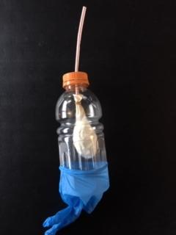
Make a Model!
Table of Contents
Trachea
Diaphragm
Lungs
Pharynx
Pleural cavity

Slide 61
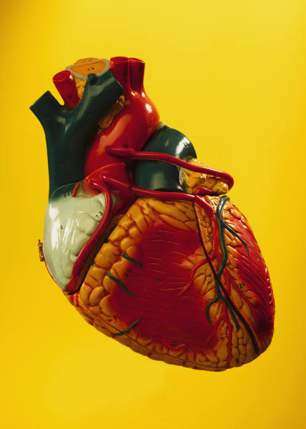
More Models!
Table of Contents
Skeleton
Reproductive
Brain
Skin
Urinary

Slide 62
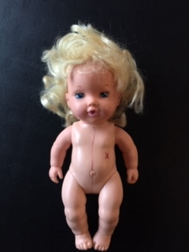
Creepy Baby Doll :)
Table of Contents
Planes
Cavities
Regions
Directional
Quadrants

Slide 63
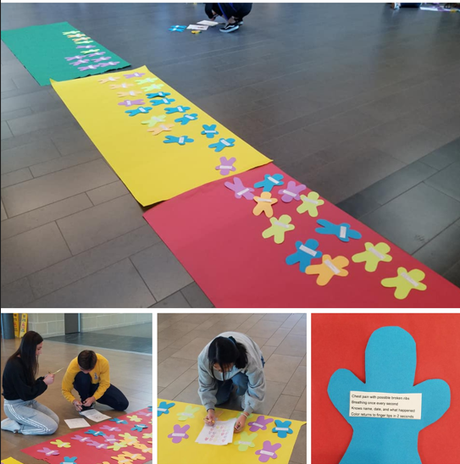
Make a Model
:
Give them a patient

Slide 64
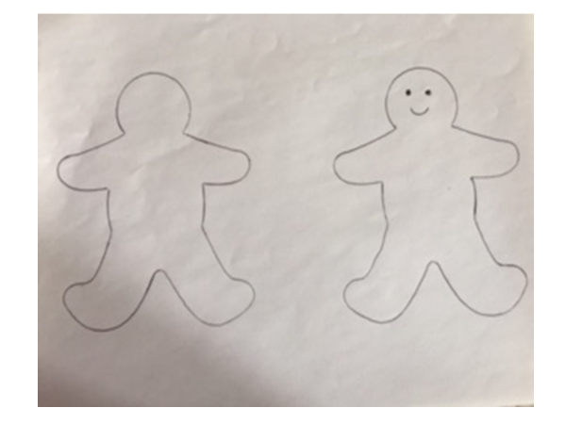
Make a Model
:
Give them a patient

Slide 65
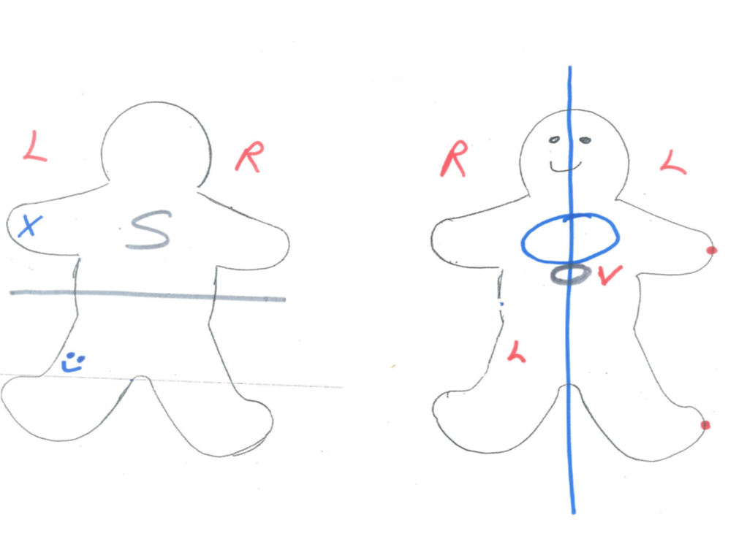
Make a Model
:
Give them a patient

Slide 66
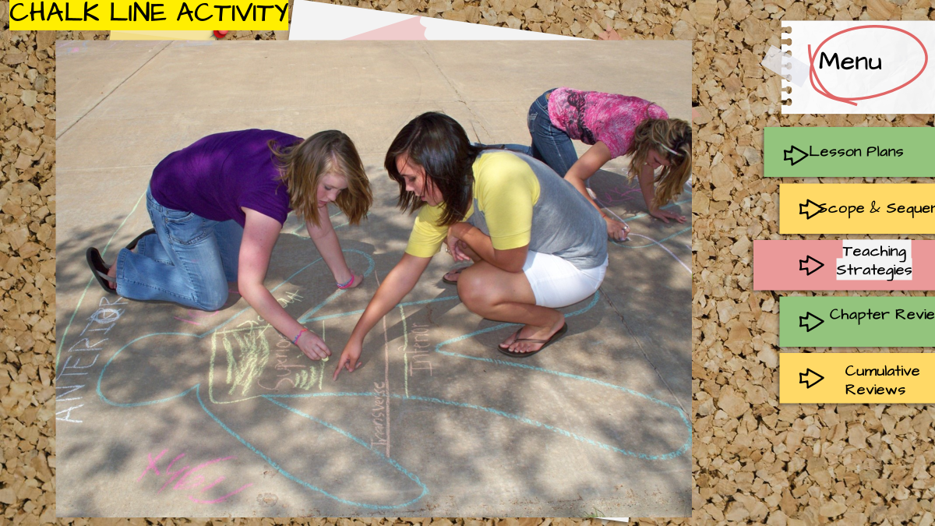
Make a Model
:
Give them a patient

Slide 67
Make a Model
:
Give them a patient

Slide 68
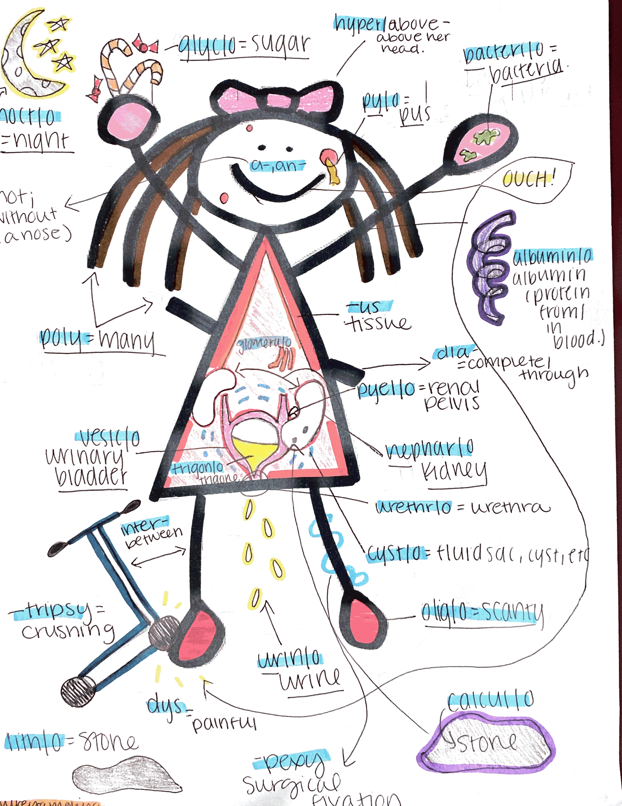
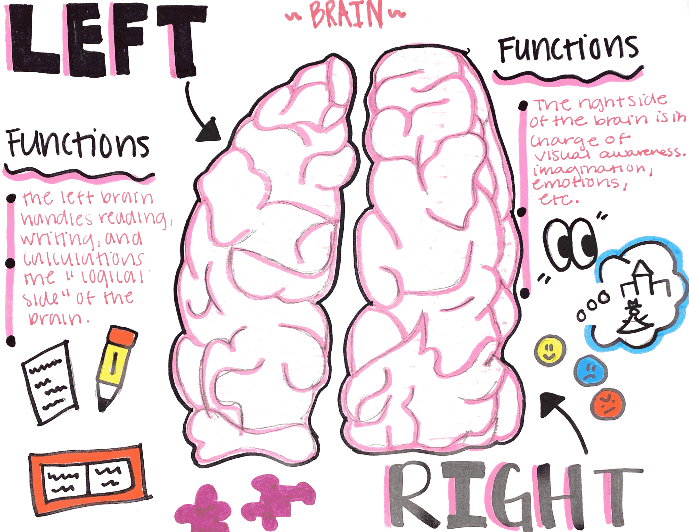
Pinterest Ideas
Table of Contents
Planes
Cavities
Regions
Directional
Quadrants

Slide 69
Pinterest Ideas
Table of Contents
Planes
Cavities
Regions
Directional
Quadrants

Slide 70
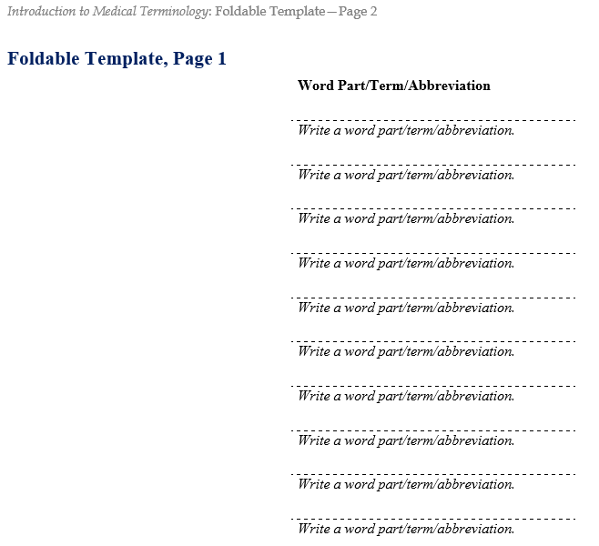
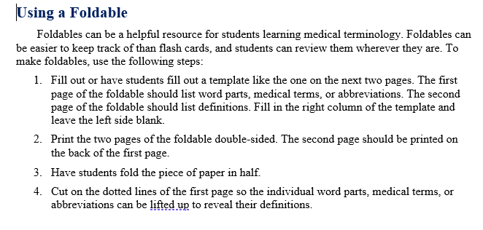
Direction found in Lesson Plans
Foldables
Bell ringers
Exit Tickets
Labs
Flash
cards
White Boards
Review Activities/Foldables Template
Models
Table Groups
Small group Races
Diagram cards
Word Surgery
Word Construction
Diagram Drills

Slide 71
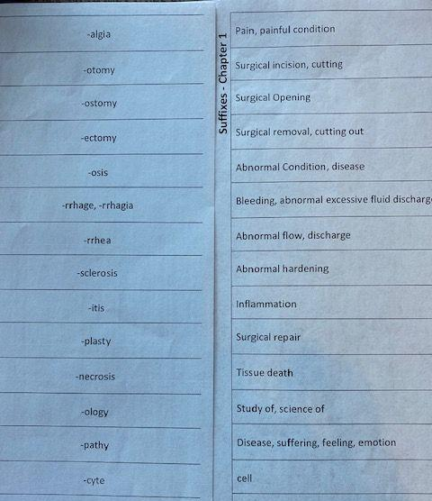
Foldables
Notes:
Have students act out/be visuals for the organs!

Slide 72
Direction found in Lesson Plans
Foldables
Bell ringers
Exit Tickets
Labs
Flash
cards
Games
White Boards
Review Activities/Exit Tickets
Models
Table Groups
Small group Races
Diagram cards
Word Surgery
Word Construction
Diagram Drills
Bingo
Flyswatter
Kahoot
Gimlet
Quizlet

Slide 73
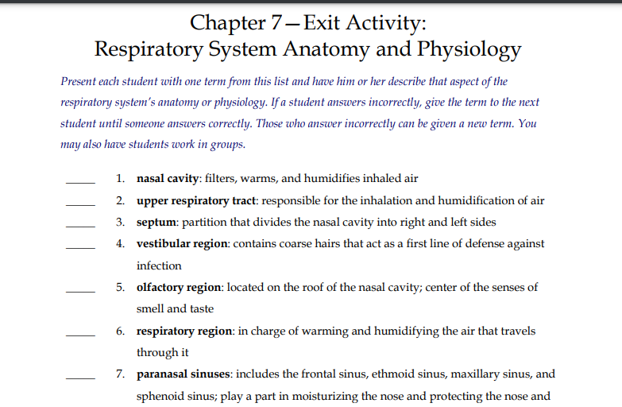
What’s its function?
Exit Ticket

Slide 74
What’s its function?
Bell Ringer
Brain Break
Exit Ticket

Slide 75
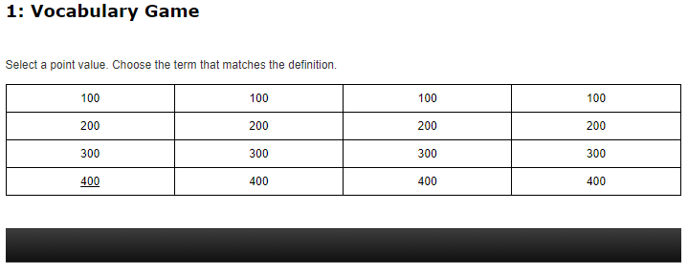
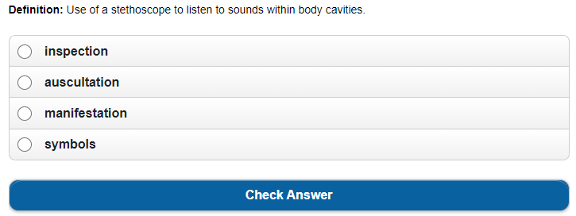
What’s its function?
Exit Ticket

Slide 76
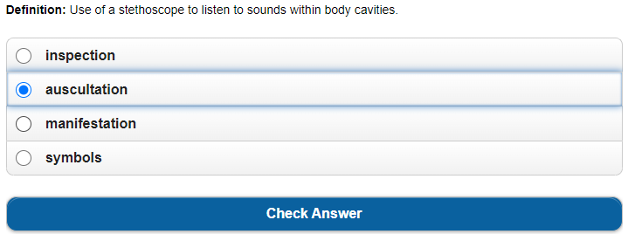
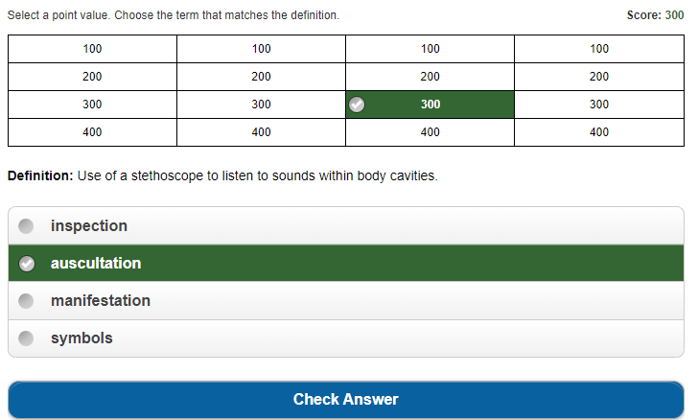
What’s its function?
Exit Ticket

Slide 77
Menu
Lesson Plans
Scope & Sequence
Workbook
Teaching Strategies
Chapter Reviews
Instructor Resources
Cumulative Reviews
!
ExamView
& Games
At your fingertips

Slide 78
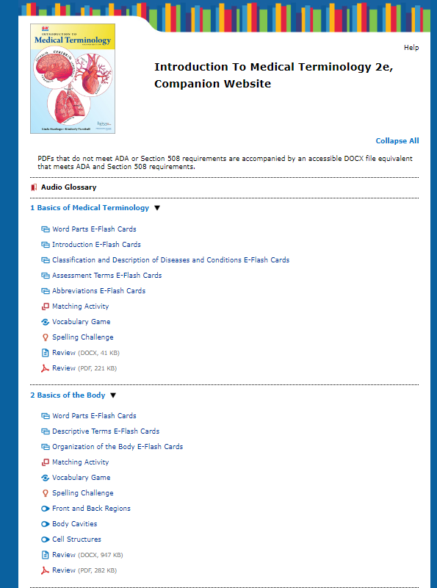
Menu
Lesson Plans
Workbook
Teaching Strategies
Chapter
Instructor Resources
!
ExamView
& Games
Instructor Resources
Companion Website
Digital Activities
At your fingertips

Slide 79
Resources and Autogradeable Options
Notes:
Have students act out/be visuals for the organs!

Slide 80
Lesson Plans include Standards
Notes:
Have students act out/be visuals for the organs!

Slide 81
Lesson Plans timeline
Notes:
Have students act out/be visuals for the organs!

Slide 82
Menu
Lesson Plans
Scope & Sequence
Workbook
Teaching Strategies
Chapter Reviews
Instructor Resources
Cumulative Reviews
!
ExamView
& Games
At your fingertips

Slide 83
Work book features
Notes:
Have students act out/be visuals for the organs!

Slide 84
Please Pick up materials and
Put everything except diagrams back into the bag
??????
Questions
Answers

Slide 85
Contact Information
kim.turnbull62@gmail.com
Introduction to Medical Terminology
2nd Edition
linda.stanhope6@gmail.com
www.g-w.com

Slide 86
Thanks!
Table of Contents
Section 1
Section 2
Section 3
Section 4
Credits
Do you have any questions?
Mallory Dufek, Acquisition Editor - mdufek@g-w.com
Abigail Hess, Marketing Manager - ahess@g-w.com
G-W Goodheart-Willcox Publisher
Please keep this slide for attribution.

