Slide 1
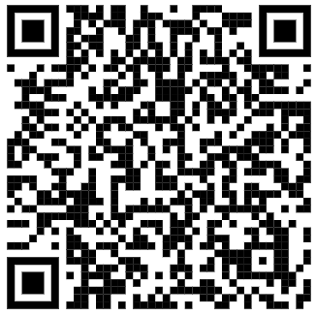
Welcome
START!
Linda Stanhope
Kim Turnbull
Mallory Dufek

Slide 2
Medical Terminology, Alive and Well
Activities
Labs
Scenarios
Drills
Research
What’s NEW in Ed 2

Slide 3
New to Edition Two
Text enhancements for student with disabilities
Combined glossary
New and updated info on Mental Health
COVID-19
Workplace Skills
HOSA Event Prep
Reordering of chapters
Med Term Scavenger Hunts
Medical Transcription Practice

Slide 4
Medical Term Scavenger Hunt
In this chapter, you will learn medical word parts and terms related to basic anatomy and physiology. Before you begin this chapter, read the scenario that follows.
Norah Le, a 16 y/o Asian female, comes to the ER c c/o pain in the RLQ of the abdominal area. The nurse places her in lateral position until the doctor comes in, @ which time pt. is placed in a supine position. Upon PE, while palpating in the Rt iliac region, the pain becomes more intense. Dr. Jutte orders a STAT CBC, UA, HCG, and ultrasound of the abdomen to r/o appendicitis.
For each highlighted medical term or abbreviation, search through this chapter to find the meaning. Some of these terms and abbreviations were introduced in the previous chapter.

Slide 5
Real Life
•
Medical Record Practice

Slide 6
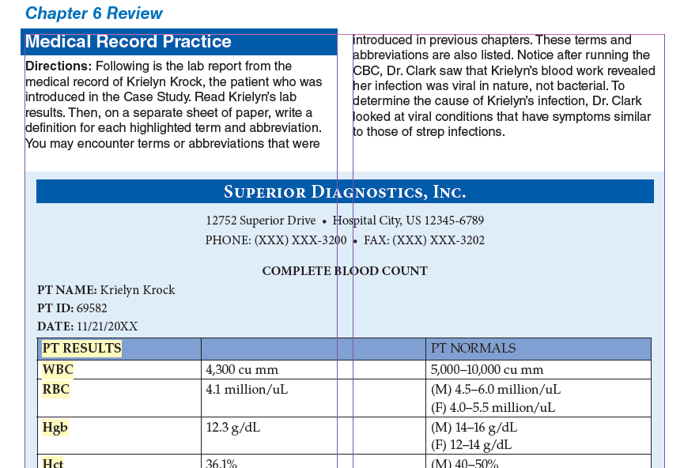
Medical Record
Labs
X-ray Reports
Consultations
H & P
Nurses Notes

Slide 7
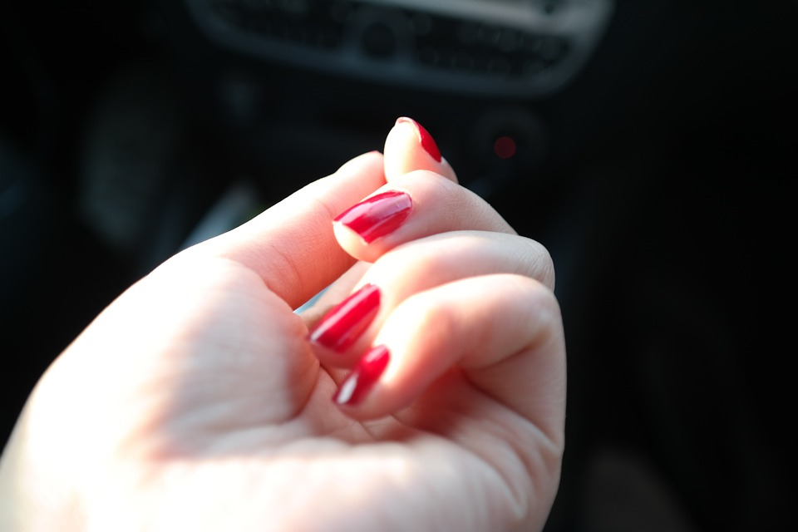
Fingernails
The fingernails are said to cover the dorsal surfaces of the distal phalanges (the bone segments that are the farthest away from the wrist in each hand). From a common-sense point of view, this might seem inaccurate. Should fingernails be located on the anterior, or front, of each hand? Remember, however, that in science and medicine, locations and positions on the human body are described from the perspective of anatomical position. In anatomical position, the body is erect
with the arms at the sides and the palms facing forward. From this point of view, the fingernails cover the dorsal surfaces of the distal phalanges.
NEXT!
Ponder This

Slide 8
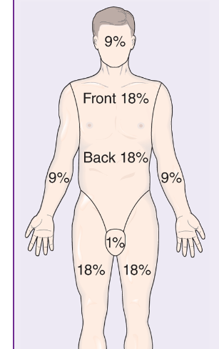
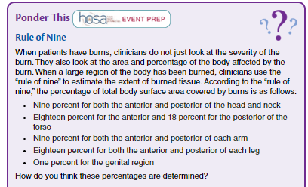
Ponder This
New Ponder This
Labs
X-ray Reports
Consultations
H & P
Nurses Notes

Slide 9
Ponder This
New Ponder This
Labs
X-ray Reports
Consultations
H & P
Nurses Notes
Let’s Practice
Juan suffered burns from an explosion to the entire posterior of his body. What % was affected?
Notes:
Juan – 49.5%

Slide 10
Career Spotlight
A prosthetist (PRAHS-thuh-tist) measures,
designs, fabricates, fits, and services a prosthesis
(prahs-THEE-sis), or artificial limb.
CREDITS
A licensed
physician can prescribe a prosthesis for the
replacement of an extremity due to amputation,
congenital deformity, or absence. A prosthetist
must have at least a master’s degree and complete
a one-year residency to obtain certification.
Prosthetist

Slide 11
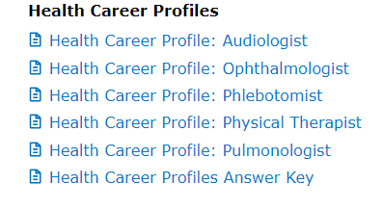
Career Spotlight
A Day in the Life
CREDITS
Career List
Phlebotomist

Slide 12
Career Spotlight
CREDITS
Phlebotomist

Slide 13
Table of Contents
Official Event Resource
Sports Medicine
Career Health
Display
Biomedical Debate
Medical Spelling
Epidemiology
Middle School
Secondary/Postsecondary

Slide 14
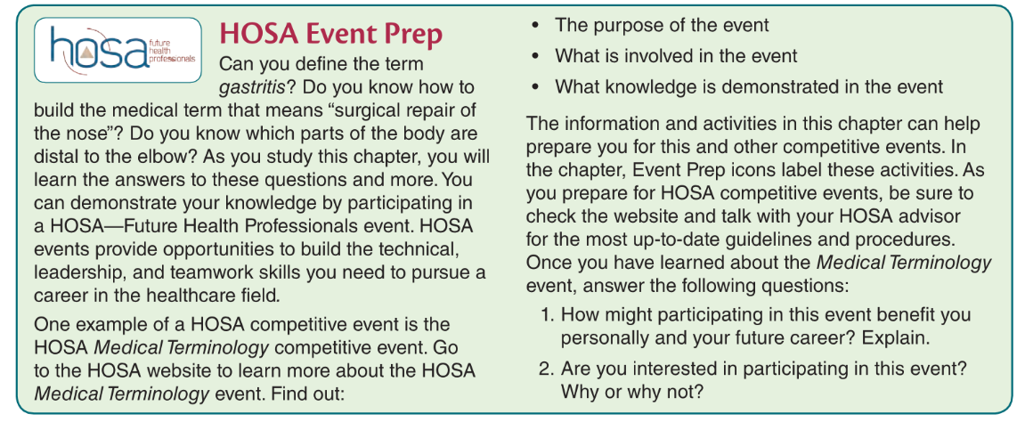
Table of Contents
Event Prep
Sports Medicine
Career Health
Display
Biomedical Debate
Medical Spelling
Epidemiology

Slide 15
The purpose of the event
What is involved in the event?
What knowledge is demonstrated in the event The information and activities in this chapter can help prepare you for this and other competitive events.
1. How might participating in this event benefit you personally and your future career? Explain.
2. Are you interested in participating in this event? Why or why not?
Event Prep
Check it out!

Slide 16
Table of Contents
Event Prep
Sports Medicine
Career Health
Display
Biomedical Debate
Medical Spelling
Epidemiology
Excellent time to encourage your students to participate in Forensic Science. Each chapter suggests different events. This is an excellent opportunity to incorporate HOSA in the classroom.

Slide 17
Table of Contents
Event Prep
Sports Medicine
Career Health
Display
Biomedical Debate
Medical Spelling
Epidemiology

Slide 18
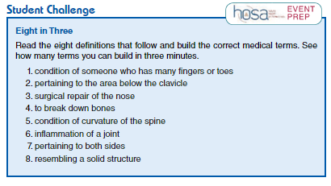
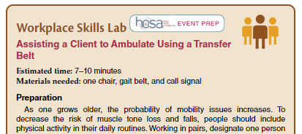
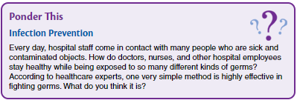
More HOSA Events
And, much, much more

Slide 19
New Labs in Intro to Medical Terminology, 2nd Ed
Inquiring Minds
Labeling the Body
Skin Function
Fingerprints
Understanding Calcium - chicken bones
Rigor Mortis
Blood Type & Cross
Pulse points
Arrhythmias
Rhinovirus - research lab
Virus mutations - research COVID mutations
Digestion in Oral Cavity
Diarrheal Diseases - top 5
Diarrheal Diseases - top 5
Developmental Disabilities - research
Neuro VS
Supertasters
Taste and Smell
Type I & Type II DM - research
Hydration - group lab
Prostate Cancer Tx - research
Types of Birth Control - small group research
PMS - research
DNA Testing

Slide 20
Kitchen Labs
Lesson for Osmosis to help students understand concepts of
Hypertonic
Hypotonic
Isotonic
Fetal Alcohol Syndrome

Slide 21
Dipstick Lab
Workplace Lab
HOSA Competition
Real world application
Springboard discussion over hydration, infection, diabetes/disease conditions

Slide 22
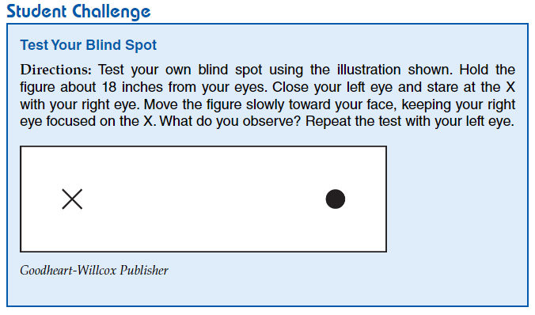
Test your Blind Spot

Slide 23
Direction found in Lesson Plans
Foldables
Bell ringers
Exit Tickets
Labs
Inquiring Minds
Student Challenge
Team Challenge
More Student Labs
Additional Labs found in Teacher Resources
Models
Pulse Points
Skin Function
Understanding Calcium
Your Spine in Action
Long Bones
Dig Deeper
Trash Skin Cell Project
Punnett Square Practice
Calculating I/O

Slide 24
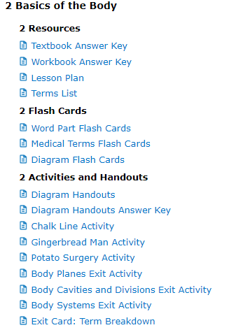
Menu
Lesson Plans
Scope & Sequence
Games
Teaching Strategies
Chapter Reviews
Labs in Teacher Resources
!
ExamView

Slide 25
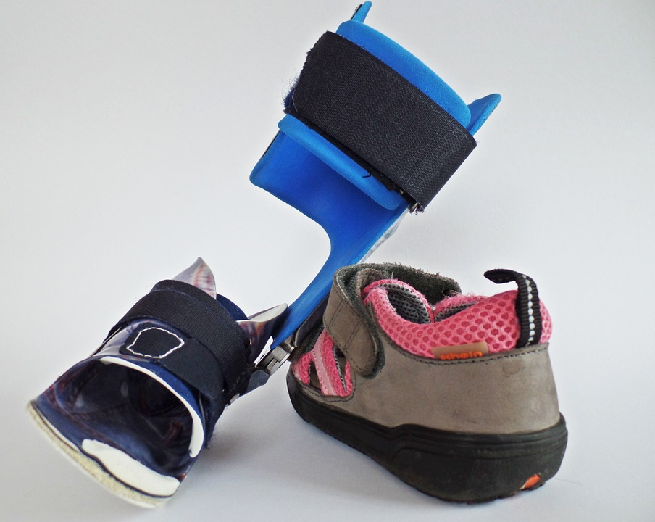
Walk in the patient’s shoes -
Literally
Help teach students empathy for their patients through simulations of disabilities
Breathing problems- have students' breath through straws and compression binders
Aging- have students wear braces and use canes and walkers
Hemiparesis/stroke – tie down limbs with braces or torn rags to restrict movement

Slide 26
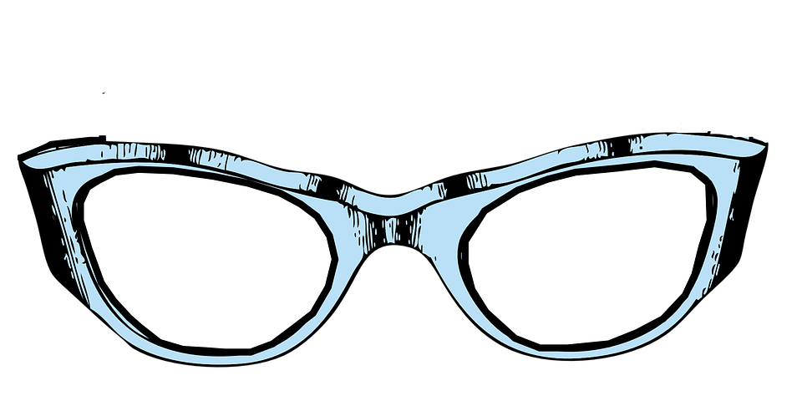
Walk in the patient’s shoes -
Literally
Help teach students empathy for their patients through simulations of disabilities
Vision- cheap readers, Vaseline, sleep mask
Arthritis- tape fingers/toes, rice or popcorn kernels in disposable gloves and socks, sticks
Sensory perception- thin or thick gloves and blindfolds
Hearing-earplugs and noise canceling headphones

Slide 27
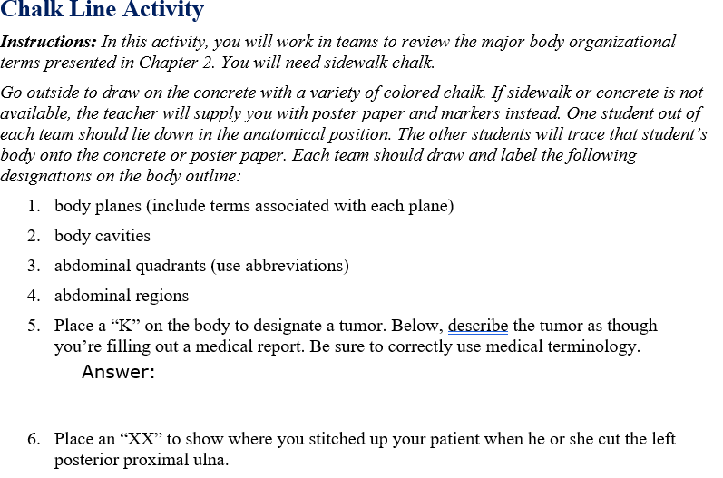
Menu
Lesson Plans
Scope & Sequence
Games
Teaching Strategies
Chapter Reviews
Cumulative Reviews
CHALK LINE ACTIVITY
ExamView

Slide 28
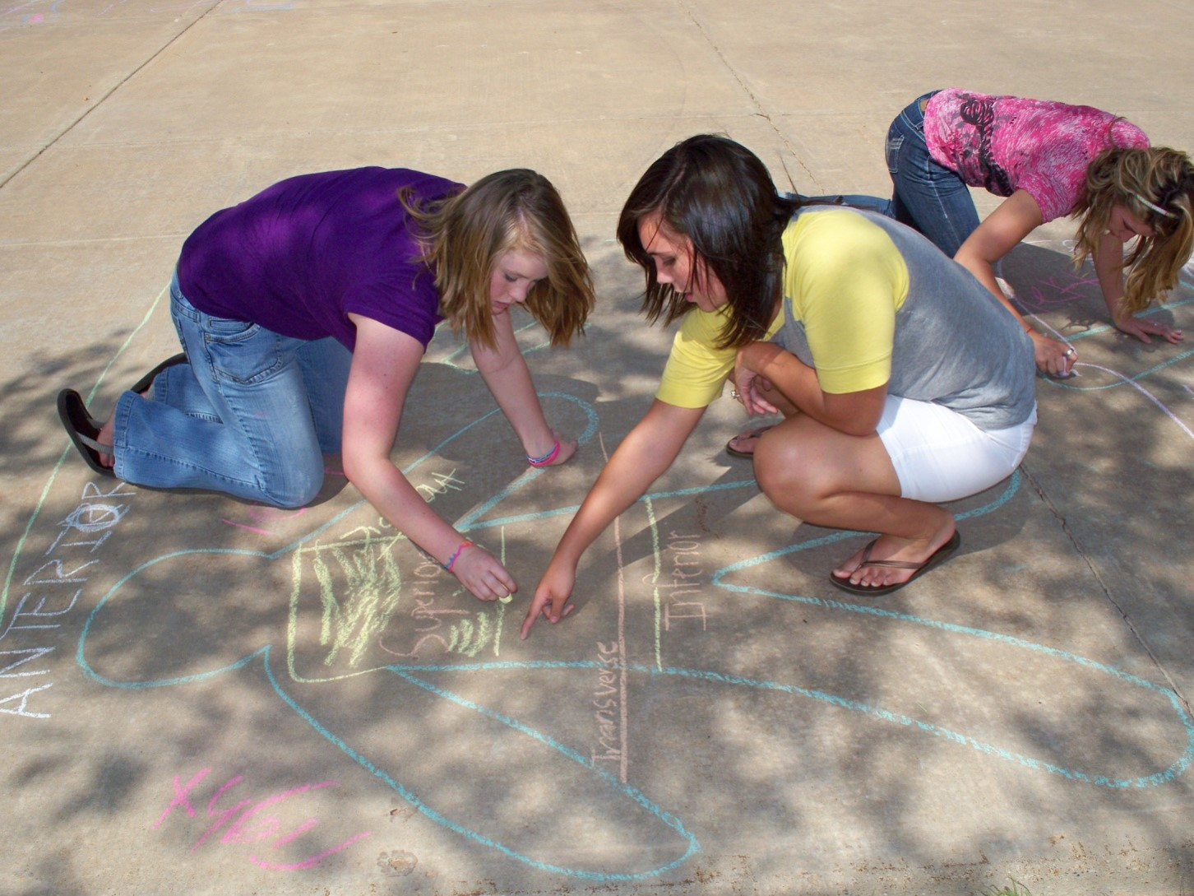
Menu
Lesson Plans
Scope & Sequence
Games
Teaching Strategies
Chapter Reviews
Cumulative Reviews
CHALK LINE ACTIVITY
ExamView

Slide 29
Student Challenge - 1 of 30
Percentage Body Weight
Blake weighs 140 pounds, 60 pounds of which are muscle. What percentage of Blake’s body weight is muscle?
¼ = 25%
Calculate this
The ratio of muscle to total body weight is often expressed as a percentage. Percentages can also be expressed as fractions. To calculate a percentage, first set up a fraction. Then divide the numerator (top number) by the denominator (bottom number).
2. What is the percentage of muscle weight for an 80-pound female with 35 pounds of muscle?
Math!!

Slide 30
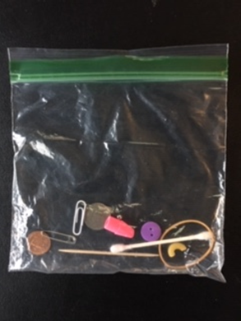
Student Challenge - oldy, but goody
What is
neuropathy?
In this activity students will work in pairs to perform a modified version of the
Some
materials
required
“Stereognosis Exam”

Slide 31
Respiratory Organs
Team Challenge
Respiratory System organs
Left lung
Using the slips of paper to arrange the organs in order
trachea
During inhalation
alveoli
Check Answer Key
bronchus
Now exhale
pharynx
Shuffle slips and repeat for time against other teams

Slide 32
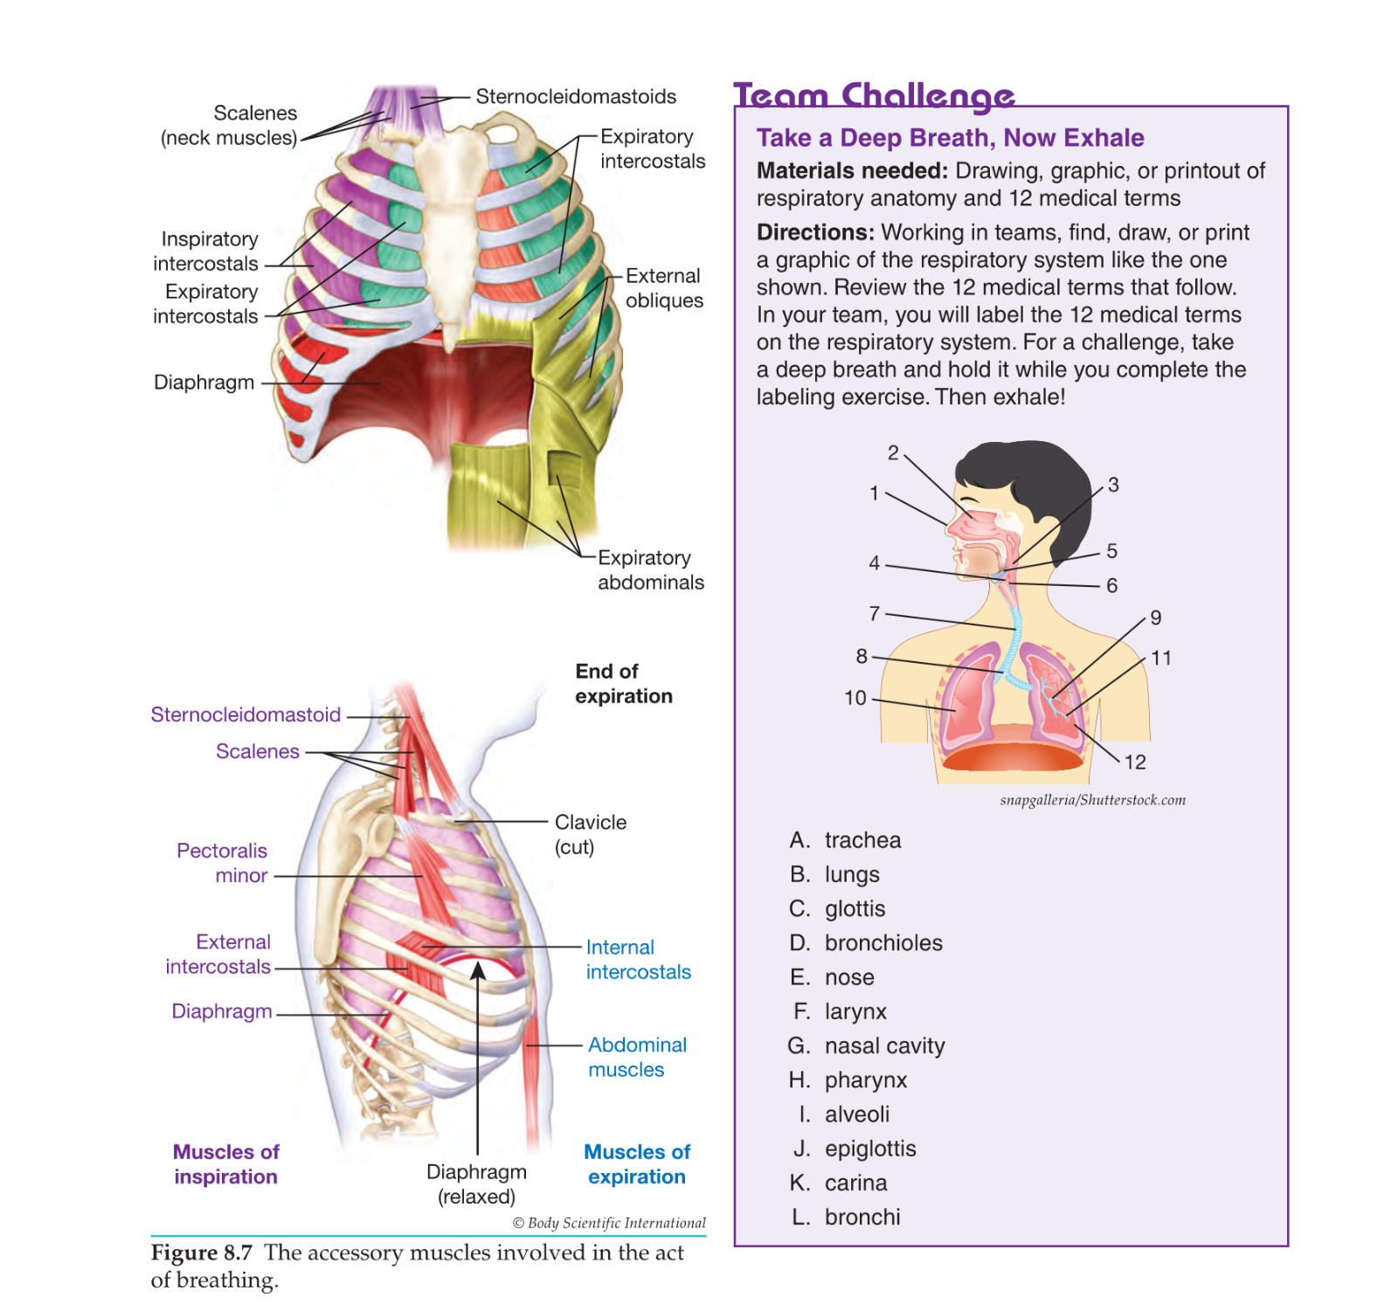
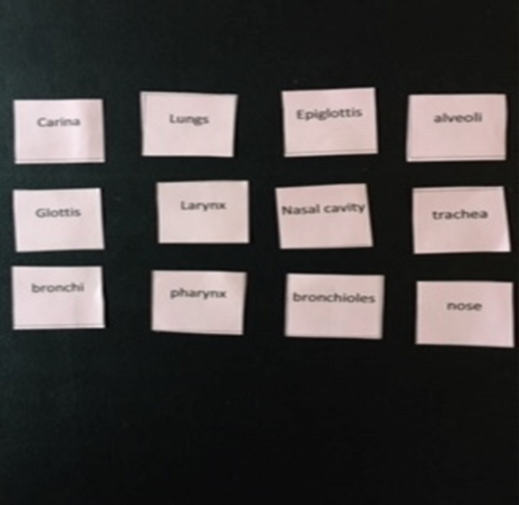
Team Challenge
:
Breathe In! Breathe Out!

Slide 33
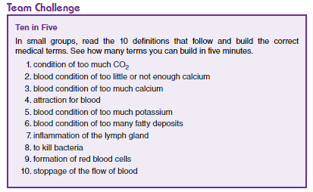
Team Challenge – Ten in Five
:

Slide 34
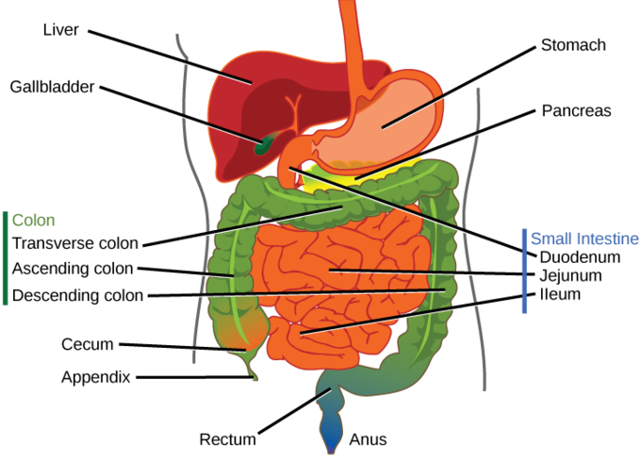
This Is a Map!
Table of Contents
Stomach
Duodenum
Jejunum
Ileum
Colon
Team Challenge

Slide 35
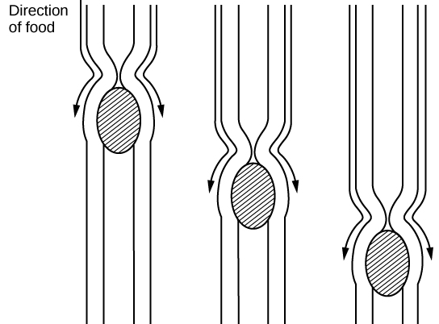
What happens to the “Corn” we eat?
Team Challenge
The organs,
Enzymes and how long does it take
DIG DEEPER

Slide 36
The GI Organs!
Stomach
Acidic and churns food to digest.
breaks down protein
The liver processes the blood and breaks down, balances, and creates nutrients for the body to use.
Bile from the gallbladder
Helps break down and digest fats
Large Intestine
Absorbs water and and expels waste (POOP!)
https://www.dailymotion.com/video/x6tx7y5
Physiology
Small Intestines
This is where most of the absorption of nutrients occurs

Slide 37
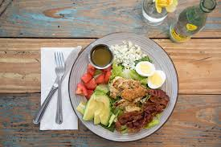
Inquiring Minds
Therapeutic Diet:
Any special diet
Enterally: Through a Feeding Tube
Parenteral: nutrition given
through an IV due to a non
functioning GI tract
Registered Dietitian: assesses nutritional status and plans diets according to needs of the patient.

Slide 38
Specialized Diets for Patients
Inquiring Minds
Clear Liquid: Clear broth and juice, ginger ale, gelatin, popsicles, clear coffee, tea.
Requires minimal digestion - common after surgery
Full Liquid: Strained soups/cereals, coffee, fruit and veggie juice, ice cream, pudding + all clear liquids.
If unable to chew or swallow solid food (transition diet b/w clear liquid and solid food).
Soft and Bland
When a patient cannot swallow hard or coarse food.
Mechanical Soft: Soft diet except food is ground or strained.

Slide 39
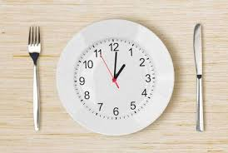
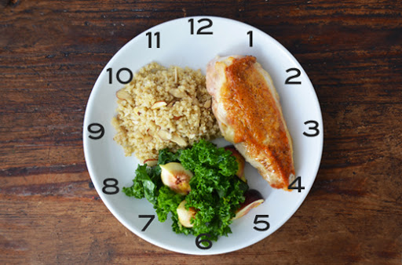
Student Challenge
If the patient is unable to see and would like to feed himself, describe the position of the food on the tray.
Ie - cold liquids in the left corner, hot liquids in the right corner.
Describe the food on the plate in terms of a clock face.

Slide 40
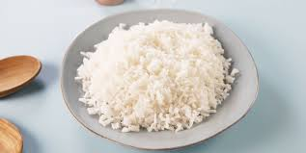
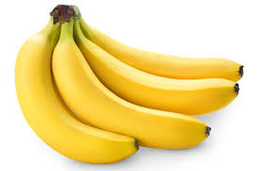
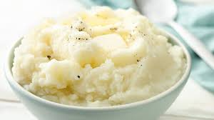
Collage ideas!
Notes:
Bland

Slide 41
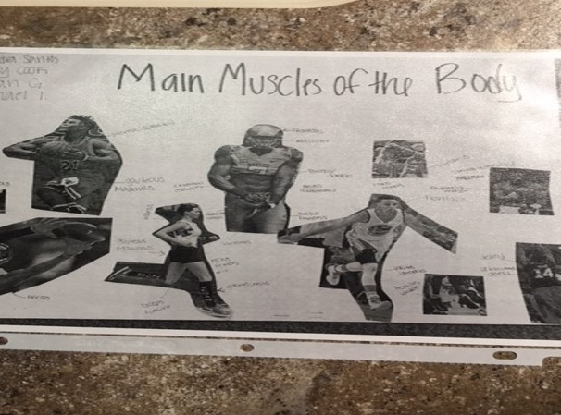
Collage ideas!

Slide 42
Work Place SKILLS,
in every chapter
Skill #17
Height & Weight
SKILL #10
Feeding the Dependent
Resident
Skill #4
Range of Motion
Skill # 8
Taking a
Pulse

Slide 43
Start with
terms students understand
Range of Motion
Snow Angel Arms
1
2
3
Brush your Hair
Open the door
Ankle circles
4
5
6
Passive ROM
Students take turns being patient and caregiver
Work Place Skills
Abduction
And
Adduction
Flexion
And
Extension
Pronation
And
Supination
Inversion
And
Eversion
Circumduction
Rotation
lateral/medial

Slide 44
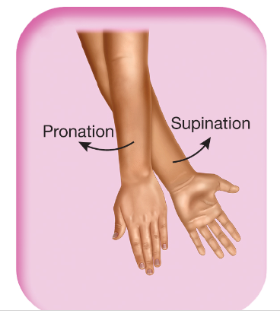
Start with
terms students understand
Range of Motion
Snow Angel Arms
1
2
3
Brush your Hair
Open the door
Ankle circles
4
5
6
Passive ROM
Students take turns being patient and caregiver
Work Place Skills
Abduction
And
Adduction
Flexion
And
Extension
Pronation
And
Supination
Inversion
And
Eversion
Circumduction
Rotation
lateral/medial

Slide 45
End of Chapter Reviews in the Book
Word Surgery and Word construction.
Medical Records Practice and Doctors orders
Word Parts
And
Abbreviations
Anatomy
and Physiology
Matching
Spelling
Pronunciation
Exercises

Slide 46
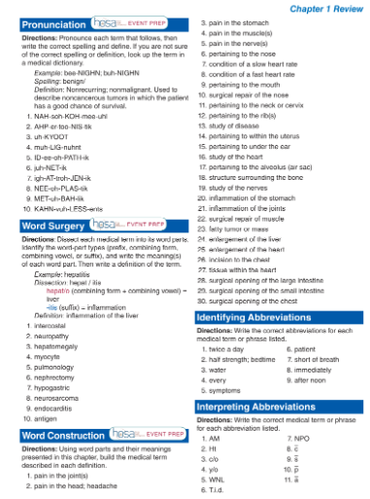
End of Chapter Reviews in the Book

Slide 47
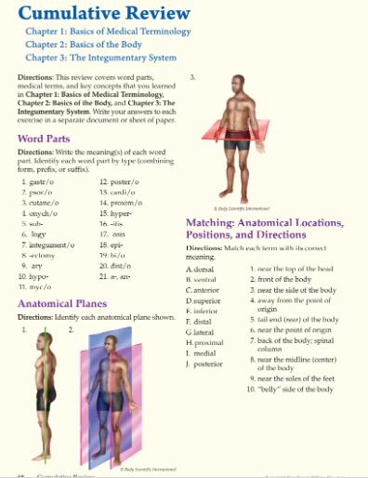
Cumulative Reviews in addition

Slide 48
Direction found in Lesson Plans
Foldables
Bell ringers
Exit Tickets
Labs
Flash
cards
Games
White Boards
Review Activities
Models
Table Groups
Small group Races
Diagram cards
Word Surgery
Word Construction
Diagram Drills
Bingo
Flyswatter
Kahoot
Gimlet
Quizlet

Slide 49
Word Surgery

Slide 50
Myo/rrhexis

Slide 51
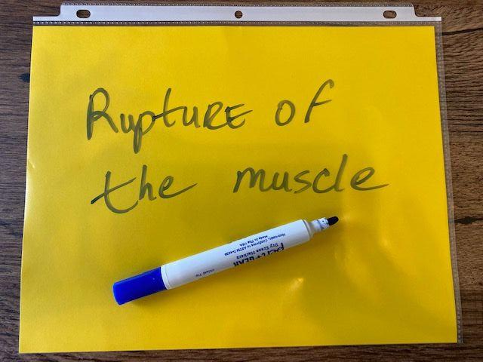

Slide 52
Rupture of the muscle

Slide 53
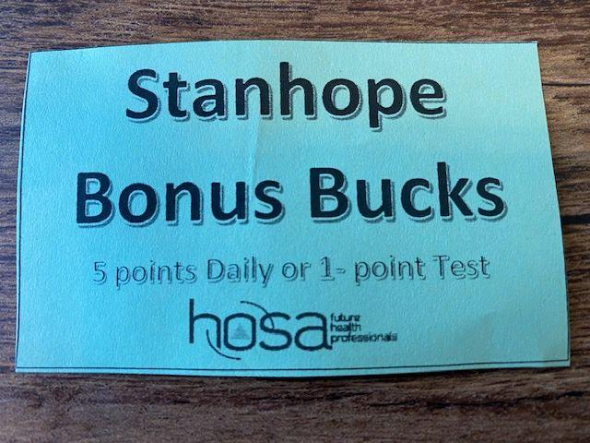

Slide 54
Direction found in Lesson Plans
Foldables
Bell ringers
Exit Tickets
Labs
Flash
cards
Games
White Boards
Review Activities
Models
Table Groups
Small group Races
Diagram cards
Word Surgery
Word Construction
Diagram Drills
Bingo
Flyswatter
Kahoot
Gimlet
Quizlet

Slide 55
Word Construction

Slide 56
Condition of without a rhythm

Slide 57
Arrhythmia

Slide 58
Direction found in Lesson Plans
Foldables
Bell ringers
Search the Source
Labs
Flash
cards
Games
White Boards
Review Activities
Models
Table Groups
Small group Races
Diagram cards
Word Surgery
Word Construction
Diagram Drills
Bingo
Flyswatter
Kahoot
Gimlet
Quizlet

Slide 59
Directions: Using reliable and credible online resources, complete the following activities.
1. The Ebola outbreak in 2014 was one of the largest Ebola outbreaks in history, and it was the first Ebola outbreak in West Africa. Visit the Centers for Disease Control and Prevention website and research signs and symptoms of Ebola hemorrhagic fever (EHF). Then study the graph below and answer the questions that follow.
A. What was the number of confirmed cases of Ebola in Guinea during the week of June 8, 2014? - Answer 33 B. What was the number of suspected cases the same week? -- Answer 4
C. Which time frame saw the highest number of confirmed cases of Ebola? Week of March 16, 2014 Week of April 13, 2014 Week of May 25, 2014
Search the Source

Slide 60
Direction found in Lesson Plans
Foldables
Bell ringers
Exit Tickets
Labs
Flash
cards
Games
White Boards
Review Activities/Diagram Drills
Models
Table Groups
Small group Races
Diagram cards
Word Surgery
Word Construction
Diagram Drills
Bingo
Flyswatter
Kahoot
Gimlet
Quizlet

Slide 61
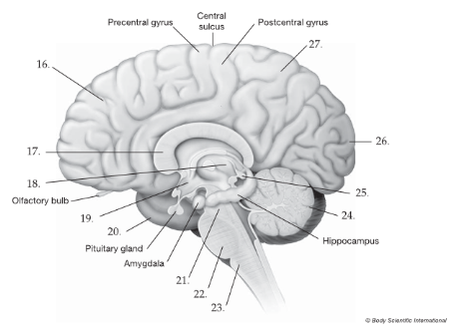
Diagram Drill

Slide 62
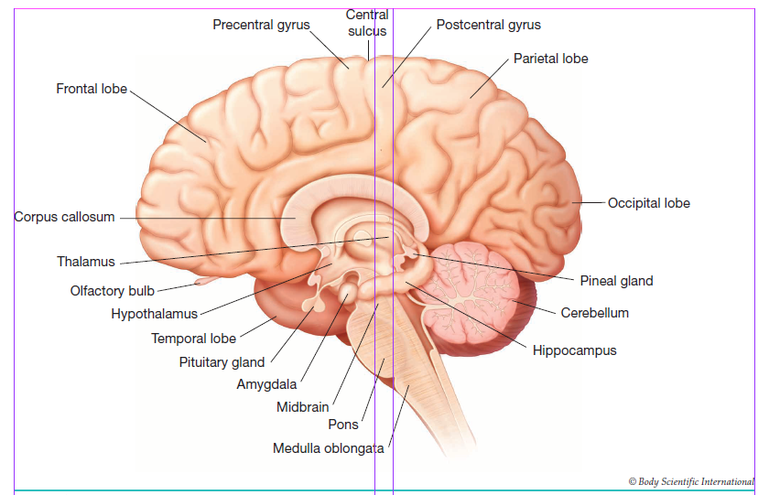
Diagram Drill

Slide 63
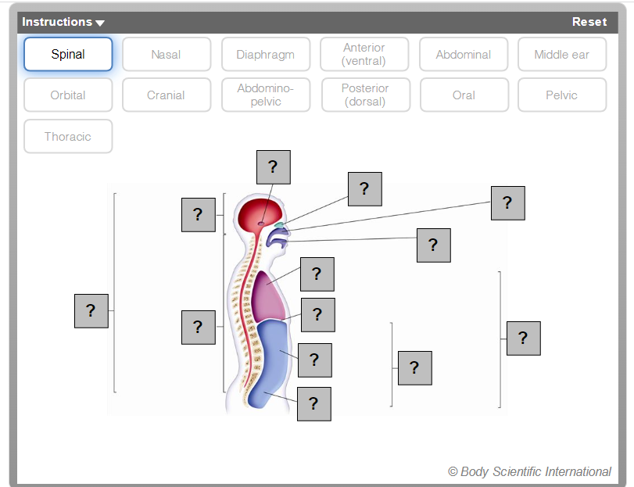
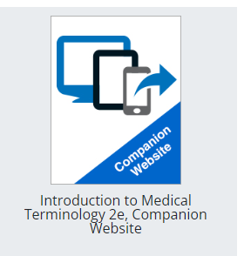
Companion Website

Slide 64
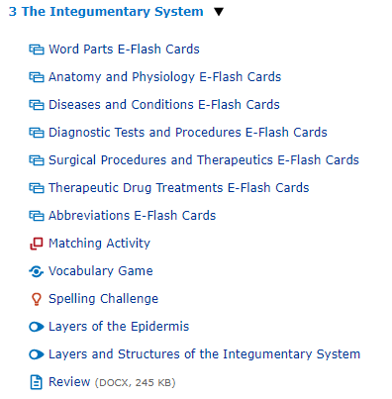
Companion Website

Slide 65
Companion Website
https://www.g-wonlinetextbooks.com/introduction-medical-terminology-cws-2023/~~Attachments/index.htm

Slide 66
Direction found in Lesson Plans
Foldables
Bell ringers
Exit Tickets
Labs
Flash
cards
Games
White Boards
Review Activities/Diagram cards
Models
Table Groups
Small group Races
Diagram cards
Word Surgery
Word Construction
Diagram Drills
Bingo
Flyswatter
Kahoot
Gimlet
Quizlet

Slide 67
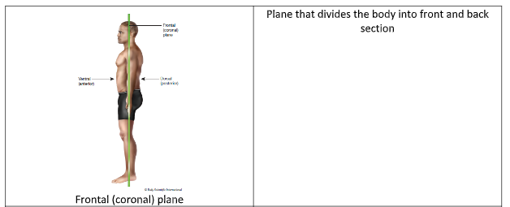
Diagram Card

Slide 68
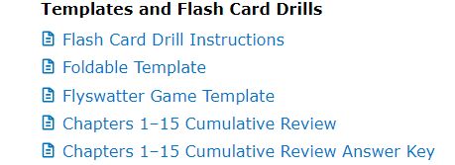
Direction found in Lesson Plans
Foldables
Bell ringers
Exit Tickets
Labs
Flash
cards
Games
White Boards
Review Activities/ Flashcards
Models
Table Groups
Small group Races
Diagram cards
Word Surgery
Word Construction
Diagram Drills
Bingo
Flyswatter
Kahoot
Gimlet
Quizlet

Slide 69
Flashcards
Drills
Term
Definition
Nephr/o
kidney
Practice!!

Slide 70
Flash Card Drill Instructions

Slide 71
Direction found in Lesson Plans
Foldables
Bell ringers
Exit Tickets
Labs
Flash
cards
Games
White Boards
Review Activities/Flyswatter game
Models
Table Groups
Small group Races
Diagram cards
Word Surgery
Word Construction
Diagram Drills
Bingo
Flyswatter
Kahoot
Gimlet
Quizlet

Slide 72
Flyswatter
Template is available in Teacher Resources

Slide 73
Direction found in Lesson Plans
Foldables
Bell ringers
Exit Tickets
Labs
Flash
cards
Games
White Boards
Review Activities/Models
Models
Table Groups
Small group Races
Diagram cards
Word Surgery
Word Construction
Diagram Drills
Bingo
Flyswatter
Kahoot
Gimlet
Quizlet

Slide 74
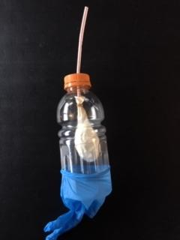
Make a Model!
Table of Contents
Trachea
Diaphragm
Lungs
Pharynx
Pleural cavity

Slide 75
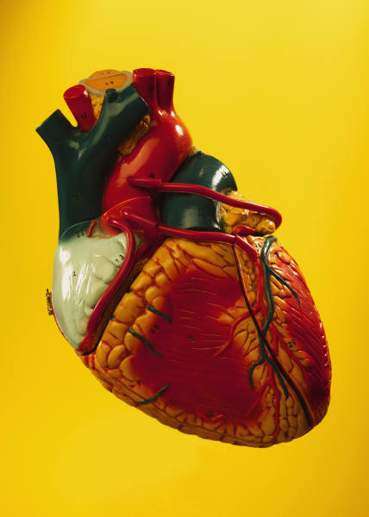
More Models!
Table of Contents
Skeleton
Reproductive
Brain
Skin
Urinary

Slide 76
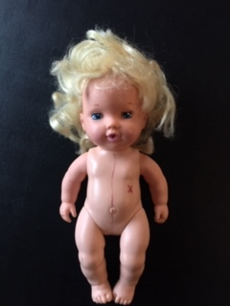
Creepy Baby Doll :)
Table of Contents
Planes
Cavities
Regions
Directional
Quadrants

Slide 77
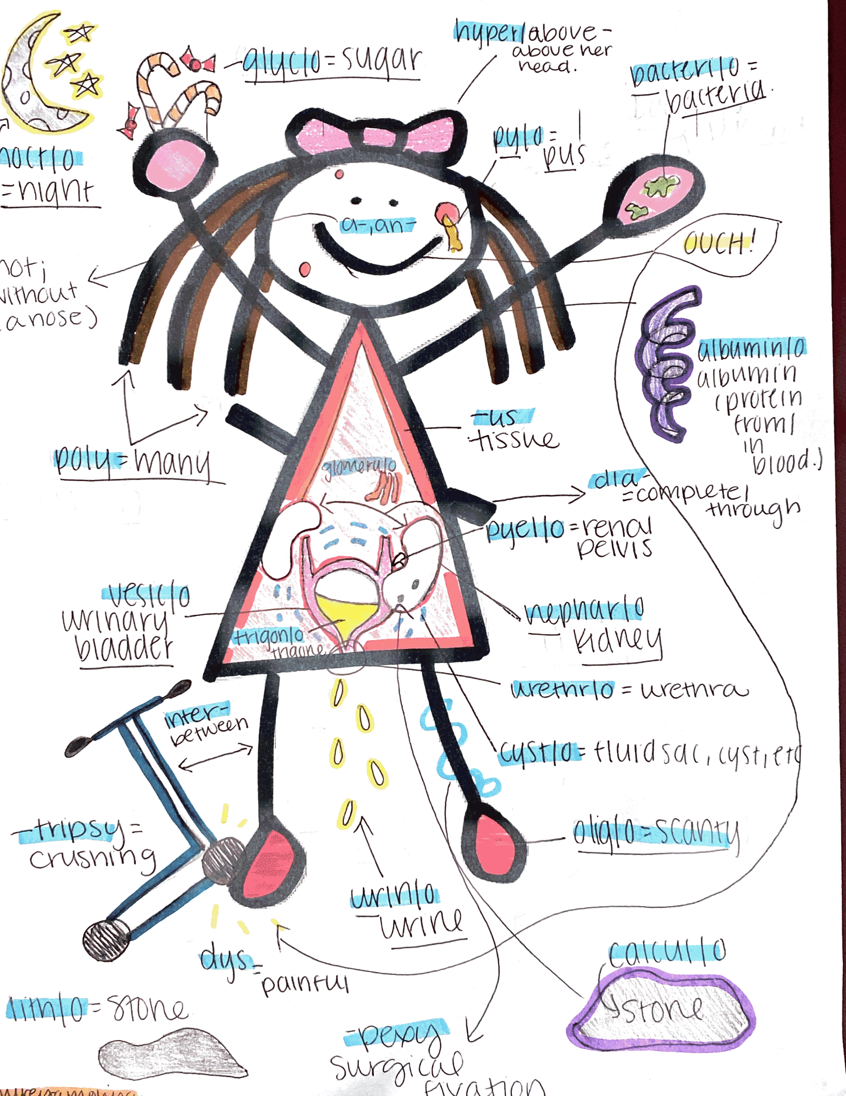
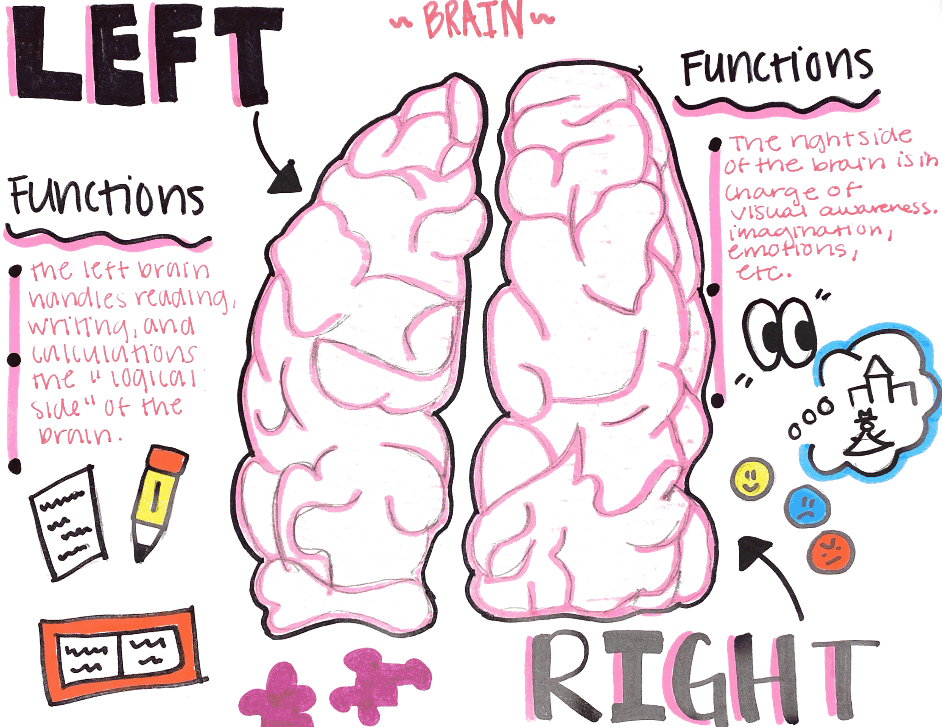
Pinterest Ideas
Table of Contents
Planes
Cavities
Regions
Directional
Quadrants

Slide 78
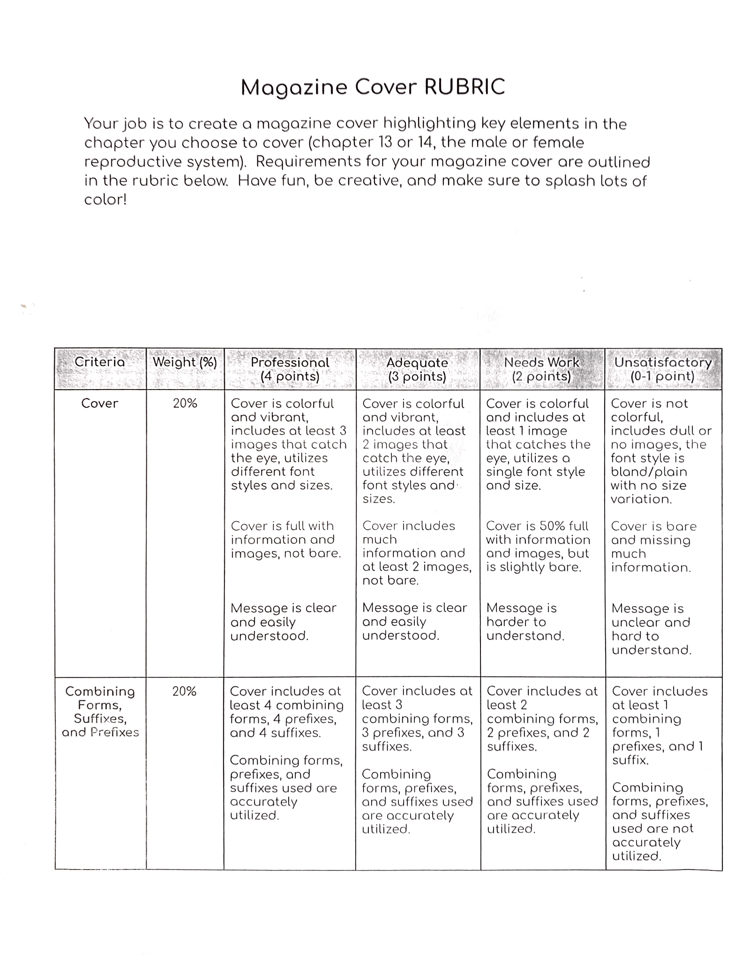
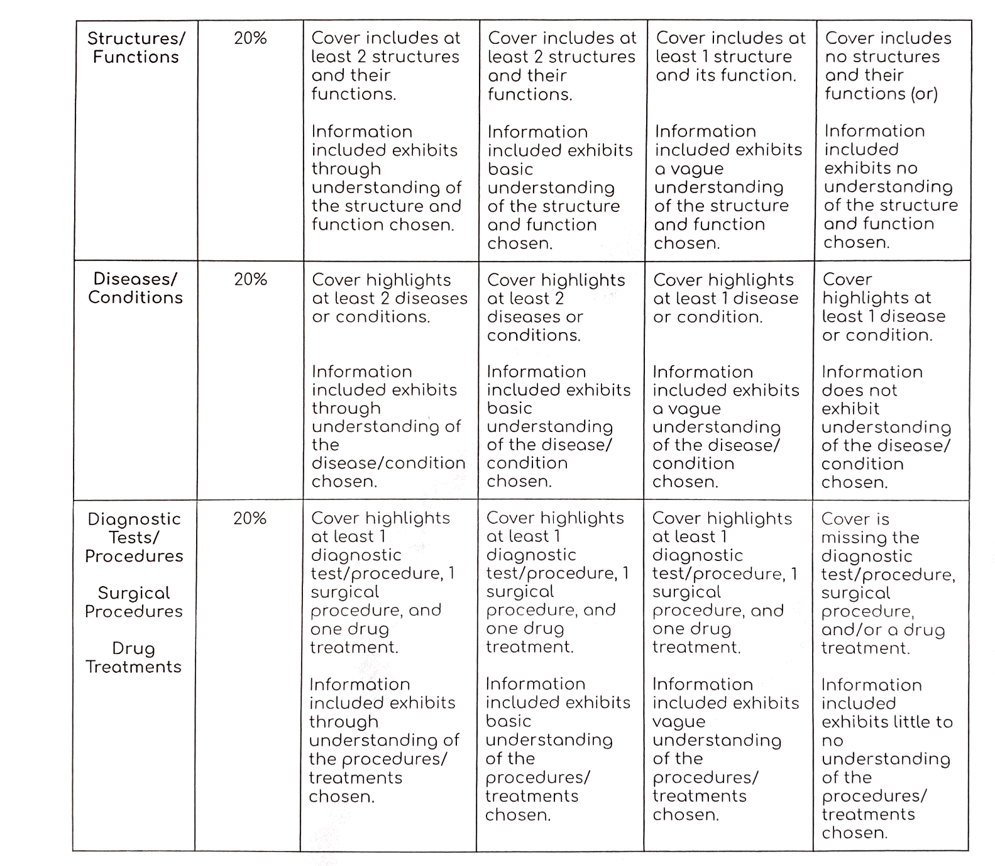
Pinterest Ideas
Table of Contents
Planes
Cavities
Regions
Directional
Quadrants

Slide 79
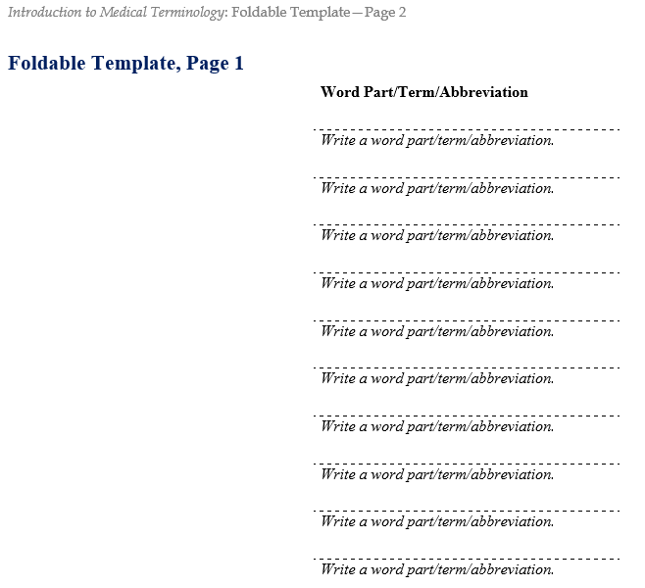
Direction found in Lesson Plans
Foldables
Bell ringers
Exit Tickets
Labs
Flash
cards
Games
White Boards
Review Activities/Foldables Template
Models
Table Groups
Small group Races
Diagram cards
Word Surgery
Word Construction
Diagram Drills
Bingo
Flyswatter
Kahoot
Gimlet
Quizlet

Slide 80
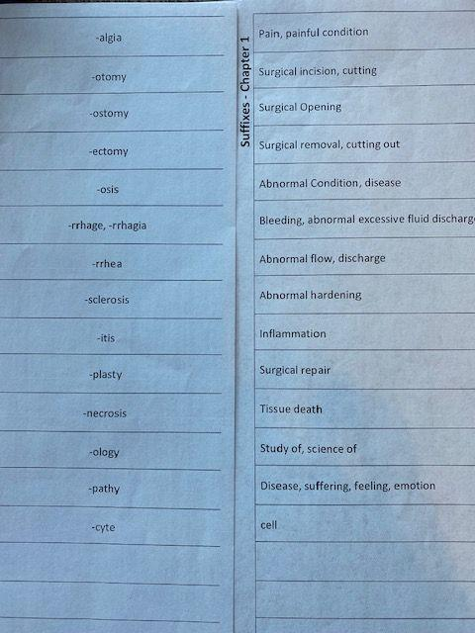
Foldables

Slide 81
Direction found in Lesson Plans
Foldables
Bell ringers
Exit Tickets
Labs
Flash
cards
Games
White Boards
Review Activities/Exit Tickets
Models
Table Groups
Small group Races
Diagram cards
Word Surgery
Word Construction
Diagram Drills
Bingo
Flyswatter
Kahoot
Gimlet
Quizlet

Slide 82
What’s its function?
Exit Ticket

Slide 83
What’s its function?
Exit Ticket

Slide 84
What’s its function?
Exit Ticket

Slide 85
Resources and Autogradeable Options

Slide 86
Menu
Lesson Plans
Scope & Sequence
Workbook
Teaching Strategies
Chapter Reviews
Instructor Resources
Cumulative Reviews
!
ExamView
& Games
At your fingertips

Slide 87
Lesson Plans include Standards

Slide 88
Lesson Plans timeline

Slide 89
Menu
Lesson Plans
Scope & Sequence
Workbook
Teaching Strategies
Chapter Reviews
Instructor Resources
Cumulative Reviews
!
ExamView
& Games
At your fingertips

Slide 90
Work book features

Slide 94
Q & A
??????
Questions
Answers

Slide 95
Contact Information
kim.turnbull62@gmail.com
Introduction to Medical Terminology
2nd Edition
linda.stanhope6@gmail.com
www.g-w.com

Slide 96
Thanks!
Table of Contents
Section 1
Section 2
Section 3
Section 4
Credits
Do you have any questions?
Mallory Dufek, Acquisition Editor - mdufek@g-w.com
Abigail Hess, Marketing Manager - ahess@g-w.com
G-W Goodheart-Willcox Publisher
Please keep this slide for attribution.

