Slide 1
Instructor Competencies

Slide 2
Objectives
Discuss basic communication skills and their importance for instructors
List two ways to enhance classroom communications

Slide 3
WIIFM
WIIFM: It is essential for CERT instructors to communicate CERT training effectively so that the resulting skills are comprehensive and can be relied on by professional responders in an emergency.
Knowles: learners need to know why they should learn something.

Slide 4
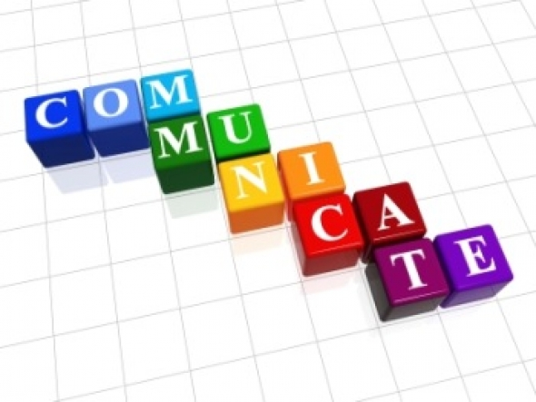
Communications
Basic Communications
What you say, how you say it
Verbal (read, speak, write), musical
Engage! Motivate!
What you do, what your body
language says
Body (role play, hands-on),Visual (charts)
Gardner’s Multiple Intelligences

Slide 5
Communications
Create meaningful perceptions
Bloom’s Cognitive Domain: Comprehension
People interpret things differently “Do Not Enter”
Watch your class for non-verbal communications from learners
Bobbing heads
Confused looks
Maintain an “open door” policy
Creates two-way information flow
Enhances your “safe” environment

Slide 6
Enhancing Communication
Learning Involves Making Hundreds of Decisions
Provide as much pertinent information as possible; question to check perceptions and comprehension
Avoid the weeds
Results depend on the cognitive perceptions you create
Vary the ways you communicate!
Utilize at least three of Gardner’s learning styles
Verbal, Visual, Kinesthetic are used most often
Lecture, discussion, demonstrations, activities and other are all modes of communicating information

Slide 7
Discussion
What are some other reasons that excellent communication skills are especially critical for instructors?

Slide 8
Revisions
Slide 2: Gagne’s Nine Events, event 2. Inform learners of objectives.
Slide 3: WIIFM, Knowles’ six assumptions. The learner’s need to know why they should learn something.
Slide 4: Three of Gardner’s Multiple Intelligence learning styles
Slide 5: Refers to 3 of Gardner’s learning styles: verbal, visual, and kinesthetic
Slide 6: Blooms Cognitive and Affective Domains

