Slide 1
CERT MASTER INSTRUCTOR Texas Community Preparedness

Slide 2
Welcome!
Instructor Introductions:
Jackie Uselton
Peggy Fonseca

Slide 3
Housekeeping
Emergency
Exits (fire)
Muster location
Shelter (storm)
AED and fire extinguisher locations
Rest rooms
Smoking area
Water, refreshments, meals
Special needs or requests

Slide 4
Class Rules
Show courtesy and respect for others at all times
Put cell phones on silent and face down during class
Please exit the classroom if you must make or take a call
Please wait to be called on to provide input; refrain from interrupting other speakers
Practice inclusion; encourage contributions from all participants
Be ready to continue discussions on break
Limit sidebar conversations
Have fun!

Slide 5
Participant Introductions
In one minute, please provide:
Name
Jurisdiction
Years of CERT experience
One thing you hope to learn in this class

Slide 6
And now…TEAM UP!
Learn creative ways to group
Builds camaraderie and class morale
Enables new networking opportunities
Gets participants moving
Creates opportunities to learn new approaches and perspectives
Famous Duos

Slide 7
INTRO TO TEXAS CERT MASTER INSTRUCTOR
INTRO TOI

Slide 8
Goals
CERT Master Instructor Course Goals
1) To build a State cadre of highly qualified instructors capable of delivering CERT TTT in diverse areas of Texas
2) Grow and develop your instructor competencies and knowledge of Texas training protocols
3) Provide tools to deliver effective training in a professional, engaging and motivational manner

Slide 9
What to Expect
Review of 428 instructor development concepts
Training on Texas CMI responsibilities and expectations
Introduction of master level instructor concepts
Networking and collaboration!

Slide 10
TEACH BACKS

Slide 11
Teach Back WIIFMs
Developing self awareness will make you a better, more confident instructor
Provides a safe environment to practice instructional delivery and evaluation skills
Highlights instructor strengths and areas for improvement
Practice prepares you to be mentally, physically, and emotionally prepared to teach

Slide 12
Teach Back Assignment
In teams of 2, prepare a 20 minute presentation from any of the CERT Train the Trainer (428) modules listed on the Teach Back handout.
Each instructor will teach 10 minutes
No PowerPoint
Target audience: aspiring 428 instructors.
Include instructor concepts from this class and/or 428 when delivering your presentation.

Slide 13
WHY ARE WE HERE?

Slide 14
Why Are We Here Today?
To build a strong State instructor cadre with common knowledge, skills, and a commitment to keeping Texas CERT held to the highest standards.
By instilling high instructor standards, the knowledge, skill level, and reputation of the entire CERT community are raised.
To maintain and enhance the trust of our first responders, elected officials, and emergency management professionals.

Slide 15
History of CMI
CERT Basic Training, 1993
417, CERT Train the Trainer (TTT)
517, CERT Master Instructor, May 2010
To provide free, regionally balanced, locally delivered Train the Trainer classes
428, New CERT TTT, Jan. 2011
417 was retired, the number is obsolete
Adopted the 2010 CMI curriculum as 428

Slide 16
CERT
CERT: Instructor Excellence is Important
The CERT program educates volunteers about disaster preparedness for the hazards that may impact their area and trains them in basic disaster response skills such as fire safety, light search and rescue, team organization, and disaster medical operations.
CERT offers a consistent, nationwide approach to volunteer training and organization that professional responders can rely on during disaster situations.
Through CERT, capabilities to prepare for, respond to and recover from disasters are built and enhanced.

Slide 17
CERT Train the Trainer
428, CERT Train the Trainer
Is focused on instructor delivery skills and techniques for presenting Basic CERT
Basic CERT curriculum is not re-taught in 428 TTT
Trainers with 417 certificates should take 428 to be current
Once trained, contact information for 428 trainers will be tracked in a data base
Trainers may be asked by the State to teach Basic CERT in areas of Texas with identified needs

Slide 18
428 Prerequisites
Prerequisites to take 428, CERT TTT:
Must complete an application and have a referral from a CERT sponsoring agency. The CERT sponsoring agency could be a local, regional, State government agency, or NGO.
Must have taken the CERT Basic Training course
IS-317, Introduction to CERT, is not an acceptable substitute
Substantial CERT experience is required
IS-100, 200, 700, and 800 are required

Slide 19
517 Prerequisites
Prerequisites for 517, CERT Master Instructor (CMI)
CERT instructors will be recruited and selected to take the 517 course based on the following qualifications:
Completion of CERT Basic Training course
Completion of CERT TTT course (428)
Extensive CERT and CERT training experience
Jurisdiction recommendation
State-level approval
Contents of application/authorization and commitment forms understood and agreed to by participant signature
Enthusiasm and desire to teach preparedness are essential qualities for a CERT Master Instructor

Slide 20
CERT Master Instructor
T-517: CERT Master Instructor is a Texas class
Focused on State training protocols and master level instructor knowledge, skills, and abilities
Reviews some 428 concepts; 428 is not retaught
Dynamic (living) curriculum
Annual evaluation: curriculum analysis, design, development, implementation, and evaluation (ADDIE model)
Qualified graduates may be eligible to teach 428*, but are not guaranteed an opportunity to do so
(*If requested and/or approved by the State Community Preparedness Manager)

Slide 21
CERT Master Instructor
517 instructors are tracked in a State data base and may be asked by the State to teach 428 in areas of Texas with an identified need
Payment for instruction
CMIs are not authorized to accept payment for teaching CERT or CERT TTT unless contracted by or through a state or a federal agency.
Travel/lodging reimbursement payments (actuals) are okay.

Slide 22
Tests
Pre-test is an evaluation tool to identify existing strengths, capabilities, and areas for improvement.
Course instructors can focus more time on areas of greatest need.
Post-test is used at close of class to measure effectiveness in reaching course goals.

Slide 23
Pre-Test

Slide 24
ENVIRONMENT

Slide 25
Learner Centered
A suitable training facility with an environment conducive to learning will make you a more effective instructor and will enhance the learning experience of your students.

Slide 26
The Training Venue
Location, Location, Location!
Convenience for participants
Expense vs. Free:
Libraries, FD/PD, EOCs, Lion’s
or Elk’s Clubs
Amenities? AV, tech assistance
Be cognizant of construction or outside
activities
Check for other events/holidays that
may compete for your target audience

Slide 27
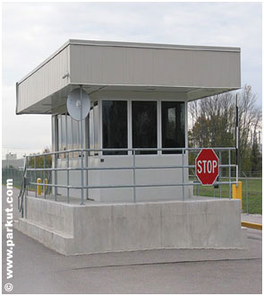
Training Venue
ASK ABOUT:
Availability of water, drinks, snacks, food
Parking
Security protocols
Restrooms
Access to building for early set up

Slide 28
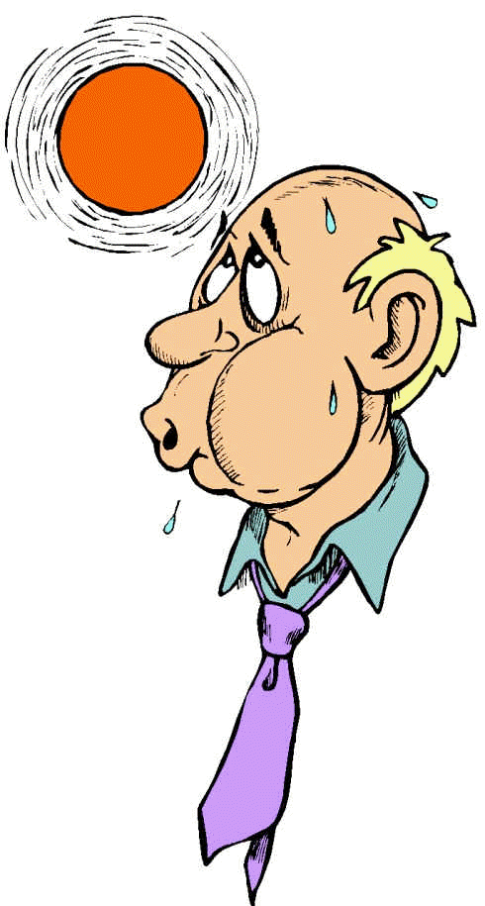
The Classroom
Classroom Considerations:
Lighting, acoustics, noise, temperature
controls
Space to conduct classroom activities
Layout
Configuration of tables and chairs
Walls, windows, doors
Permissions/awareness: moving furniture, putting things on walls (paper bleed-through)

Slide 29
Classroom Resources
Classroom resources support and enhance messages
PowerPoint
KISS, basic outline, 18 font minimum
Talk to your students, don’t read!
Easels
Enable group work and expression
Capture ideas
Easily repositioned
Parking lots
Use large print and blue/black markers (for distance)
CERT

Slide 30
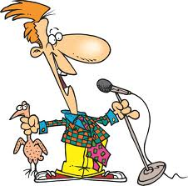
Classroom Resources
Video
Nice change of pace, presentation format
Add emotion, impact
Not recommended after lunch!
Microphone
Use if available, it’s about your students
Computer
A “must have” resource
Great for back-up
Facilitates other resources
Flash/jump drive – more than one

Slide 31
Discussion
Additional Ideas?

Slide 32
WIIFM

Slide 33
Instructor Skills: WIIFM
WHAT’S IN IT FOR ME?
Focused on the LEARNER, not the
instructor
WIIFM is a key part of every topic
you present
Tells the learner why the information is
important, snags your audience

Slide 34
Discussion
Why is it important to give a WIIFM for every topic? When did you provide a WIIFM for this class?

Slide 35
LEARNER INHIBITIONS and BUILDING CONFIDENCE

Slide 36
Discussion
What are learner inhibitions? What do you believe causes them?

Slide 37
FEAR!
FEAR drives many inhibitions
Creating a good learning environment means creating a SAFE environment.
Inhibitions are related to PAIN
Past
Attempting to
Interfere
Now
Set your students at ease

Slide 38
Learner Inhibitions
Fear Factors
Past experiences
Nervousness in social situations
New material
New behaviors
Learning challenges
Change
Work related (peers, supervisors)

Slide 39
Reducing Inhibitions
Ways to put students at ease
Greet everyone as they enter
Shake hands
Smile, be sincere
Have materials out
Answer any questions
Set and enforce rules

Slide 40
Building Confidence
Group the experienced with the inexperienced
Separate supervisors from staff
Include light humor
Start simple, build complexity
Link new material with known material
Teach using realistic situations/scenarios

Slide 41
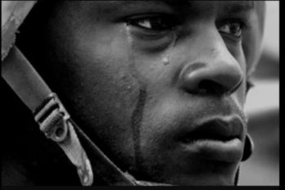
Learning Inhibitors
Psychological
List
Physiological
List
Emotional
List

Slide 42
Primary Inhibitors
Psychological
Stress
Resistance
Physiological
Sight
Hearing
Mental capabilities
Emotional
Anxiety
Fear
Personal challenges

Slide 43
What Can You Do?
Empathize
Accommodate
Alleviate
Validate
?

Slide 44
MOTIVATION

Slide 45
Motivation is Key
Why are your students in class?
The reason is key to your approach, and how much each student will learn

Slide 46
Types of Motivation
Intrinsic
Pride
Success
Curiosity
Value
Extrinsic
Required
Obligated
o

Slide 47
Motivation
Motivation is often influenced by inhibitors
Psychological, physiological, emotional
Additional learning readiness factors
Previous experience, training and education
Ability to absorb and use information presented (prior frameworks, hippocampus limitations)

Slide 48
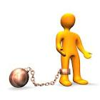
Types of Students
Three student types
The Prisoner (extrinsic)
Wants only to complete the class and go home
The Vacationer
“Vitamin” student: only does minimum daily requirements
The Adventurer (intrinsic)
Wants to learn and have fun!

Slide 49
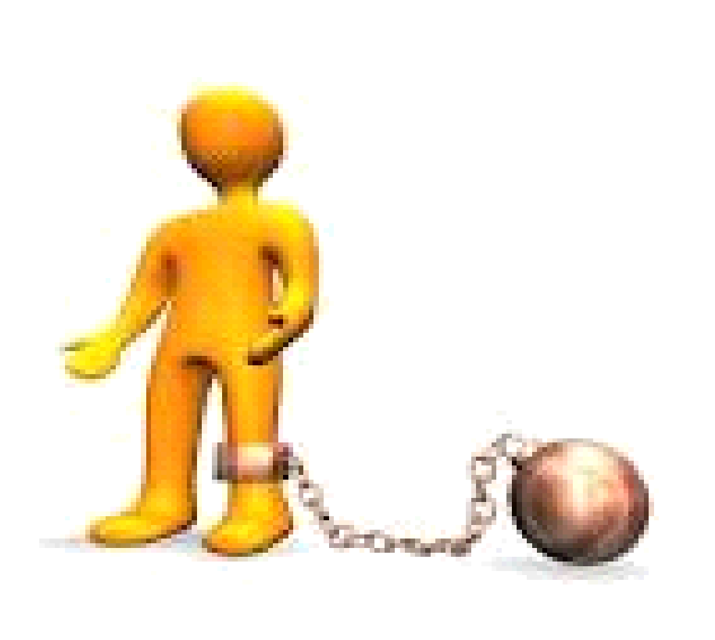
Characteristics
Prisoners: Need information to be relevant
Vacationers: Want to be left alone
Adventurers: Ready to try new things
Many students are combinations of the three

Slide 50
Discussion
Types of Students: have you been in each of these roles?
How did the role(s) affect your learning experience?

Slide 51
Motivating Tools
Inclusion
Create environment of inclusion, respect and connection
Attitude
Present and foster a positive disposition – attitude is contagious!
Meaning
Create thoughtful, challenging, relevant experiences
Competence
Instill confidence and provide an environment to apply and practice new skills

Slide 52
ADULT LEARNERS AND LEARNING NEEDS

Slide 53
Adult Characteristics
Course expectations:
Keep topics relevant
Control the classroom
…but don’t commandeer
Present only verifiable information
Different needs, challenges
Fear, frustration, personal challenges, other?
Need to ask questions confidently

Slide 54
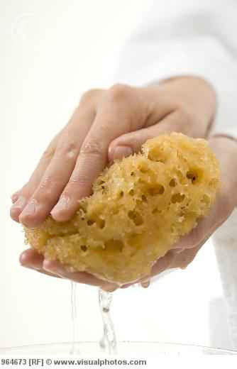
Adult Characteristics
Adults want to learn, encourage!
Give generous praise
Sponges get full
recognize saturation points
take breaks
Facilitate discussions
Sharing experiences is critical for adult learners

Slide 55
Recognizing Student Needs
GROUP ACTIVITY
Learning Factors:
Physical
Emotional
Intellectual
Scribe five examples of each learning factor (use your best guess)

Slide 56
Physical Factors
Proper room setup
Comfortable room temperature
Comfortable seats
Proper lighting
Proper amplification
Scheduled breaks

Slide 57
Emotional Needs
To be treated like adults (peers)
To direct their own learning whenever possible (self-motivated)
To know they are doing it right or at least that they are trying hard
Provide meaningful feedback and reinforcement
To feel accepted as they are
To see a reason for the training

Slide 58
Intellectual Needs
To share their experiences
To connect new information to what they already know
Build bridges between old and new information
To be involved in the learning
Make learning active with hands-on exercises
To learn the way they like to learn

Slide 59
Giving Feedback
Negative
Positive
Developmental
Define each and give an example
On every instructor’s diet: the feedback sandwich

Slide 60
Receiving Feedback
Listen with open mind
Don’t be defensive
Ask probing and clarifying questions
Consider options

Slide 61
TEACH BACK PLANNING TIME

Slide 62
ADULT LEARNERS AND LEARNING STYLES

Slide 63
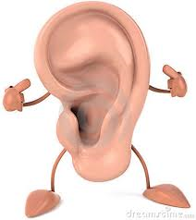
Learning Styles
Three predominant learning styles
Auditory Visual Tactile/Kinesthetic
(+ Combinations)

Slide 64
Auditory Learners
Learn through listening:
- Lectures
- Discussions
- Talking things through
- Listening to what others have to say
Written information has little meaning
- Need to hear text by reading it aloud
- Like to use a recorder

Slide 65
Visual Learners
Learn through seeing:
Demonstrations
PowerPoint Slides
Videos
Hand-outs
Instructor’s body language and facial expressions help them understand
Like to take detailed notes to absorb info

Slide 66
Tactile/Kinesthetic
Learn by doing, moving, touching
Hands-on activities
Volunteer to help with demonstrations
Find it hard to sit still for very long
Want to actively explore physical world around them

Slide 67
Learning Style
ACTIVITY
What Is Your Learning Style?

Slide 68
To Retain Learning
Hear it
See it
Say it
Do it
Teach it
-Active learning retained best
-Three times, three ways
Passive Learning
Active Learning

Slide 69
Cone of Learning

Slide 70
Maximize Learning
Motivate
Especially at beginning of training
What’s in it for me (WIIFM)
Reinforce - frequently and positively
Repeat concepts - at least 3 times, 3 times, 3 times for learning retention
Address multiple learning styles
Understand adult learning characteristics and needs and how to best accommodate them

Slide 71
INSTRUCTOR ROLES AND ATTRIBUTES

Slide 72
Six Instructor Roles
Subject matter expert
CERT trainers should be experienced subject matter experts in the fields they instruct
Classroom manager
Role model
Trainer
Know your resources!
Friend and Coach
Evaluator

Slide 73
Credibility
The book says credibility is established
45% on how you appear
45% on how you sound
10% on the actual words you say
How do you judge credibility?

Slide 74
Credibility
An instructor’s experience in the topic is vital to their credibility as an instructor.
Experienced CERT Instructors:
Make connections that show CERT as cohesive model
Explain answers and where info is referenced
Instruct with confidence
Provide lessons learned
Have genuine concern for student’s success

Slide 75
Building Credibility
Use WIIFM to guide your key points
Keep current on knowledge, skills and abilities
Emulate integrity, respect
Answer questions honestly
if you don’t know, say so
Connect! Communication is 2-way

Slide 76
DIFFICULT SITUATIONS

Slide 77
Conflicts Between Students
Possible reasons for conflict:
May have a past history that you are unaware of
May have different ideas, values, beliefs
May have personality clashes
Ways to deal with it: put on your Teflon suit!
Emphasize points of agreement
Minimize points of disagreement
Don’t criticize either student
Take a break, address it privately

Slide 78
Instructor Challenges
How will you deal with:
The train the trainer student who is not qualified to be an instructor?
Sexually inappropriate behavior?
Who decides what is acceptable?
Arrogant or disrespectful learners?
Talkers (side conversationalists)?

Slide 79
Respect Your Learners
Challenging situations involving learners still require respect
Actions should be positive whenever possible
Addressing issues should be done privately
Avoid asking a learner to leave, or reprimanding in front of the class

Slide 80
Time Challenges
Too much time, not enough information
Too much information, not enough time
Returning from breaks
Long War Stories, One-upmanship

Slide 81
Time Management
Tips for effective time management
Clock
Establish ground rules
Control distractions
Regain control of the conversation from a talkative/interruptive person
Ask for help from the class: “we’re squirreling!”
Follow your schedule

Slide 82
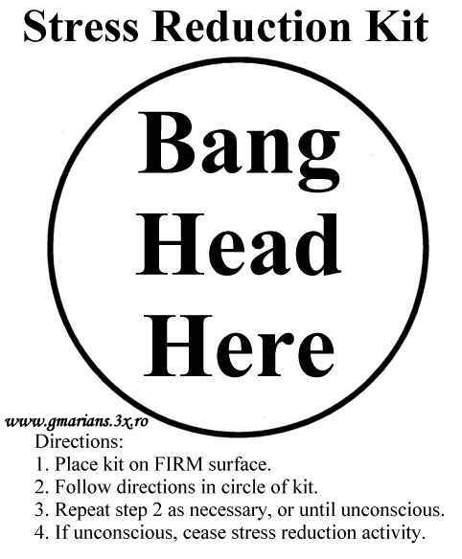
When All Else Fails….

Slide 83
Managing the Classroom
Management Summary
Everything you think, do and say potentially impacts your ability to manage a classroom
Starts with initial planning (critical), continues to course close
Know your options, keep a variety of tools in your toolbox

Slide 84
SKILLS OF A MASTER INSTRUCTOR

Slide 85
Communication Skills
What you say (7%), how you say it (28-38%)
Voice inflection as a communications tool
“I did not say I ate those cookies”
(Career Team, YouTube)
Non-verbal (55-65%)
Visual, expressions, body language
Watch for non-verbal communications from your learners

Slide 86
What Is Perception?
Our brain’s sensory systems trying to make sense of the environment (data, input)
What happens when things don’t make sense?

Slide 87
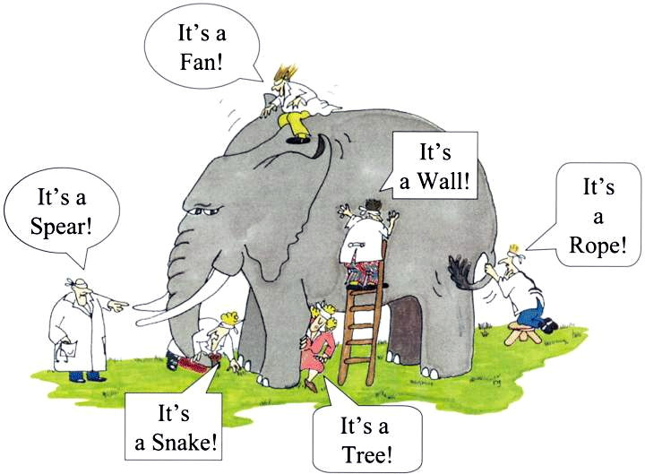
Perception
Drivers
Inflection
Body language/expressions
Experiences
Motivation
Expectations
Context
Physical, emotional,
intellectual needs and/or limitations

Slide 88
Perception
Auditory Processing
How we intake and process information varies:
“There is a sack of potatoes on the counter. Peel half of them, put them on the stove in a 4 quart pot, cover with water, and set the burner under them to medium heat.”

Slide 89
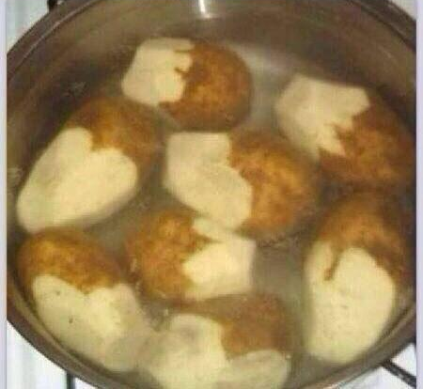
Result

Slide 90
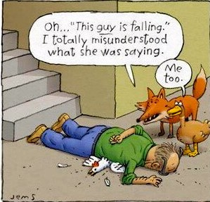
Impacts on Auditory Processing
Hearing challenges
“The sky is falling!”

Slide 91
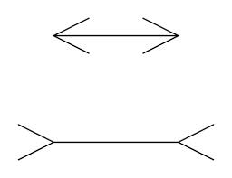
Controlling Perception
Influence of Surrounding (Context) Information
“Perception is reality to the person perceiving.”
Create frameworks that support your intended concepts and results

Slide 92
Controlling Perception
Learning involves hundreds of decisions
Provide as much pertinent information as possible
Results depend on the perceptions you create
Build strong frameworks to mitigate the chances of misperception
Vary the ways you communicate
Avoid the “weeds” (hippocampus limits)
Phrasing: say what you mean
The chocolate chip cookie syndrome
Avoid clichés and slang

Slide 93
Pertinent Information
GROUP ACTIVITY
Communications Activity

Slide 94
ESSENTIAL TOOLS FOR YOUR CMI TOOLBOX

Slide 95
Course Numbers
Federal and state course numbers are alpha-numeric
E, L, G, K, V, IS: Emergency Management Institute
E= Resident on campus delivery, Emergency Management Institute (EMI)
L= Local delivery of an EMI course
G= State/Government course delivery
K= Adobe Connect delivered
V= VTC delivered
IS= Independent Study

Slide 96
Course Numbers
PER, MGT, AWR: DHS, National Training and Education Division, Center for Domestic Preparedness and others
AWR = Awareness
PER = Performance
MGT = Management
Numeric:
Indicates course content

Slide 97
Facilitated Discussion
Why is it important for a CMI to understand the alpha-numeric class catalog system?

Slide 98
Certification vs. Certificate
Certification
Knowledge, skills and abilities assessed and evaluated against predetermined (professional) standards
Usually time bound (e.g. 5 years)
Certification assessment is
independent of a specific class, course or training program
usually a third party, standard-setting organization (usually a board)

Slide 99
Certification vs. Certificate
Certificate
Newcomers and professionals
Awarded by programs or institutions (non-degree)
Indicates completion of a course or series of courses with specific focus
CERT is a certificate of completion program
Consider the importance if asked, “Are you certified to teach this class?”

Slide 100
STATE PROTOCOLS CMI DUTIES AND RESPONSIBILITIES

Slide 101
Lead Instructor Duties
Communicate with/get approval from State Community Preparedness Manager
Secure buy-in and approval from local or regional CERT authority
Identify
Venue
resource/logistics needs
Transportation
Lodging
Stipends (428 or higher only)
Consider ability to meet minimum attendance

Slide 102
Lead Instructor Duties
Complete HS Funded Training Request, as needed (eGrants, OOG)
Submit Course Coordination Worksheet to Preparing Texas (PTO) via your Training Officer
Set up class on PTO
Create class announcement
Send to State CP Manager
Send locally and to interested parties

Slide 103
Lead Instructor Duties
Manage the class on PTO
Must ensure all prerequisites are met, or exceptions are supported and approved in writing by the State CCP Manager
Submit Training Submission form (link in e-Grants) to Preparing Texas (PTO) via your Training Officer
Set up class on PTO using Course Coordination Form
Create class announcement
Send to State CCP Manager
Send locally and to interested parties

Slide 104
Course Coordination Form

Slide 105
Preparing Texas
Status Filter Categories:
Any
Pending
Pending-Waitlist
Denied
Withdrawn
Viewing Transcripts
Must change from Denied to view – Uncheck “Send Email Confirmation” before Update
Be sure to change back
Making Notes (Comments: viewable to all)
Updating: Nothing stays unless you Update (notes, status, etc.)

Slide 106
Preparing Texas
Tools for Class Management (top of names)
Update (left)
Class Roster (right)
Sign-in Sheet
Lite Roster
More tools (bottom of names)
Update (left)
Cancel (left)
Get Email List (right)

Slide 107
Closing a Class
Sign-in must be completed and initialed daily (AM/PM) by participant only
Lead instructor uses P/F/I block for certificate/no certificate
Pass, Fail, Incomplete
Incompletes must be followed up
One class/course evaluation (anonymous) per participant is required
Turn in to receive test?
Score of 80% on post-test is required for certificate
Must send/scan copies of sign-in and class/course evaluations to
State Training Officer
State Community Preparedness Manager
Certificates will post to PTO/transcripts

Slide 108
TEACHING OUTSIDE YOUR JURISDICTION

Slide 109
Teaching Outside Your Jurisdiction
Conferences
Private/Faith based/NGO
Must communicate with jurisdiction and/or regional coordinators prior to any teaching commitment
Delivery must not be less than required curriculum hours

Slide 110
Teaching Outside Your Jurisdiction
CERT training must comply with State requirements and expectations
Legal impacts
Infringement on other’s situational awareness and/or responsibilities
Differences in established operating procedures and standards

Slide 111
Facilitated Discussion
Points to consider….

Slide 112
INSTRUCTOR COMPETENCIES

Slide 113
Questions
QUESTIONS
Allow instructors to appeal to different learning styles
Help reinforce the material
Make the class more interesting
Validate the evaluation process

Slide 114
Types of Questions
Open
Closed
Recall
Apply
Apply questions tell us the most about the learner’s knowledge, comprehension, and ability to use information in a given situation.

Slide 115
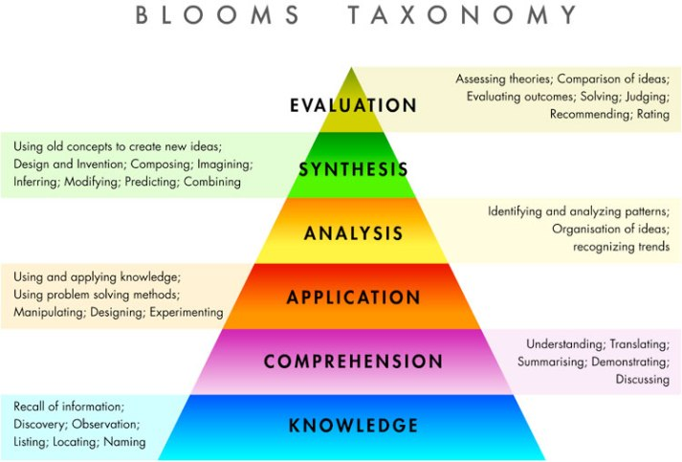
Bloom’s Taxonomy

Slide 116
Questions and Answers
Bloom’s levels 1-3 questions and resulting answers reveal information about
Knowledge
Comprehension
Ability to apply
Key information to evaluate progress

Slide 117
Questions in the Classroom
Questions are an extension of two-way communication
You can gain valuable information from a learner’s questions
If you ask a question and someone gives a wrong answer, compliment the attempt whenever possible and correct the response.

Slide 118
Delivery
Students often judge an instructor by
How the instructor sounds (45%)
How the instructor appears (45%)
What he/she has to say (10%)

Slide 119
Delivery
Bad presenter qualities may become the student’s focus and can inhibit learning
Deliver your trainings professionally and effectively; model the highest levels of instructional and behavioral standards

Slide 120
Delivery and Participation
Engage!

Slide 121
Encourage Participation
Encourage through verbal and non-verbal communication
Refer to participants by name
Ask questions such as “do you agree?”
Be accessible

Slide 122
Control Nervousness
Know the material (3 hours preparation for each hour in the classroom)
PRACTICE, PRACTICE, PRACTICE
Be congenial with participants
Positive visualization
Rest, avoid excessive caffeine

Slide 123
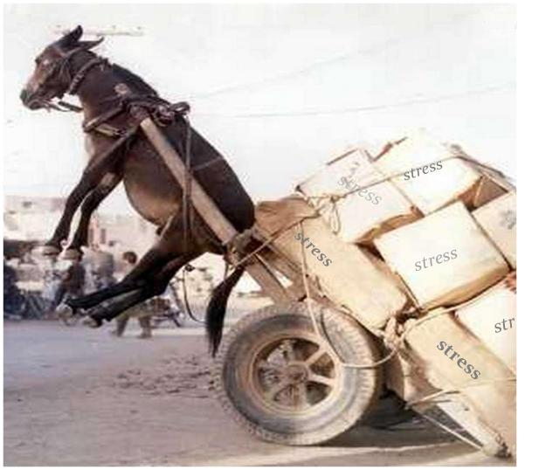
Good Instructors ……
Plan their delivery
Have supplies and props ready
Have ‘Plan B, C, D’
Are ready for class
Aren’t left up in the air!

Slide 124
Presentation Presence
Use their hands
Pause for effect
Use voice
inflection
projection
Detractors
Swaying
Fidgeting
Fumbling with keys, coins

Slide 125
Good Presenter Qualities
Maintain a neat and clean general appearance
Make eye contact
Listen to the participants
Smile
Use a strong, powerful voice
Keep an open and inviting stance

Slide 126
Good Presenter Qualities
Use purposeful gestures
Move around but don’t pace
Project an attitude that is
Positive
Accepting
Enthusiastic
Encouraging

Slide 127
Presentation Style
Every instructor has to find his/her own presenting style
The way you choose to deliver needs to encompass good presenter qualities
What do good delivery qualities look like to you?

Slide 128
TEACH BACK PLANNING TIME

Slide 129
EVALUATION

Slide 130
Why Evaluate?
Did learners “get it”?
Knowledge, comprehension, ability to apply
Are student issues being addressed?
Physical
Emotional
Intellectual

Slide 131
Types of Evaluation
Formal
Tests
Performance demonstrations
Informal
Watching body language
Observation of hands-on activities
Questions

Slide 132
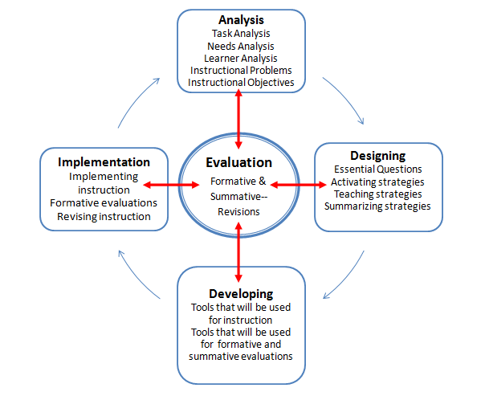
ADDIE

Slide 133
Discussion
What types of formal or informal evaluation do you use when training? How do you use the resulting information?

Slide 134
COPYRIGHT AND FAIR USE LAWS

Slide 135
Copyright and Fair Use
FIRST U.S. COPYRIGHT LAW IN 1790
EXPANDED PROTECTION WITH THE 1976 COPYRIGHT ACT

Slide 136
Copyright and Fair Use
Individuals once had to apply for copyright protection.
Since 1978 there is an assumed protection from the moment the work takes tangible form…..Whether or not a copyright notice/symbol © is attached

Slide 137
Copyright and Fair Use
Copyright is a property right attached to the original work of art or literature.
Exclusive rights to reproduce
Wrongful use gives copyright owner the right to seek and recover compensation

Slide 138
Copyright and Fair Use
ALL COPYRIGHT RIGHTS ARE HELD BY THE BOOK’S AUTHOR UNTIL THE AUTHOR SPECIFICALLY TRANSFERS THEM.
Book Owner is NOT the copyright owner.

Slide 139
Copyright and Fair Use
COPYRIGHT LAWS DO NOT EXTEND TO FACTS AND IDEAS

Slide 140
7 Broad Categories
LITERARY WORKS
MUSICAL WORKS
DRAMATIC WORKS
PANTOMIMED AND CHOREOGRAPHED
PICTORIAL, GRAPHICS, AND SCULPTURAL
MOTION PICTURES AND AUDIOVISUAL
SOUND RECORDINGS

Slide 141
Conditions for Usage
PUBLIC DOMAIN
PERMISSION
LEGAL EXCEPTION
FAIR USE

Slide 142
Fair Use: 17 USC 107
The purpose and character of the use, including whether such use is of a commercial nature or is for nonprofit educational purposes;
The nature of the copyrighted work;
The amount and substantiality of the portion used in relation to the copyrighted work as a whole;
The effect of the use upon the potential market for or value of the copyrighted work.

Slide 143
Copyright and Fair Use
The distinction between fair use and infringement may be unclear and not easily defined. There is no specific number of words, lines, or notes that may safely be taken without permission.
Acknowledging the source of the copyrighted material does not substitute for obtaining permission.

Slide 144
Copyright and Fair Use
“Excellence through plagiarism”
More acceptable version: Why reinvent the wheel?
The internet is your friend!
Google Images, Maps, Scholar, Search
Electronic networking
Web sites, Linked In
WHAT DOES THIS MEAN TO YOU?

Slide 145
Copyright and Fair Use
http://www.copyright.gov/fls/fl102.html
http://www.bitlaw.com/copyright/fair_use.html

Slide 147
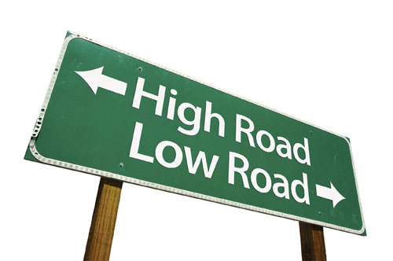
Appropriate Action Guidelines
Watch your language, jokes and comments.
Do not swear or use profanity
There is no place for jokes or comments about race, religion, gender, ethnicity or personal issues
Watch your use of acronyms: limit use and always define if used
Be inclusive of all students.
Provide a time for students to privately discuss limitations.

Slide 148
Yes, It’s Ethics
Get to know your learners.
Watch for students who start to withdraw.
Watch for students who take over or exclude other students.
If you do not know the answer to a student’s question be truthful and tell them you will find the answer.
Model appropriate behavior

Slide 149
Getting Personal
Find out about limitations but never discuss before the group. That is the student’s choice.
When touching a student or a victim, regardless of gender, make sure that you explain what you plan to do, why you are planning to do it, and ask permission.

Slide 150
Pertinent Information
GROUP ACTIVITY
Ethics Scenarios

Slide 151
TEEN CERT

Slide 152
School Administration
Buy in from stakeholders is key
Pitch training to school administrators first
Purpose of training
Part of CERT National Program at FEMA
Role in Department of Education goals
Answer administrators’ many questions

Slide 153
Scheduling
Find availability in schedule – every school has some
Work with administrators
Determine how to best offer training, how often, and how to prevent interfering with academics
Maximize availability of students and instructors
Consider different scheduling options
Remain flexible

Slide 154
Keeping Members Interested
Administrators and instructors must make effort to engage students
Encourage students to:
Assist in actual school safety efforts
Wear their CERT t-shirts
Write about CERT in newspaper
Attend meetings and workshops
Take on responsibilities at community events
Give their own ideas for member involvement
Connect with local emergency services

Slide 155
Adolescent Needs
Empower teens to make smart decisions for themselves, teammates, and school
Tap into student needs and abilities
Meet specific needs by:
Making expectations clear
Stressing safety
Acknowledging teen as an individual
Encouraging involvement
Allowing for independence

Slide 156
Learning Styles
Incorporate variety of activities to address different learning styles
Three learning styles: visual, auditory, and kinesthetic
Concentrate on auditory learning for most teens

Slide 157
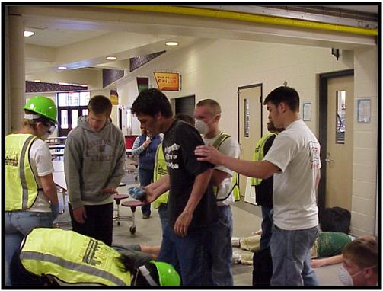
Teaching Activities
Demonstrations
Puzzles and worksheets
Q and A activities
Group inquiry
Group discussion
Information search
Learning tournaments

Slide 158
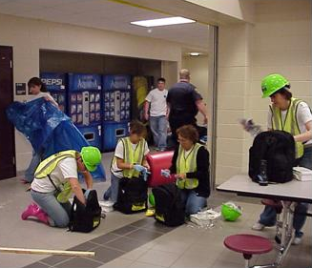
Proactive Teaching
Plan ahead and anticipate problems
Prepare for interruptions or delays
Be aware of school climate
Pick battles
Reinforce positive behavior

Slide 159
Reactive Teaching
Prepare to use a reactive approach at times
Remain calm
Ignore minor infractions
Offer choices if students are not responding
Be consistent when enforcing rules
Be sensitive with adolescent moods

Slide 160
TEACH BACKS

Slide 161
WRAPPING UP

Slide 162
Post-Test and Evaluation
Any questions?
Post-test
Course evaluations

Slide 163
Final Items
Turn in test and course evaluation sheet
Thank you for being a part of our lives!

Slide 164
Thanks and Credits
Tom Hirt, Emergency Management Institute, Emmitsburg, MD.
Melanie Devine, NCTCOG, Arlington, TX
Kit Marshall, Parker County, TX
Dr. Nancy Olthoff, Apache Junction, AZ
Liz Massey of Creative Liberty
University of Florida, IFAS

