Slide 1
Notes:
Hello and welcome to Starting a Patient Care Technician Pathway Program.
Whether you are you starting new program or searching for content to build courses, today we are going to share free tools and materials as well as products and curriculum offered by Realityworks that can jumpstart your pathway development.

Slide 2
Who is Realityworks?
Notes:
First, here is your 30-second introduction to Realityworks, for those of you who aren’t familiar with us!
We are an employee-owned company based in Eau Claire, Wisconsin, that creates experiential learning tools for teaching job and life skills.
We got our start over 20 years ago, when former NASA engineer Rick Jurmain created the first RealCare Baby infant simulator, then went on to found the company that is now Realityworks.
Today, our training tools combine curriculum with hands-on learning tools, student activities and assessments.
Baby is still around, but now you can look to us for tools like our Bovine Birthing and Ultrasound Simulator, virtual reality welding simulator, wearable geriatric sensitivity suits… if you have some time, we encourage you to check out our website and see it all.

Slide 3
Agenda
Identify resources for building pathways (general, health science)
Introduce hands-on resources
Additional resources
Q&A
Notes:
Here is a brief outline of what we will be covering today.
Schools across the country are starting new Patient care technician programs. During this webinar we will walk you through key concepts needed in these courses and show you how you can align tools and curriculum to help jump-start your courses.
We are hoping that the information shared will help save you some time as you do your planning.

Slide 4
Job Nuances
 | Nursing Assistant | PATIENT CARE TECHNICIAN/ASSISTANT | Medical Assistant
Certification | State | National | National
Main Responsibilities | Patient Care | Patient Care+++ | Patient Care+++ and/or Administrative
Job Prospects | 11% | ? | 29%
Salary | $13.23 | $15.00 | $15.61
Education | 4-12 weeks | 2-7 months | 1-2 years
Notes:
Let’s start with actually understanding the role of the patient care technician. Students often wonder what the differences are between different career paths within health science. So let’s take a moment to break things down and compare nursing assistants to medical assistants to patient care assistants or technicians. Please note that ultimately patient care technicians and patient care assistants are synonymous. I will be referring to them as patient care technicians during this presentation, but I am really referring to both.
In terms of certification, nursing assistants’ requirements vary from state to state, so if your students become certified in your state, if they move, they may need to recertify. Certification for both medical assistants and patient care technicians are recognized nationally. In terms of responsibilities while on the job, nursing assistants are primarily clinical in nature: assisting with activities of daily living and patient movement and transfers are common examples of nursing assistant duties. Medical assistants and patient care technicians both build on the foundation of nursing assistant duties with additional responsibilities. Patient Care Technicians often include phlebotomy procedures and EKG. Medical assistants likely have those same advanced skills along with collecting vital signs, some types of medication administration, as well as having an administrative component to their job, including checking patients in and out and answering phones. Simply put, nursing assistant is the entry level position, patient care technician falls in the middle, and medical assistants have the highest level of responsibility of the three positions. The salary levels reflect this as well. The hourly wages and expected industry growth listed here are from the Bureau of Labor Statistics. The job classification of Patient Care Technician is relatively new, which might be why there isn’t current data about expected job growth for the role. But if the leveling of responsibilities with the amount of schooling and wages is consistent, we could expect the outlook for patient care technicians to fall in the middle of the 11 and 29%. The data here is general though and may vary slightly from state to state.

Slide 5
Building a Career Pathway
Notes:
We are going to talk about the resources available to you at every stage in your planning process. We will begin with the broadest level of resource: any pathway program. Later on, we will get more and more specific. We will break it down further to talk about health science programs and the resources available at that level. After that we will talk about the resources available that are specific to patient care technician.

Slide 6
Six Key Elements for Developing Career Pathways
https://lincs.ed.gov/professional-development/resource-collections/profile-841
Notes:
Here are the six key elements for developing career pathways – these elements are important to consider for any pathway program you develop including health science.
We will talk about several of the six of these, but not all. Funding and measuring system change will not be topics we cover today, because we could easily spend 45 minutes on each topic. This graphic is pulled from a 142 page document devoted to the details about developing pathways, so if you’d like information about topics we won’t be covering today, I would recommend this for a little light reading. The link is at the bottom of the slide.
We will touch on a couple of the others, but really, we will be spending the majority of the time on the topic of designing education and training programs. This is the curricular piece. And is likely the piece that you all have been tasked to figure out.

Slide 7
Build an Advisory Council
Invite 5-10 industry professionals to participate in a health science advisory council
Meet several times per year
Focus on outcomes – what are employers looking for
Are you teaching the right things?
Form partnerships for field experience, job shadowing, guest speaker opportunities
Notes:
Involving local healthcare industry leaders and clinical professionals in your pathway development is critical. How can you understand what local employers are looking for in a health care professional if you don’t ask? Consider putting together a health care advisory council. Choose these from a variety of settings and levels of responsibility to get a variety of viewpoints and input.
Meet on a regular basis, perhaps quarterly. Have a frank dialogue and ask, “What are you looking for in your employees?” Does your course content align with what they are looking for in the patient care technicians they hire? To lighten the load, think about combining your advisory council with other health science specialties to get the most information in the most efficient manner possible.
Use your advisory council members to form partnerships. Are they willing to allow students at their location for field or job experience or job shadowing? Also are they interested in coming in to be a guest speaker in your classes?
Engaging employers is one of the 6 key elements for developing career pathways as seen in the earlier slide.

Slide 8
Seek Industry-Recognized Certifications
Does your state dep. recommend a specific certification or testing agency?
Are your instructors licensed to teach PCT courses?
What are local employers looking for?
Is employment transferable?
What is the cost of certification or a specific credential?
Notes:
Many districts require that any career pathways created lead to industry-recognized certifications or credentials of some sort.
In order to find the right certifications or credentials for your program, ask the right questions such as (see slide)
If you are newly developing a program, make sure you research and find out what to do so your students get certified properly. Are there any other certifications that students can go after? For example, CPR?
Think back to the 6 key elements for developing career pathways. Certifications and credentials are part of the step for aligning policies and programs.

Slide 9
Building a Health Science Pathway
Notes:
Okay, so we have talked about some coniderations for building ANY pathway program, so let’s narrow our focus a bit to starting any health science pathway.

Slide 10
Career Tech
Notes:
So let’s begin with careertech.org. This site houses a plethora of resources for any and all career pathways. If we navigate to the Health Science portion of the site and then locate the Career Cluster Frame, we can get an understanding of which health science careers fall into which pathway.

Slide 11
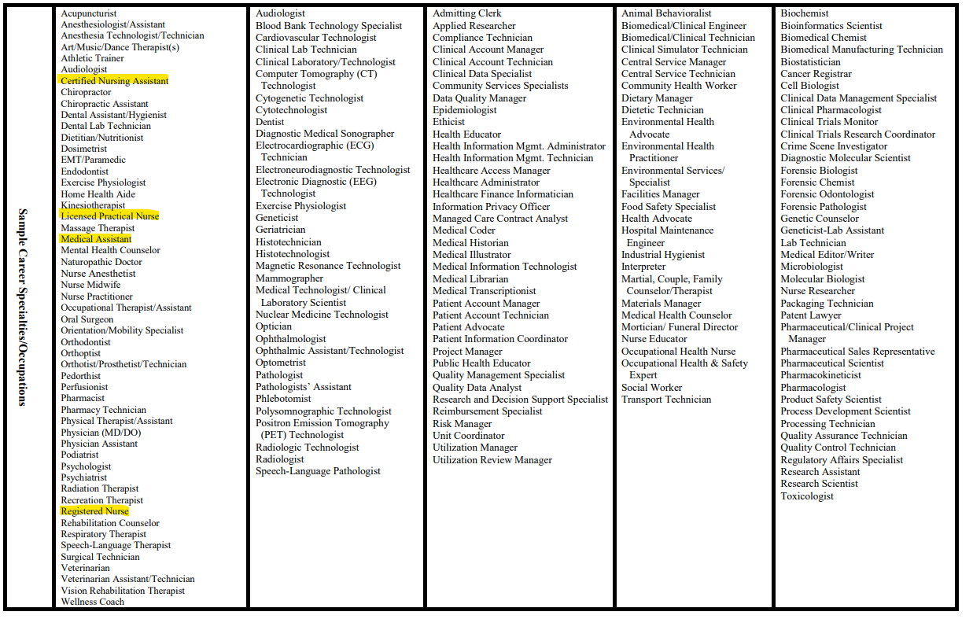
Health Science Pathways
Notes:
So you will notice that Patient Care Technician is not specifically listed here anywhere. But, within the therapeutic services column you will see similar roles: certified nursing assistant, medical assistant, licensed practical nursing, and registered nursing, so we can safely assume that the role of patient care technician, if it were listed, would be in this column.

Slide 12
Therapeutic Services Pathway
Includes Knowledge and Skills Statements for the Cluster and each individual pathway
Identifies an editable Plan of Study template
Notes:
So now that we have identified which pathway we want to focus on, we can dig more deeply on the careertech.org website. Under the therapeutic services portion, we can see two options: knowledge and skills statement and plan of study. Let’s talk about both.

Slide 13
Knowledge and Skill Statements
Notes:
Your first option under the Therapeutic Service Pathway is the Knowledge & Skills Statements. Clicking on this link will lead you to a 21 page document that outlines both general and specific learning objectives for the last three sections listed here: the green essential knowledge and skills section, the red cluster knowledge and skills section and the blue pathway knowledge and skills section. This is a great resource if writing learning objectives is not your forte. Even if you don’t use them word for word, they can provide an awesome starting point. The breadth of information here also gives you peace of mind that you are not omitting any really important pieces when you are creating your pathway program.

Slide 14
Knowledge and Skill Statements – Therapeutic Services
Notes:
Here is one example of a knowledge and skills statement specific to the Therapeutic Services Career Pathway which is where Patient Care Technician programs fit. You can see that it focuses on effective communication. You will notice the specific expected student learning outcomes included here, so if writing these types of outcomes is a struggle for you, you have ready-made items already created for you. If you do write your own, you can use these items to check your program to see if you have any gaps in how you are assessing your students.

Slide 15
Building your Plan of Study
Secondary
Post-Secondary
Notes:
Your second option in the therapeutic service portion is the plan of study. This document provides an example of how you might lay out a full program of study, including both secondary and post-secondary courses. Having a master document like this is vital to ensuring that all required components are covered in your program of study, and it helps to keep the objectives of each course well defined. It’s a one-stop-shop to help you visualize the entire program.
https://www.careertech.org/career-clusters

Slide 16
NCHSE
Notes:
Okay, so we talked about careertech.org as being a great resource for all pathway programs, and sourced some specific health science information from there. Now here’s another resource that’s specific to health science. The national consortium for health science education is the health science education resource to go to..
The National Health Science Standards provide a clear and consistent understanding of industry and post-secondary expectations for health science teachers and students. These standards are designed to provide the essential knowledge common across health professions to prepare and increase the number of students that are college and career ready. They are free to the public and are available on their web page.

Slide 17
National Health Science Standards
Academic foundations
Communications
Systems
Employability skills
Legal responsibilities
Ethics
Safety practices
Teamwork
Health maintenance practices
Technical skills
Information technology in healthcare
Notes:
NCHSE gives you a clean topical outline organized into 15 Foundations. They are listed here on the screen.
Academic foundation includes all your anatomy and physiology, pathophysiology, and medical math. Communication skills including medical terminology. Systems includes understanding levels of care, governmental organizations, research organizations and non-profits. Employability skills includes basic soft skills helpful to health science students. Legal issues including HIPAA, scope of practice, and such. Next are the ethical components including cultural considerations. Safety practices includes infection control, environmental and personal safety issues. Teamwork includes topics specific to healthcare teams as well as handling conflict. Health maintenance practices including self-care, behavioral health, and mental health. Next is technical skills including vital signs and CPR. And last but not least is IT in healthcare dealing with EMRs obviously, but also topics like wearable devices and apps.
You certainly are not obligated to follow their outline, but if you are beginning your curriculum writing from scratch, it can be a great tool to check against to make sure you aren’t forgetting any vital topics in your courses.

Slide 18
NCHSE Crosswalk
Notes:
NCHSE also provides a curriculum crosswalk which can be extremely helpful in planning your courses. It takes their foundation standards and allows you to map where in your own curriculum you are covering those topics. These exercises provide transparency and accountability for the topics included and can help keep everyone on the same page regarding what is happening when during the curriculum.

Slide 19
Building a Patient Care Technician Pathway
Notes:
Okay! Now we are getting to the most specific level of resource: those that actually pertain to patient care technician pathway programs.

Slide 20
National Organizations with Certifications
American Medical Technologists
National Patient Care Technician Organization
National Association for Health Professionals
National Healthcare Workers Association
National Healthcareer Association
National Center for Competency Testing
Notes:
So here are six examples of organizations that provide certification testing services. There are differences in content, services provided, and associated costs for testing and certification between these organizations, so I recommend that you do some digging to find out which matches with any requirements your state or district might have. And I am sure there are more out there.

Slide 21
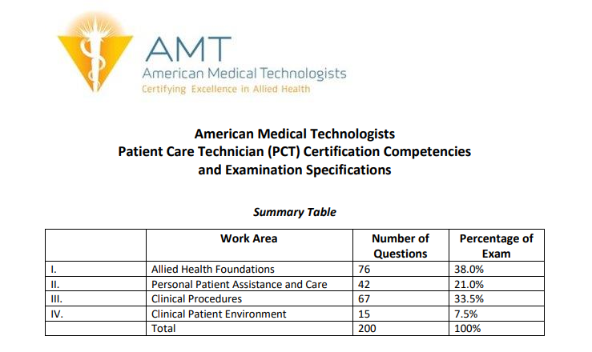
PCT Content Outline Example
Notes:
When you visit an organization’s website, they will all have examples like this one from American Medical Technologists. And just to be transparent, Realityworks has no affiliation with anyone and we are not promoting any program in particular. However as this webinar is sponsored through the National Consortium for Health Science Education, It is recommended to check out those certifying organizations who are members.
So this is a summary of what is included in the AMT exam, but there is a more detailed outline of included content that follows, and most of them include what percentage of the exam is related to what content areas. If you are in a district that is specifically feeding your students through the program to obtain certification, this information is gold. Once you’ve chosen the right program, you can use this information to inform what you cover in your courses and you can glean your course pacing as well by understanding how important that content is when it comes to the certification exam.

Slide 22
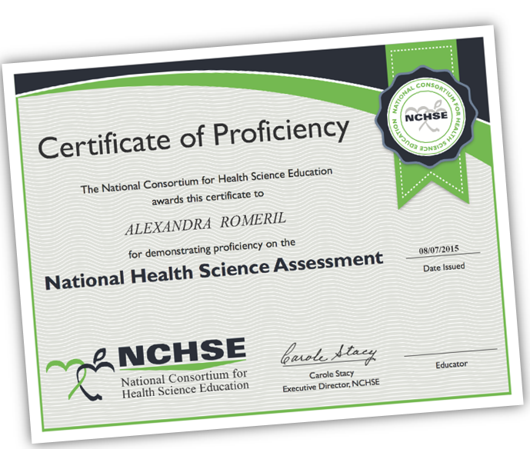
National Organizations with Assessments or Competitions
National Consortium for Health Science Education (NCHSE)
National Health Science Assessment
HOSA – Future Health Professionals
National Competitive Events
Notes:
There are other organizations that offer technical and/or skills assessments.
The National Consortium for Health Science Education offers a Health Science Assessment
Although not a right-to-work credential, the assessment:
Adds credibility of a national certification of achievement
Satisfies Perkins requirements for technical attainment
Validates student mastery of foundational healthcare knowledge and skills
Benefits for students include:
Nationally recognized end-of-pathway certificate
Validates skills attained with standards listed
Certificate for job interviews and resumes
Recognition on college applications
Easier articulation into college programs
HOSA sponsors dozens of knowledge and skills competitions at the state and national level relating to a wide variety of health science topics.
HOSA members are encouraged to take full advantage of the HOSA National Competitive Events Program as a way to increase the knowledge and skills as they prepare for future health occupations.

Slide 23
Realityworks Hands-On Tools and Curriculum
Notes:
Realityworks offers a combination of resources and curriculum that can help you realize your ideal patient care technician pathway program. First, you should know that with all the products we create, we enlist subject matter experts to create curricula to go hand in hand with the hands-on learning tools. Our subject matter experts are exactly that: experts in their fields. They understand the roles and responsibilities of the field, as well as the certifications in the field. We are so proud of the work they do to help teachers, the boots on the ground, in making their jobs easier.

Slide 24
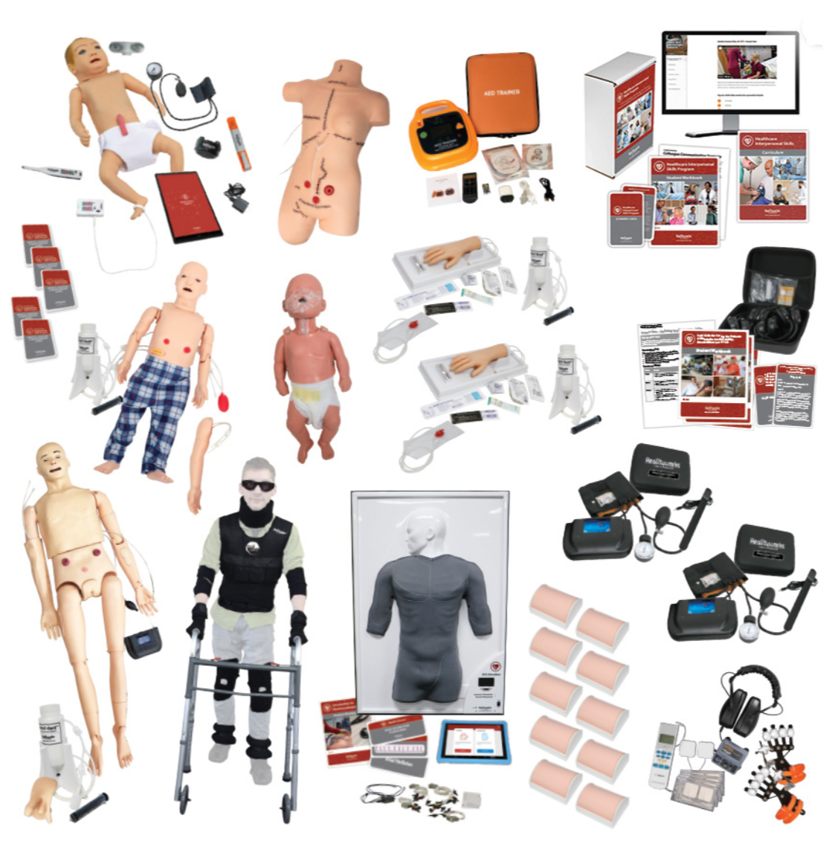
Hands-On Learning for PCT Training
Adult Nursing Manikin
Bandaging and Wound Care Simulator
ECG Simulator
2 Venipuncture & IV Hand Trainers
10 Large Injection Pads
Geriatric Simulator
Geriatric Sensory Impairment Kit
2 Blood Pressure Simulators
Healthcare Interpersonal Skills Program
Infant Vital Signs Trainer
AED Trainer
Pediatric Nursing Manikin
Infant CPR Manikin
Soft Skills Program for Caring for Patients with ID
Scenario Cards
Notes:
This is the package of products we have put together that can jump start your patient care technician pathway program. Here is where they get the hands-on learning of transferable career skills and foundational knowledge they will use in patient care technician careers. These packages are completely customizable as well. Each product comes with curriculum that’s already been created for you. Curriculum includes teacher presentation slides, pre- and post-assessments, as well as student activities that have been designed by subject matter experts.

Slide 25
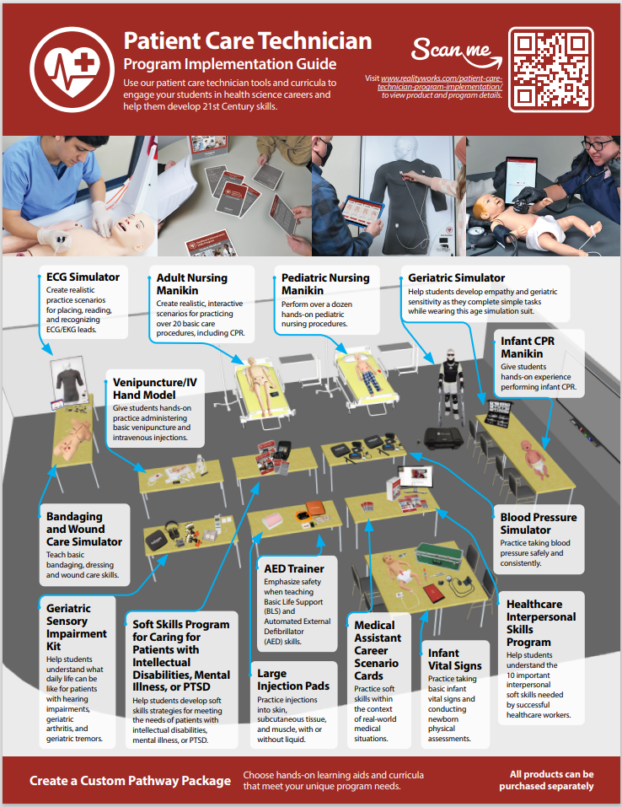
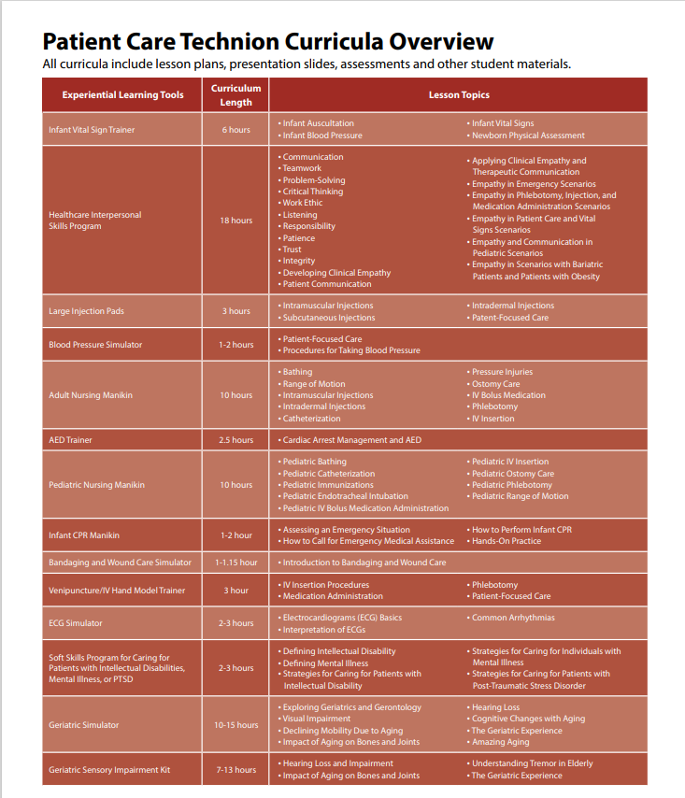
PCT Implementation Guide
Classroom Ideas - Realityworks
Notes:
Another free resource we offer is the Patient Care Technician Program Implementation Guide. Given the pathway package that’s been designed, this guide can give you ideas and suggestions for how you might set up your classroom when teaching this type of course. Additionally, for each of the included products, estimated teaching times and lesson topics are included.

Slide 26
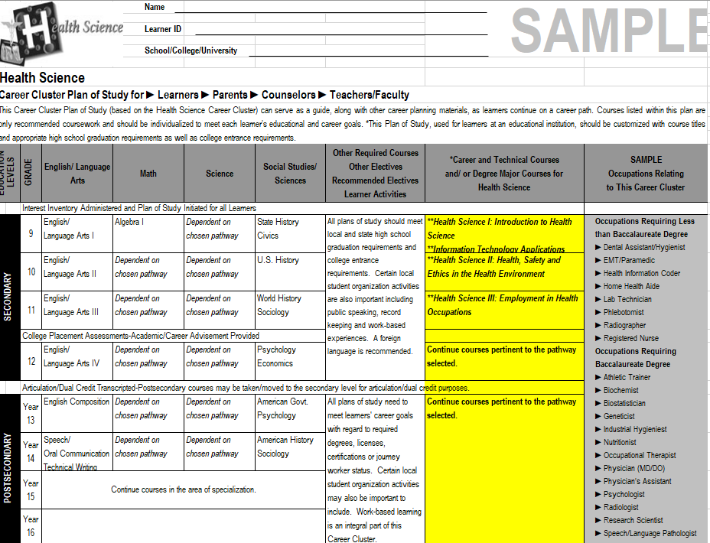
Content Applied to Plan of Study
Begin to fit these hours of content into your courses
Notes:
Once you see the breadth of content that is available, you can begin to figure out how to plug it into the courses you have in your Plan of Study. Remember the earlier slide that had the list of courses in the Plan of Study template? If you already have some of these experiential resources, you can begin to review the curriculum topics included and see where they best fit in your pathway.

Slide 27
Scan Me!
Receive free Career Exploration lessons
Enter to win $250 voucher

Slide 28
Questions?

Slide 29
Contact us today!

