Slide 1
Clinical & Employability Skills for Practicum Courses
Preparing Health Science Students for Work-Based Learning with
Welcome!
Please start your Noggin Jogger as you wait for the presentation to begin.
(Ex. Mr. Johnson weighed 150 lbs. on Monday morning. On Friday morning he weighs 163 lbs. What would you record for his weight gain in kg?)

Slide 2
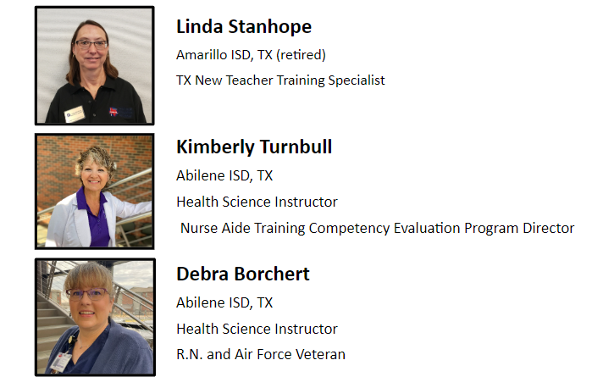

Slide 3
Agenda for the Day
After this presentation, you will take home examples and learn how to implement
Bell Ringer
On the Job Scenario
Skill Mastery Check
Station Lab
Current Events
Preclinical Worksheets
And more!

Slide 4
What Do You Need to Successfully Run Health Science Practicum
Student Needs
Clinical Site Needs
Instructor/Teacher Needs

Slide 5
Noggin Joggers
(Ex. Mr. Johnson weighed 150 lbs. on Monday morning. On Friday morning he weighs 163 lbs. What would you record for his weight gain in kg?)
Questions
Diagrams (Ex. Draw the chain of infection.)
Safety Checklist (Ex. Ambulation.)
Medical Math
Equivalencies (Ex. How many ml in an oz?)
Med Terms
Scenarios

Slide 6
Scenarios
(Ex. 1) You are working on the Medical floor at your local hospital. You have a patient who is in “Contact Isolation” and you need to take their food tray into the room and help them sit up on the side of the bed.
What type of PPE do you need for this patient task?
Any other special topics you should consider?
(Ex. 2) You are working on the Medical floor at your local hospital. You have a patient who is in “Airborne Isolation” and you need to take their vital signs.
What type of PPE do you need for this patient task?
Any other special topics you should consider?
(Ex. 3) You are working on as a transport at the hospital. You have a patient who is “Airborne Isolation” that needs to come down to x-ray for a CT scan.
What type of PPE do you need for this patient task?
Any other special topics you should consider?
Patient Background
Behavior Scenarios
(Ex. How to safely approach residents with dementia.)
Practice for clinical communications
(Ex. Introductions, asking questions.)

Slide 7
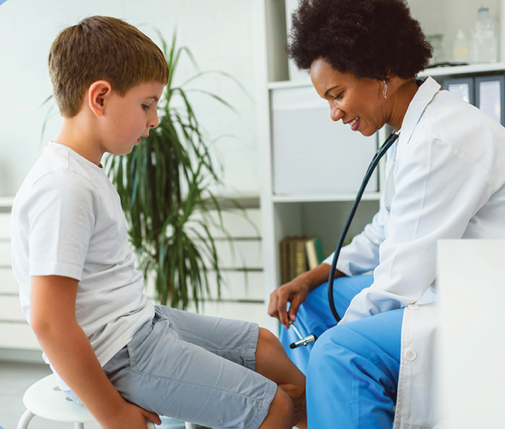
Skills Check
Examples:
Ambulation
Blood Pressure
First Aid Skills
Height & Weight
PPE
Sterile Technique
Transfer
Vital Signs

Slide 8
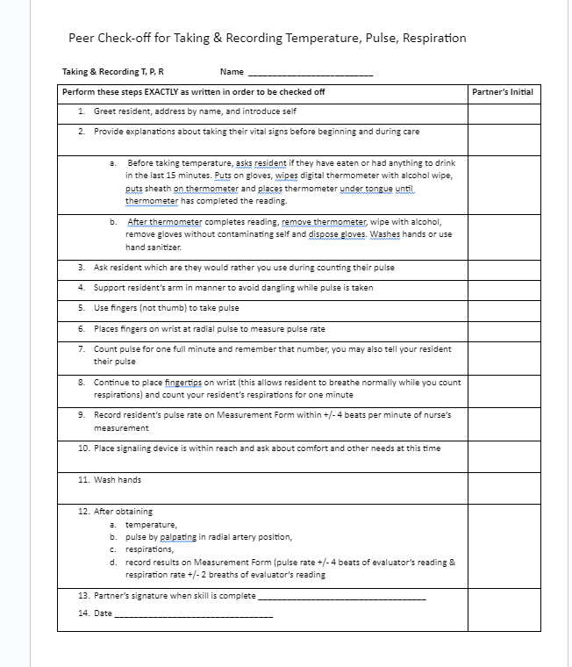
Skills Check
Examples:
Ambulation
Blood Pressure
First Aid Skills
Height & Weight
PPE
Sterile Technique
Transfer
Vital Signs

Slide 9
Station Lab

Slide 10
Current Events
(Ex.) Safety and Infection Control – TOPIC: Researching Current Outbreaks
Keeping up to date with current “bugs” or “micro-organisms” that are causing issues around the world and is in your neighborhood is a daunting job. But it is necessary to keep yourself and your patients safe. There are many places you can go to find out this information, but is it reliable? Two of the most reliable sites to find the current trends and outbreaks include the CDC (Center for Disease Control) and the WHO (World Health Organization). Visit both sites and search for outbreaks in your County, State, Country and then pick a different continent.
Pick one disorder and report back to your class the following information:
A great way to prepare students for competitive events!
Student Activity
Notes:
KIM:
Current Events activities ask students to research what’s new, what’s changed, and what’s old and still working.
Can be used with any unit and module.
Students may submit:
brochure
public service announcement
poster – Career Health Display, including recent statistics on the need for that career
written report - summarizing an article that relates to their clinical site and healthcare. Opinion – do you agree or Disagree?

Slide 11
Current Events
How would you classify this “bug”? Is it endemic, epidemic, or pandemic?
What signs and symptoms are healthcare workers looking for with this disease?
What precautions are healthcare workers required to take?
What treatments are available?
A great way to prepare students for competitive events!
Student Activity
Notes:
KIM:
Current Events activities ask students to research what’s new, what’s changed, and what’s old and still working.
Can be used with any unit and module.
Students may submit:
brochure
public service announcement
poster – Career Health Display, including recent statistics on the need for that career
written report - summarizing an article that relates to their clinical site and healthcare. Opinion – do you agree or Disagree?

Slide 12
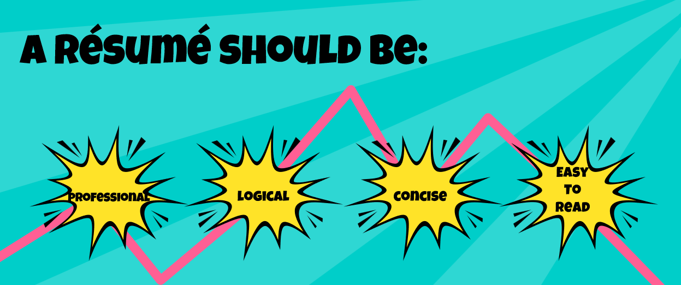
Mini Lessons (Ex. Résumé Building—Your Passport to Success)
Writing Thank You Notes
Vital Signs (including normal values)
Positioning
Height/Weight
Teacher Resource
Notes:
DEB:
Lesson PowerPoints support mini lessons on key skills. These PowerPoints should be like student notes—short, sweet and to the point.
They are backed by a lesson plan that includes the goals of the lesson, materials needed—for this one it’s the lesson PowerPoint, personal inventory document, resume template, and resume rubric.
The lesson plan also includes activity prep and notes for introducing the lesson to students.
In this activity, students will organize their personal experiences with the personal inventory worksheet, then use the template and rubric to build their resume. They will have a peer proof their final work, make edits, and then we’ll have a class debrief with questions like:
For what career possibilities can you use this résumé?
When will you need to update your resume?

Slide 13
Encourage Students to Play the Role of the Educator
Education Examples
Preschool students
Elementary students
Middle school students
High school students
Community members
Senior citizens
Useful as its own rotation when you can’t go offsite.
Student Activity
Notes:
LINDA, KIM, and DEB:
Introduce and share how you’ve encouraged students to play the role of the educator.

Slide 14
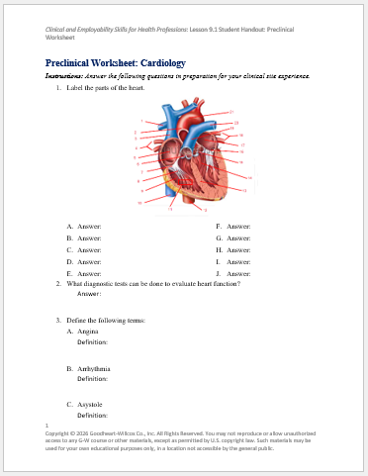
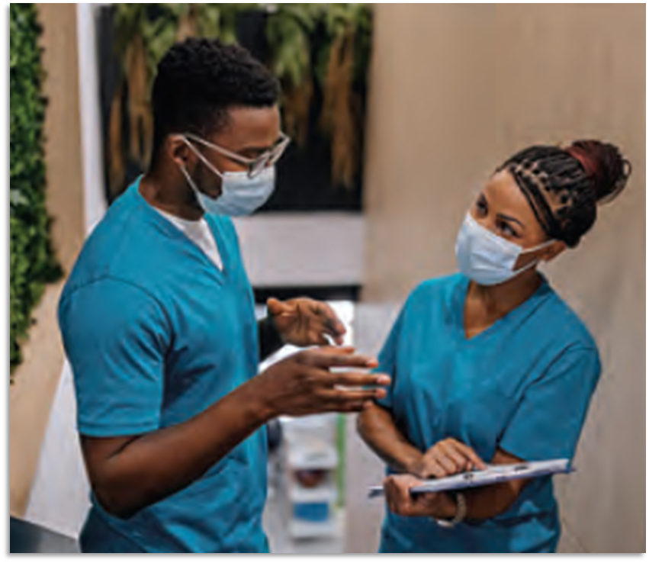
Pre-Clinical Worksheet
Designed for a Specialty (Ex. Urology)
Quick Review:
Basic anatomy of the related body system
Medical Terms
Common Conditions
Diagnostics
Treatments
Setting Expectations:
Where the student might assist.
Completed in-class or as homework before clinicals
Student Activity
Notes:
LINDA:
Pre-Clinical Worksheets are designed to prepare students for clinicals in a specific specialty (Ex. Urology). These start with a quick review of:
Basic anatomy of the related body system (ex. Students would need to understand the kidney and the flow of urine, what’s the importance of the anatomy…)
Medical Terms
Common Conditions
Diagnostics
Treatments
Then the worksheet helps set expectations for the student on where they might assist during clinicals.
These could be completed in-class or as homework due before clinicals and assigned individually.
Clinical grades are often an issue, so this is another way to do that. These worksheets take several hours to complete.

Slide 15
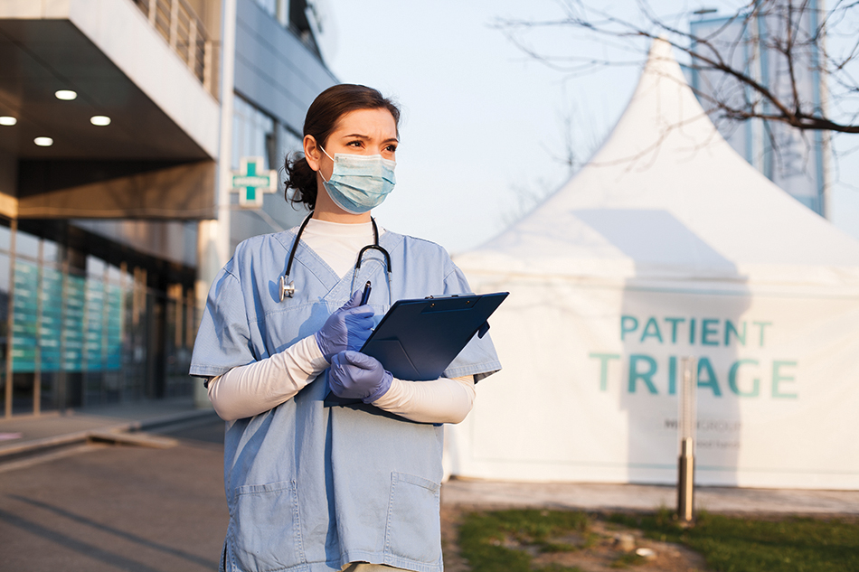
Clinical Resources: Workplace Discovery Worksheet
Includes:
What you will see in the clinical rotation
Questions to ask the technician or nurse mentor
(Ex.) Emergency Room Department
What is triage?
Describe the process for triage.
List the equipment found in a standard patient emergency room.
List additional equipment found in a trauma room that is not found in a standard emergency room.
Where are the emergency medications kept?
Define the following terms:
Chest tube
Sutures
CT-scan
MRI
Practice writing skills and reflect on experiences
Student Activity
Notes:
LINDA:
Workplace Discovery Worksheets can be used with a mentor at the affiliate site, or completed in class via research.
These worksheets include what the student will see in the clinical rotation and includes questions they can ask the technician or nurse mentor while on site. (ex. Pharmacy – how do they deliver drugs? Who do they pass them off to?)
These are completed while doing the clinical OR in place of a clinical experience. IN that case, students would research answers to these questions rather than asking a mentor.

Slide 16
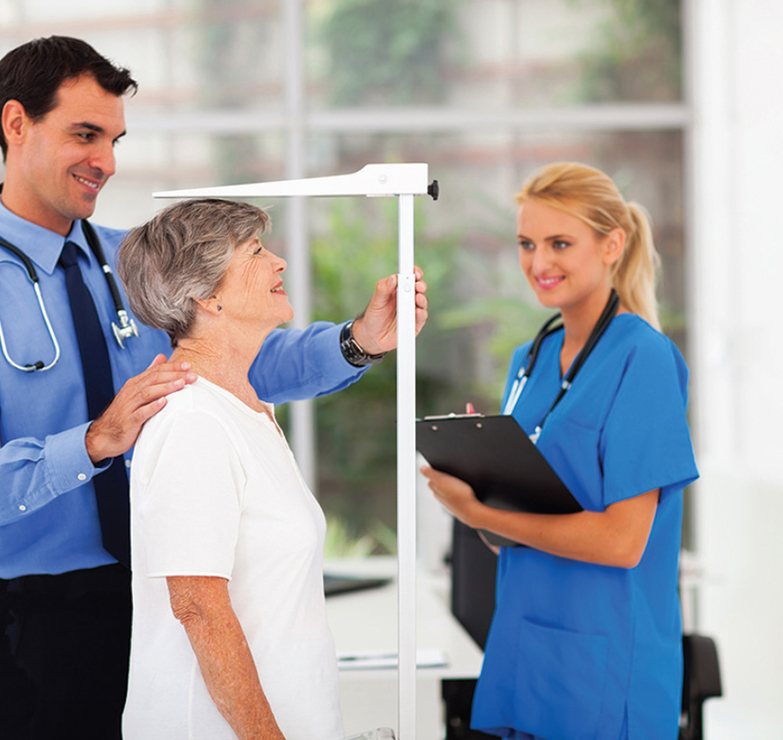
Clinical Resources: Task Sheets
List of what students might observe/assist with
Students report back and describe what they saw/did
How did it affect the patient?
What was it used for?
Affiliate Resource
Notes:
DEB:
Task Sheets are designed for the clinical affiliate.
Mentors love these, because it shows them where they can start with students and what students need to see.
Task sheets provide a list of what students might observe or assist with. Teachers can always adjust these as needed.
After the clinical, students report back and describe what they saw/did during the experience and these task sheets are great talking points to help students do that verbal report and describe their experience.

Slide 17
Questions?
Ideas to Share?
Clinical & Employability Skills for Practicum Courses
Thank you for attending!

