Slide 1
HOSA events for classroom assignments

Slide 2
Agenda
Events I can use in my classroom
Modify the event for the classroom
Assignments
Emergency sub plans/ Resources

Slide 3
Ask your neighbor (4 minutes) 1. What do you teach? 2. which HOSA events compliment that course? 3. Are there any events you already use in the classroom?

Slide 4
Choosing HOSA events to use in the classroom

Slide 5
Hosa.org/guidelines/
Is my class a HOSA event?
Health Professions Events
Biotech, Nurse Assisting, Dental Science, Medical Assisting, Pharmacy Science, Sports Medicine, etc.
Emergency Preparedness Events
EMT
Health Science Events
Nutrition, Human Growth and Development, Medical Terminology

Slide 6
Lets look at Sports medicine
Which resources are recommended?
Do I use those already in my classroom?
Can I order them? (or will my librarian?)

Slide 7
What skills are part of the HOSA event?
When I teach the skill in class can I use the rubric for students to practice?
Did we talk about how to use the rubric?

Slide 8
Ask your neighbor Backwards Design (4 minutes) 1. What skill or principle do you need to teach? 2. which HOSA events include that skill/topic/ principle? 3. Will you use the entire event or just parts of it?

Slide 9
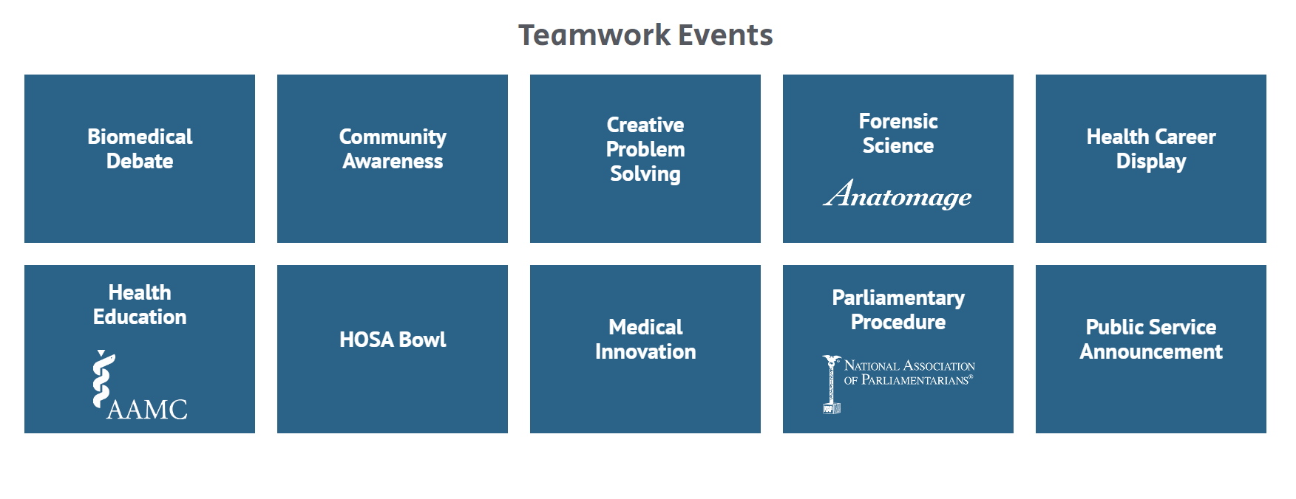
What skill do I need to Teach?
Leadership Events
Writing, photography, interviewing, Persuasive Speaking, Job Search, etc.
Teamwork events
Health careers, problem solving, community awareness, etc.
Group Projects
Health education, medical innovation, public service announcement

Slide 10
Be sure to check the topics- some change from year to year- 2023-24
Researched persuasive writing and speaking- Youth Sports Specialization: Good or Bad for Athletes?
Prepared speaking- Dare to Create!
Research Poster- the students decide, but examples include: Community Based Strategies to Reduce Mental Health Stigma, Combating Post-Partum Depression in Teen Moms, Decreasing Juvenile Incarceration Rates by increasing the Presence of Positive Male Role Models
Biomedical Debate- Should Artificial Intelligence in Healthcare be Welcomed or Feared?
Public Service Announcement- Fentanyl Will Kill You
Mental Health Promotion- create and publish a social media campaign for their peers centered on building and promoting protective factors around a selected mental health topic.

Slide 11
Can you enlist other teachers at the school to help?
Will other teachers/counselors agree to do interviews for you?
Is there a community organization that wants to help?
Can the photography teacher give a mini class on how to take the best health career photos?
Do your school officers have any tips for forensic science?
What year do English classes learn to write research papers?
Does the video marketing class have any students in your class and will one of your topics work for one of their projects?
Who teaches agriculture and can help with vet science?
Do you have a speech or debate teacher who can include your topic on their list of options?

Slide 12
Actual Assignments
What can I take back to campus and use right away?!?

Slide 13
Professional Dress
Use the HOSA dress code and see if they are ready for business

Slide 14
Professional Development

Slide 15
Medical Reading- Create a classroom library
Borrowing Life: How Scientists, Surgeons, and a War Hero Made the First Successful Organ Transplant a Reality by Shelley Fraser Mickle
Twice as Hard: The Stories of Black Women Who Fought to Become Physicians, from the Civil War to the 21st Century by Jasmine Brown
What Happened to You?: Conversations on Trauma, Resilience, and Healing by Oprah Winfrey and Bruce D. Perry
Written in Bone: Hidden Stories in What We Leave Behind by Sue Black
The Wisdom of the Bullfrog: Leadership Made Simple (But Not Easy) by Admiral William H. McRaven
5 books each year
Quiet Reading time
Book reports
Make up for absences or projects
Suggestions for the school library

Slide 16
Wednesday WOW- Whats going on in the World
Health Care Issues Exam

Slide 17
Health Careers Display
Good for any class requiring career explorations
USE THE HOSA RUBRIC
https://hosa.org/wp-content/uploads/2023/10/23-24-HCD-Final-V2.pdf

Slide 18
Help, I need sub plans!!!
HOSA–Future Health Professionals is pleased to provide “on-demand” lessons for HOSA Advisors with a desire to connect HOSA competitive events, career opportunities, and HOSA activities with classroom curriculum.
The On-Demand Opportunities began as a response to the change in the classroom setting encountered during the COVID-19 Pandemic but continues to be an excellent tool for health and biomedical science instructors / HOSA Advisors to use in their classroom.
From classroom activities, website links, alumni career spotlights, lesson plans, video lessons, what HOSA competitive event is right for the HOSA member, and engagement strategies, the “on-demand” page supports both HOSA Advisors and members.
(hosa.org)

Slide 20
Hosa.org Resources On Demand Classroom Activities
Career Exploration
Communication Skills
Handwashing
Health Insurance
HIPAA
History & Future of Medicine
HOSA Website Scavenger Hunt
Infection Control
Medical Law & Ethics
Talking About Mental Health
Cardiovascular System
Cranial Nerves
Endocrine System / Diabetes
Vital Signs
Medical Math
How to Get the Job, Admission, Scholarship
Fentanyl Kills
Stem Cell Transplant
Medical Errors
Oral Health = Overall Health

Slide 21
Lets look at Health Insurance

Slide 22
Lesson Plan Includes:
Objectives
Timeline
Materials
Instructions
Assessments Included
NCHSE standards alignment

Slide 23
Powerpoint
Includes a video lecture
Video can an also be found on Youtube and some in Edpuzzle

Slide 24
Quiz available in Word
Easy to adapt to schoology, google classroom, etc

Slide 25
Thank you
Kristen Adams MEd, ATC, LAT
512-665-0963
kristen.adams2@cfisd.net
kristen.m.black@gmail.com

